Slide 1
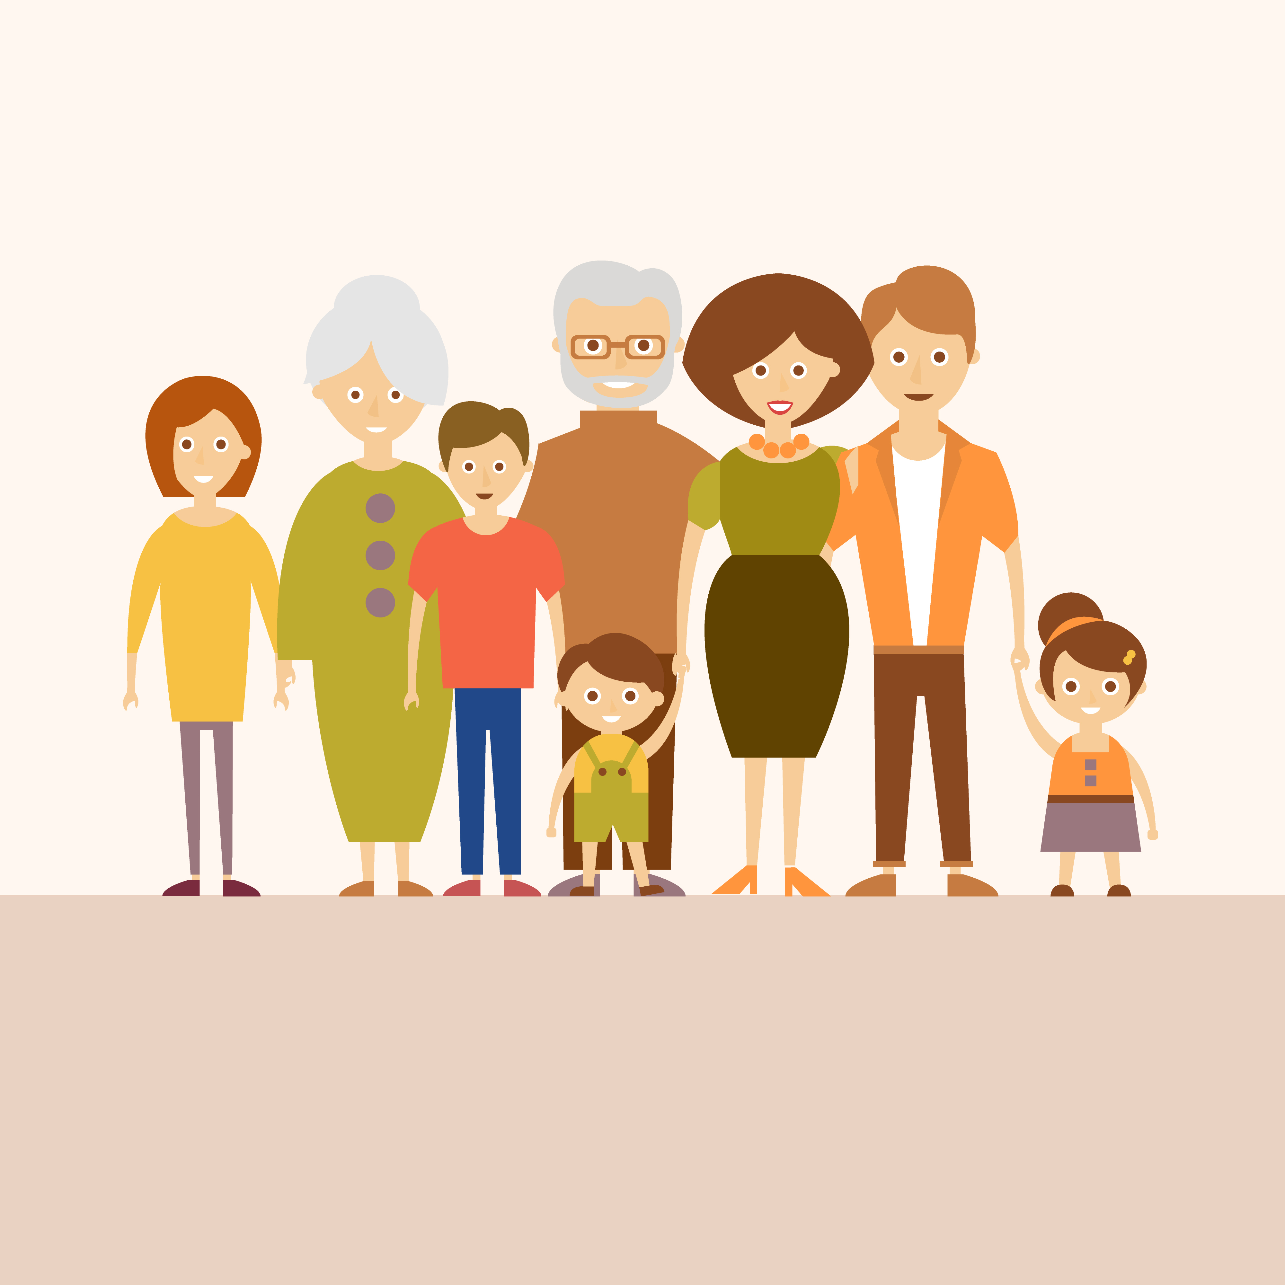

Welcome To Class!
Where is your family from originally?

Slide 2
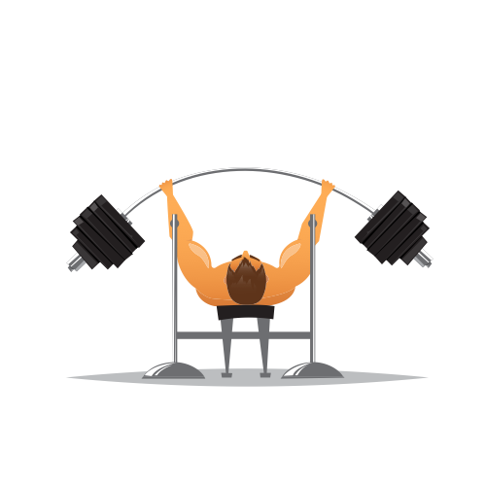
Weightlifter Video Clip
https://www.youtube.com/watch?v=KeQ5YLGmNvI

Slide 3
Weightlifter Video Clip
Did anybody notice how much weight he lifted?
Does anyone know what this official olympic lift is called?
This is one of the most difficult lifts because it involves every muscle in your body. Do you think he was always this strong, or did it take a lot of work to become that way?

Slide 4
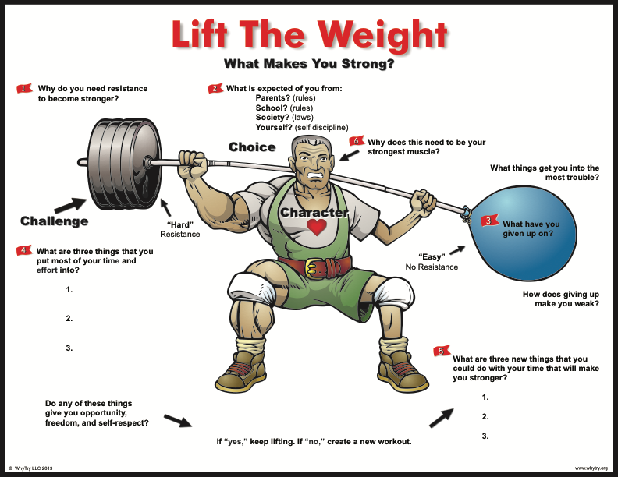

Slide 5
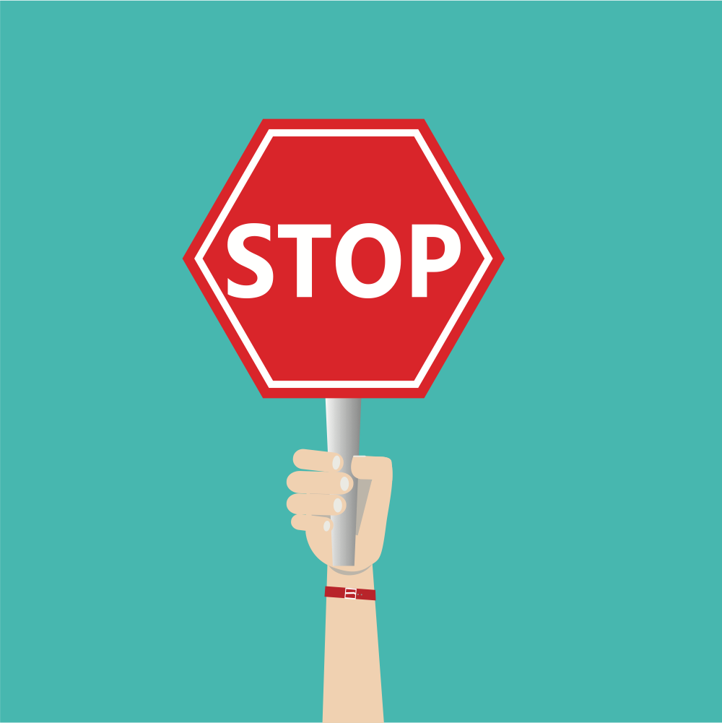
Activity: Law of the Land
Which laws or signs were most familiar?
Which laws and signs were least familiar?
Do you think some laws are more important than others?
Which laws do you think are most important?
Which laws do you think are least important?
What might happen if we got rid of some of the laws?
How do laws change?

Slide 6

Journal Activity
What are the three things you spend the most time doing outside of school?
Will these things help you get more opportunity and self respect?

Slide 7
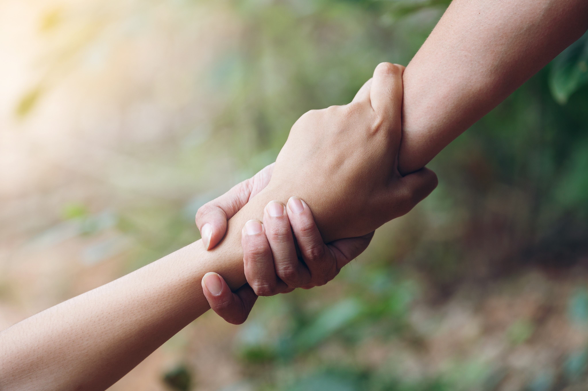
Alternate Activity: Win-Win
I need two volunteers of equal size and strength.
Come to the front and face each other?
Reach out with your right arm and grab the right arm of the other volunteer?
You have seven seconds to get to the candy bar.

Slide 8
Alternate Activity: Win-Win
What was difficult about his activity?
Why weren't you able to reach your prize?
What would it take for both of you to get you prize?
Do you think if you worked together you could both be winners?

Slide 9
Alternate Activity: Win-Win
You will have one more chance to get to the prize.
How is working as a team more effective than working alone?
What are some examples in life of time where working together would be more beneficial than working alone?

Slide 10
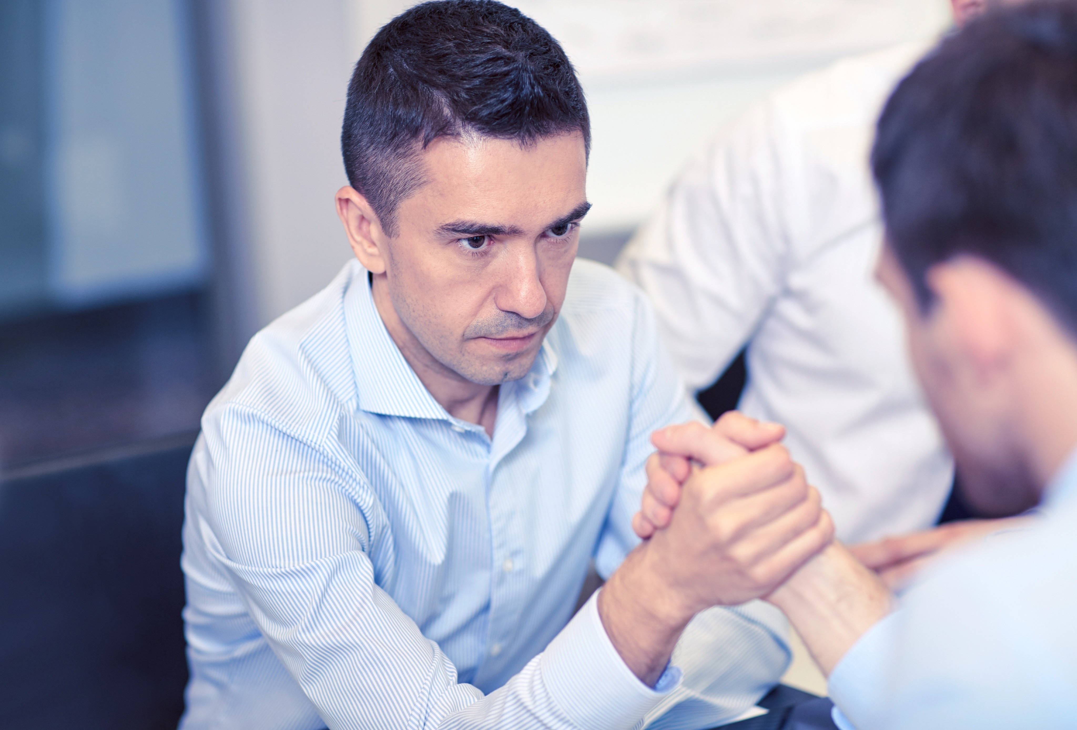
Alternate Activity: Cooperation Arm Wrestle
Get a partner that you feel you have similar arm strength to.
Face each other, reach out your right hands, clasp them together with your thumbs pointing up (like an arm wrestle).
Try to touch your partners right shoulder as many times as possible keeping your hands locked together.
To win the game you must get the most touches.
Now that you understand the rules try it again.

Slide 11
Alternate Activity: Cooperation Arm Wrestle
Why were you working against each other during this activity? Did it benefit you?
Did any team work together to get as many points as possible during the first round? Why?
How can working together and making positive choices make us stronger?
How does following the rules benefit you personally? How will it benefit your school? Your community?
In what ways could this activity apply to resisting the rules?
how can you better implement positive teamwork in your life today?

Slide 12
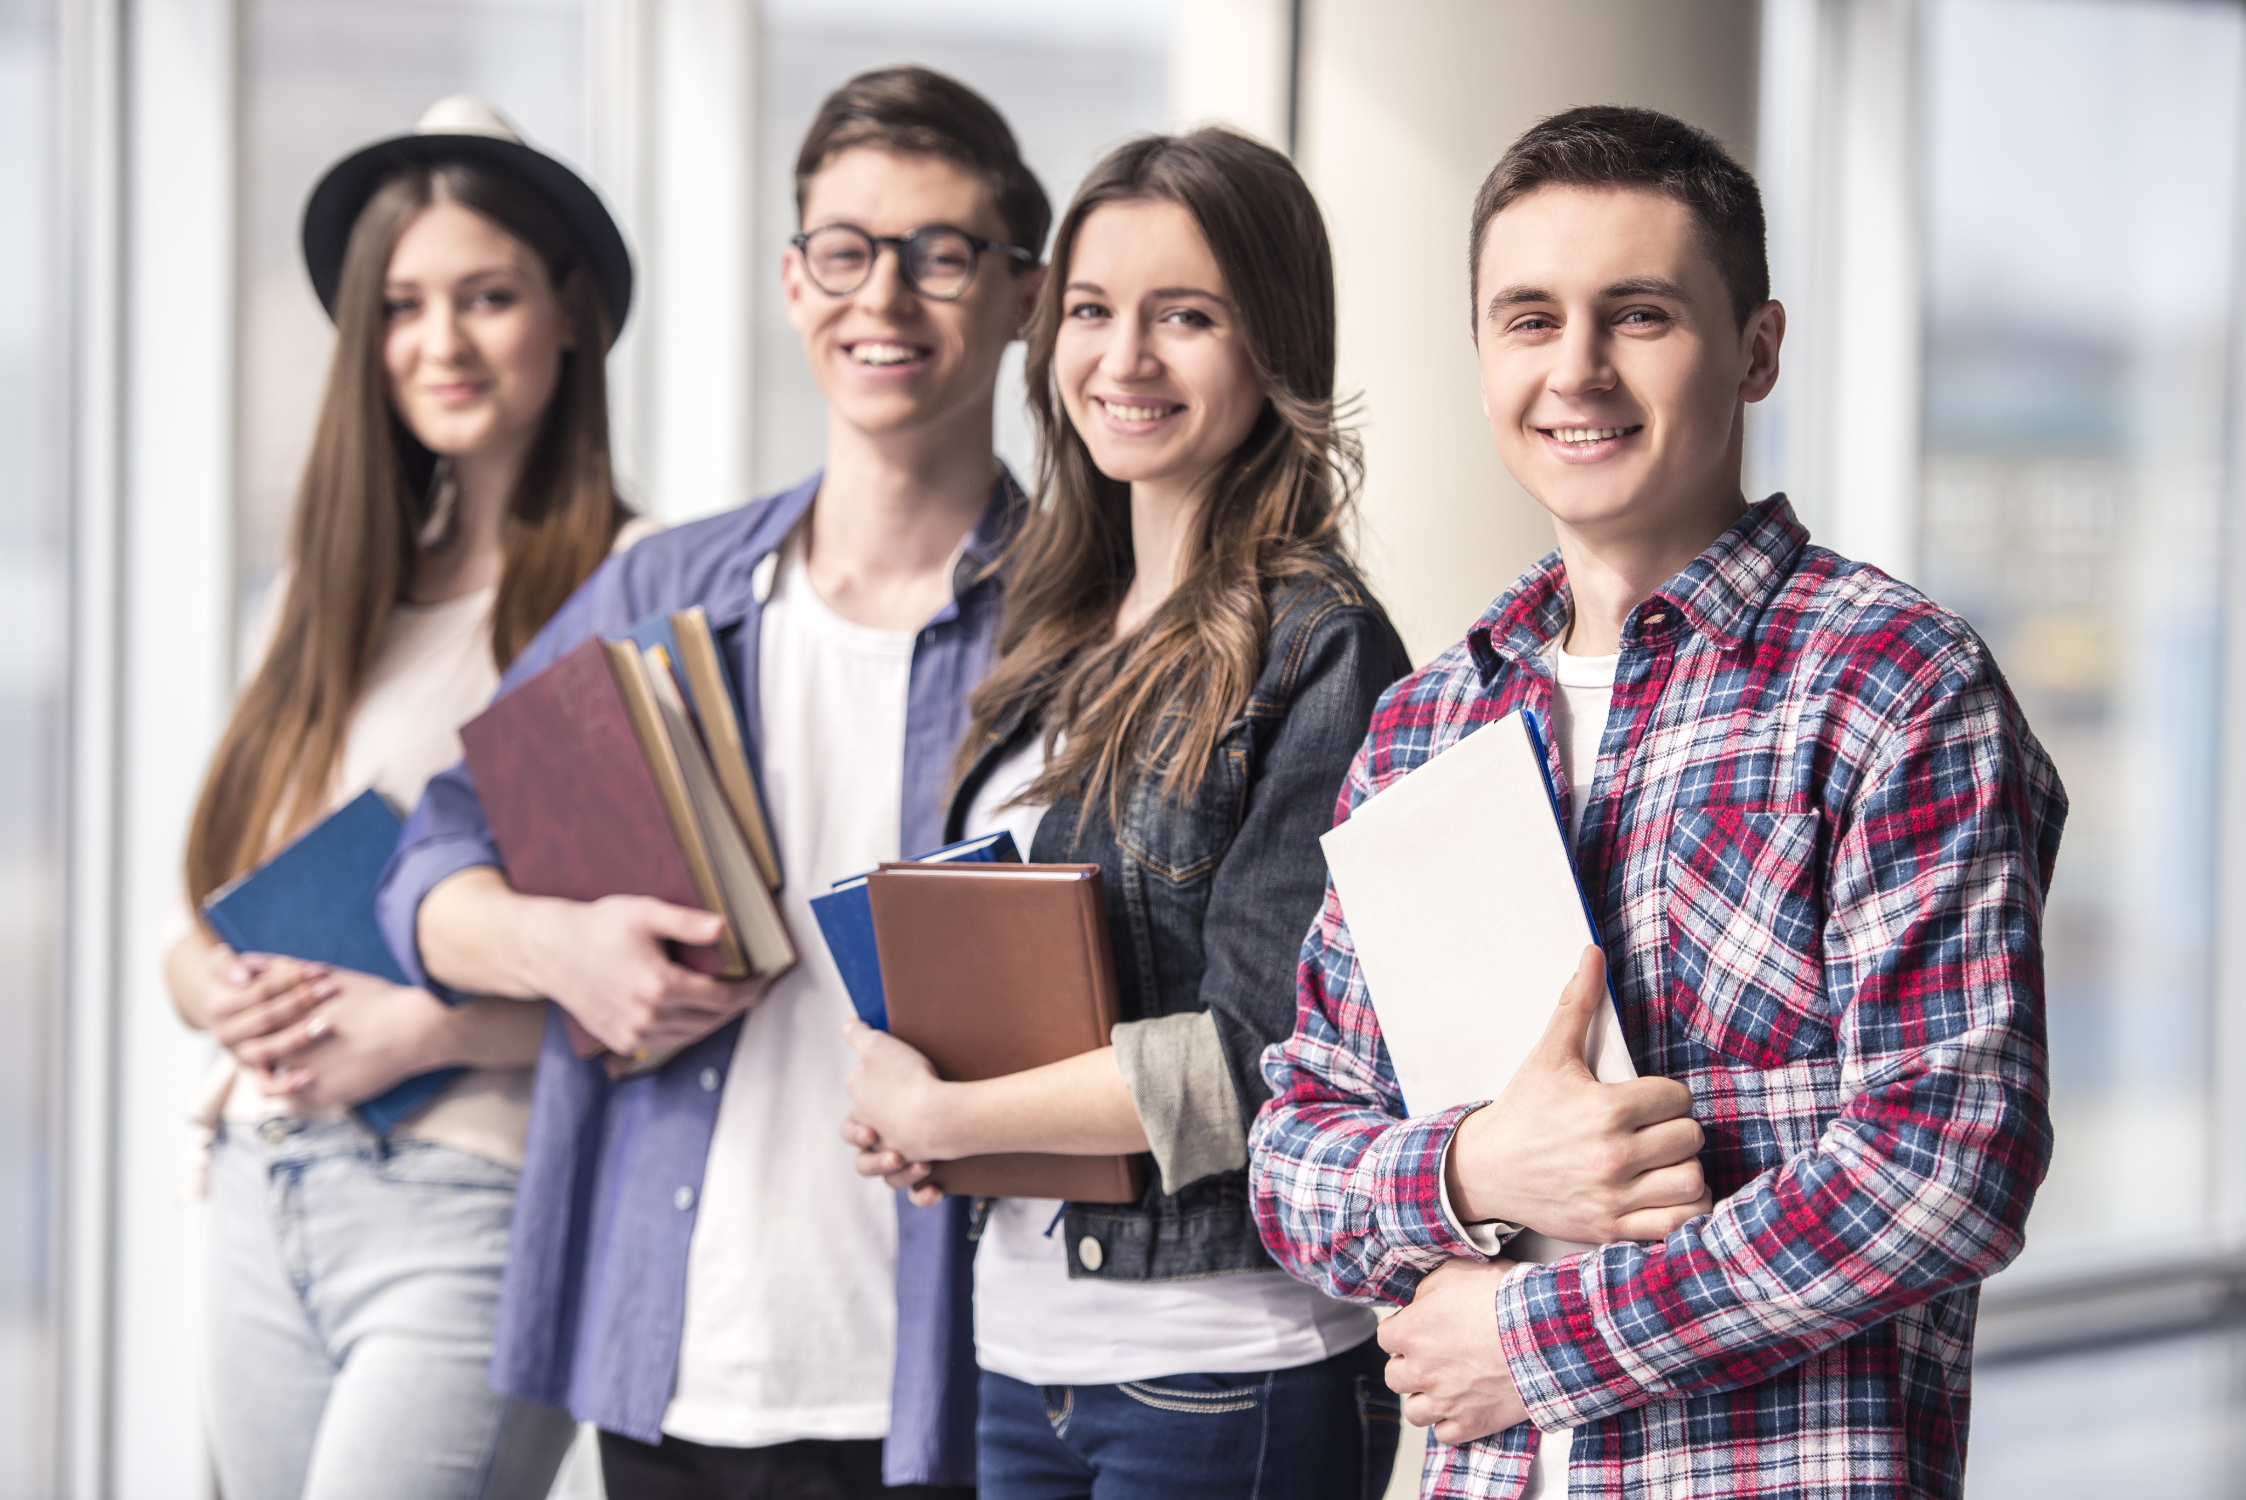
Thanks for Coming!

