Slide 1


Welcome To Class!
If you could only watch one T.V. Show for the rest of your life what would it be?

Slide 2

Student Walkthroughs

Slide 3
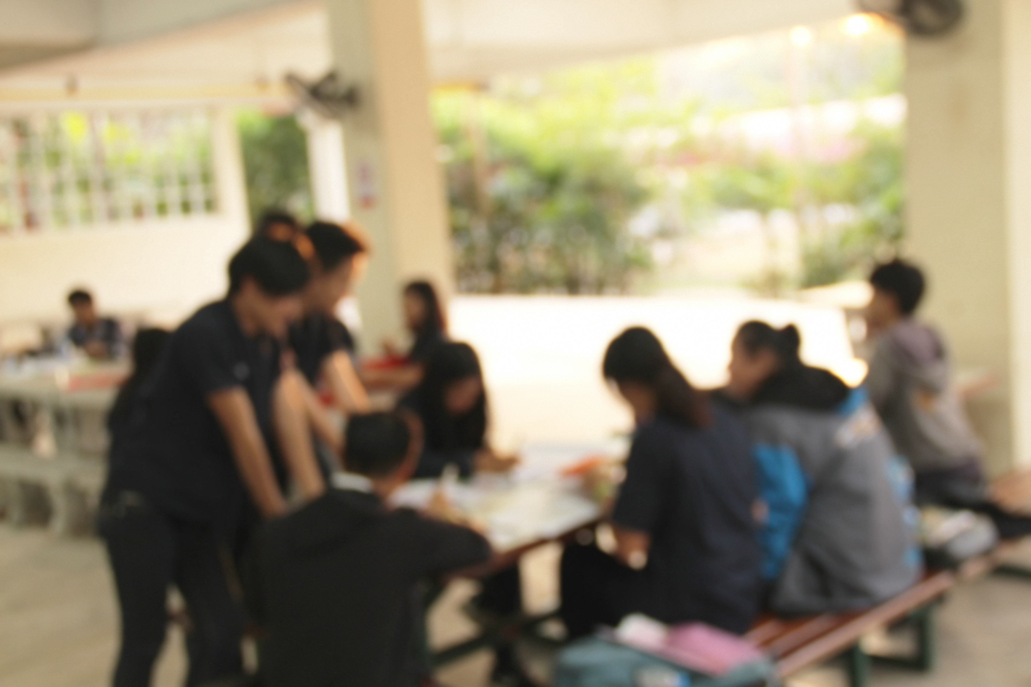
Alternate Activity
What was one of your favorite activities from this semester?

Slide 4

Thanks for Coming!

