Slide 1


Welcome To Class!
What’s Something that has inspired you recently?

Slide 2
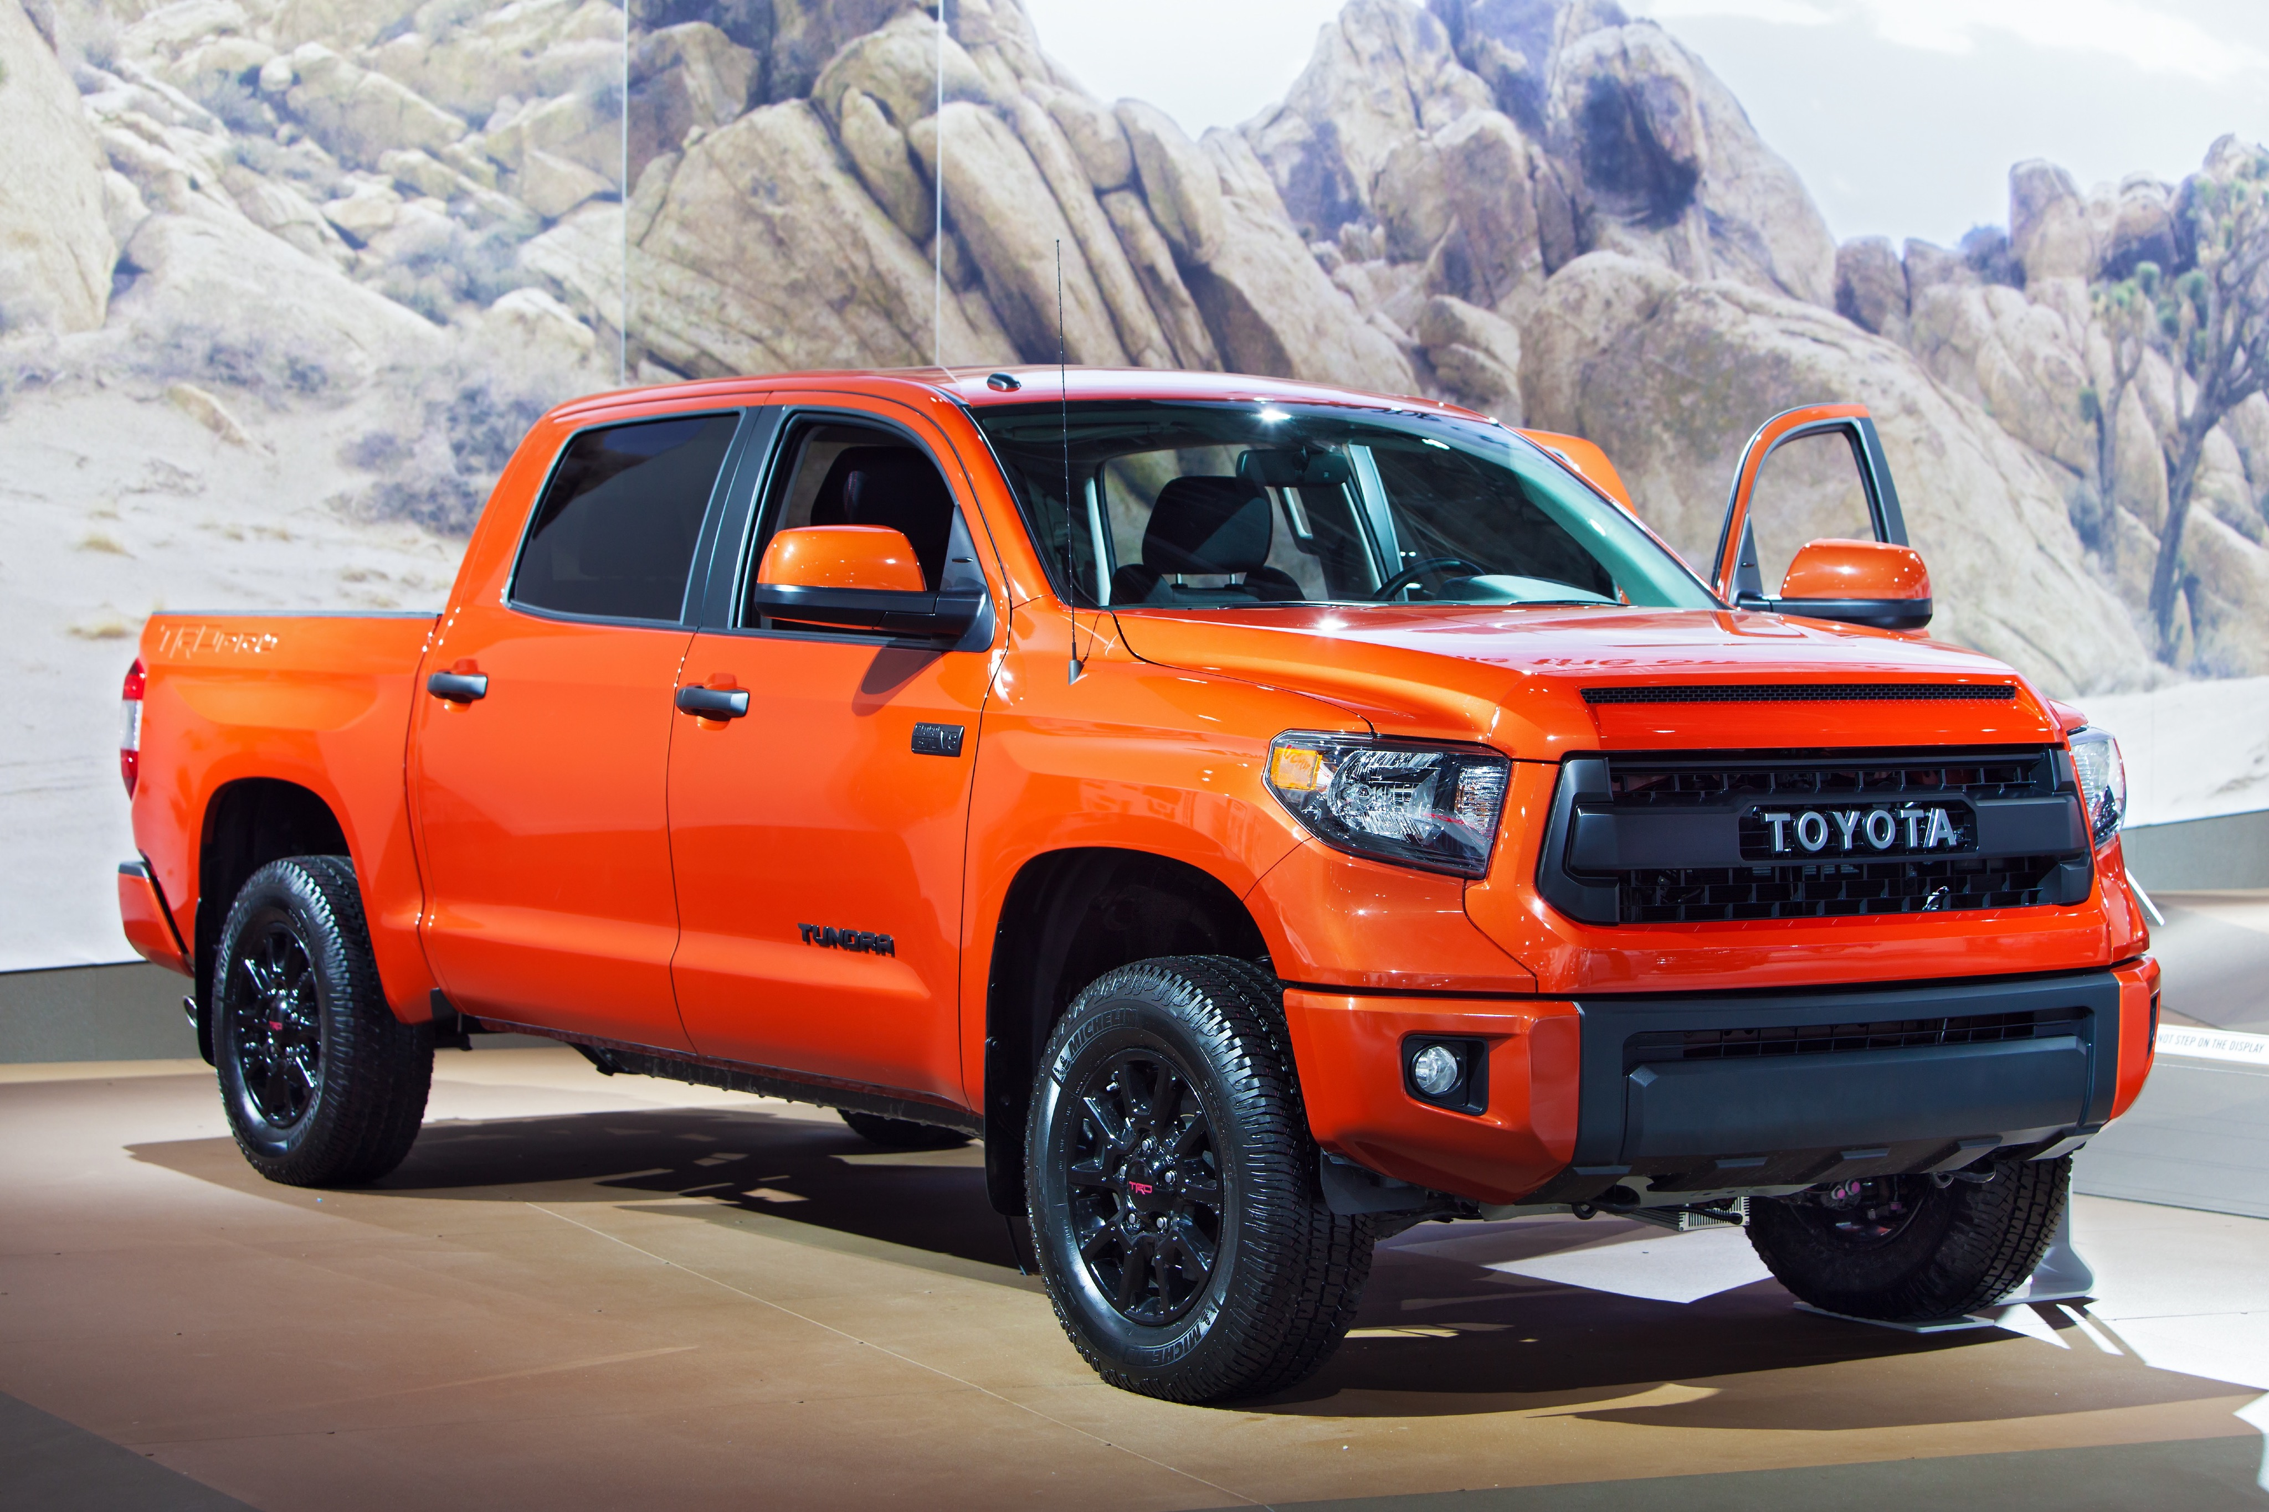
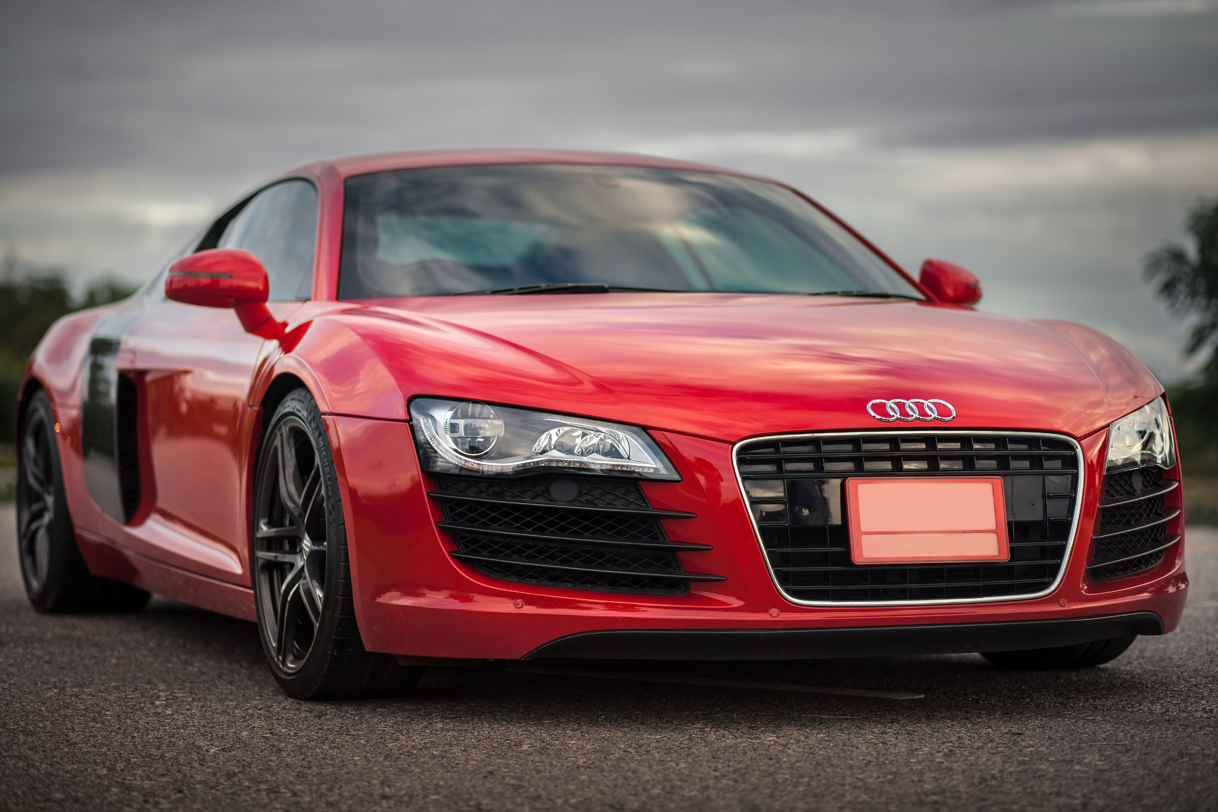
Activity:Values Continuum
Whats your favorite car?
Do you like Trucks?
Or Sports cars?

Slide 3


Activity:Values Continuum
What genre of music do you like?
Would you rather listen to hip hop?
Or Alternative Rock?

Slide 4


Activity:Values Continuum
What kind of ice cream do you like?
Do you like vanilla?
Or Chocolate?

Slide 5
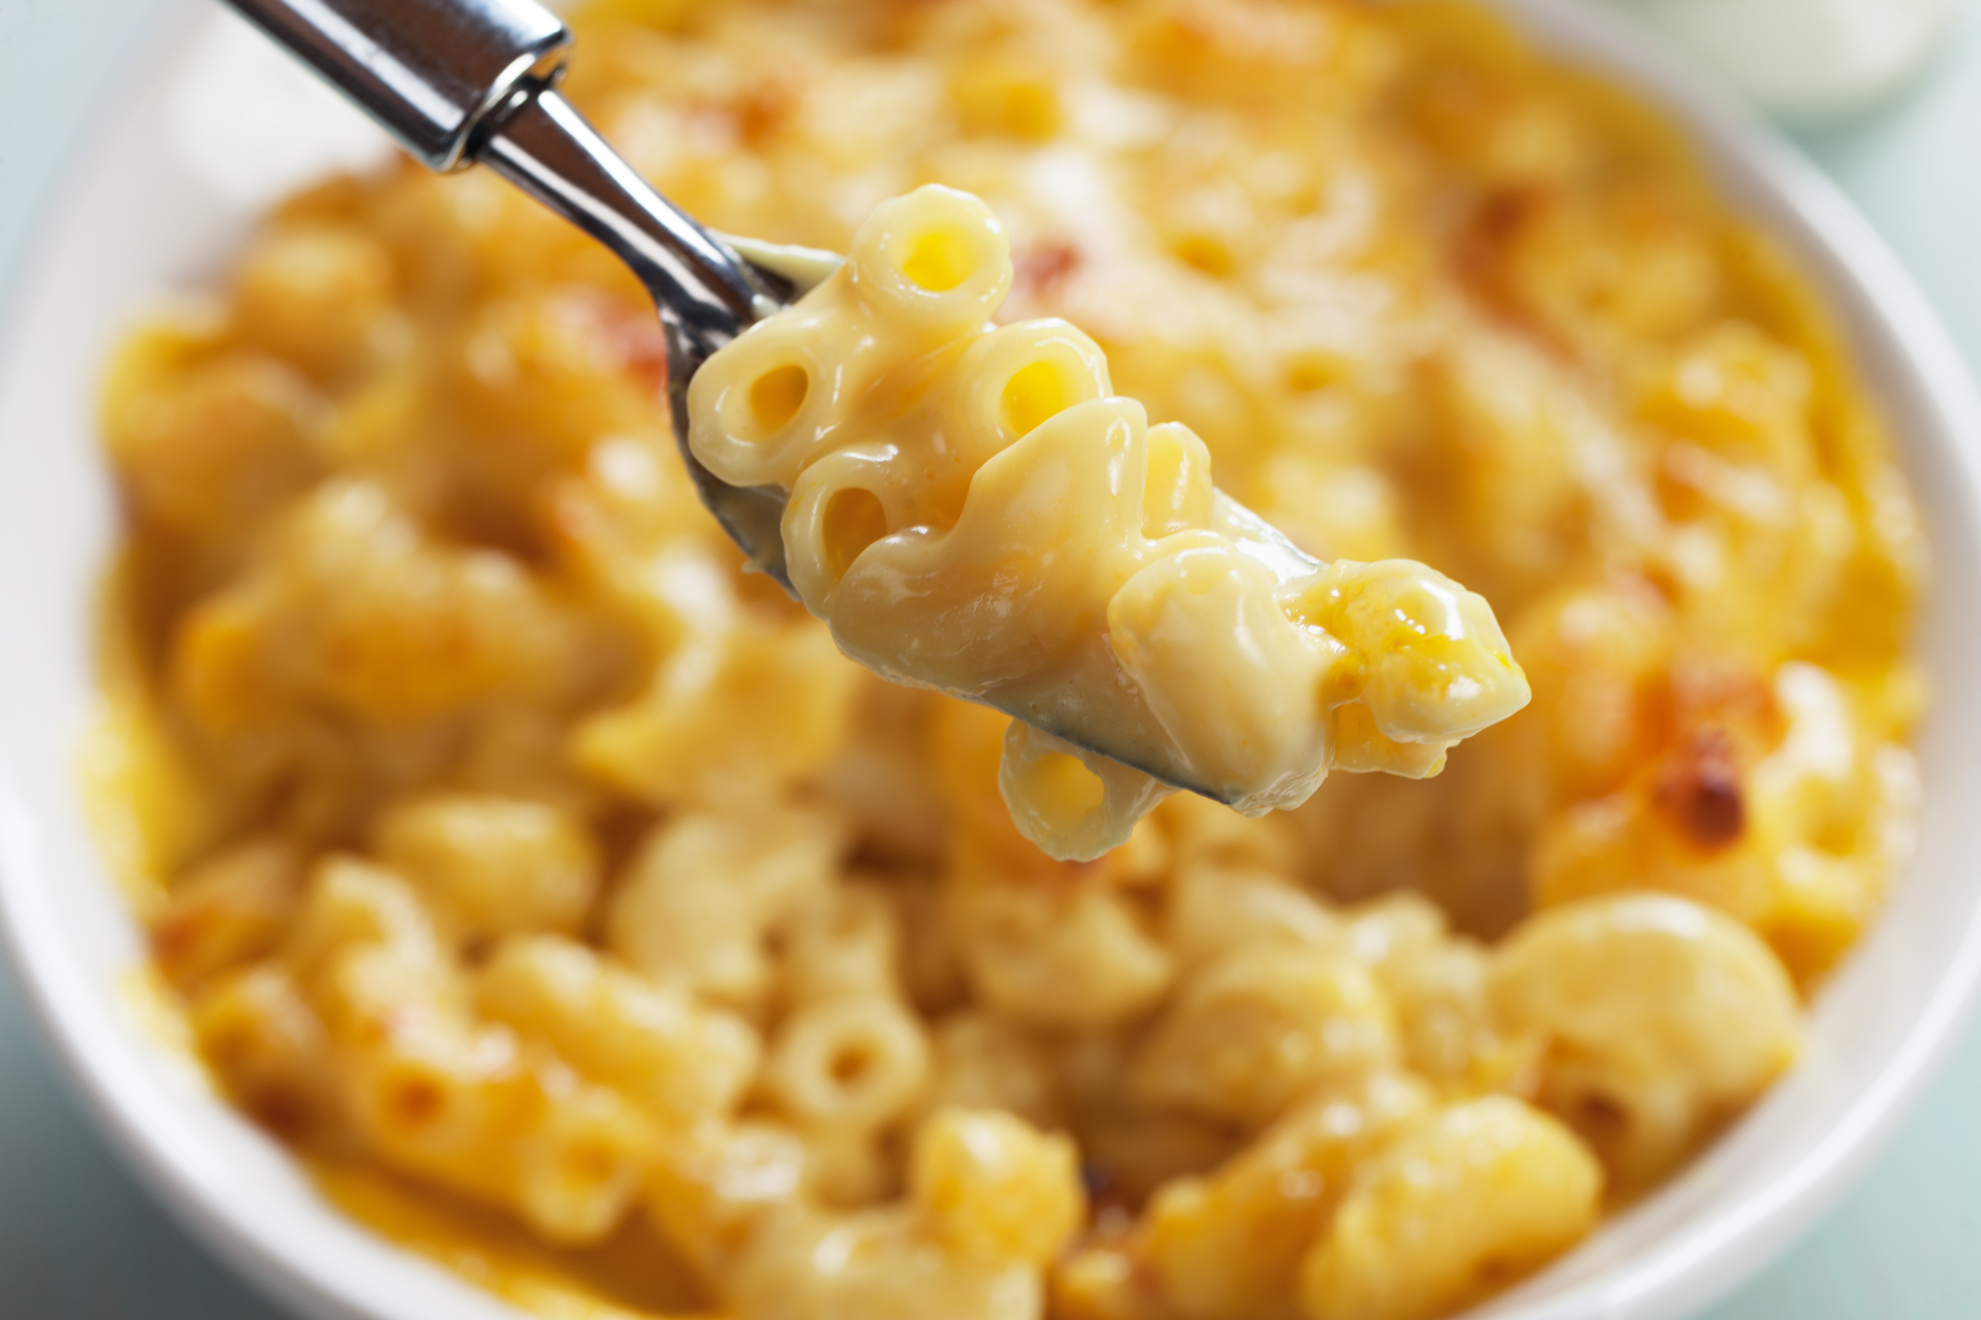

Activity:Values Continuum
What kind of noodles do you like?
Do you like macaroni and cheese?
Or Ramen noodles?

Slide 6


Activity:Values Continuum
Do you like hot or cold seasons?
Do you like Winter?
Or summer?

Slide 7

Thank for Coming!

