Slide 1


Welcome To Class!
If you could live anywhere in the world where would you live?

Slide 2
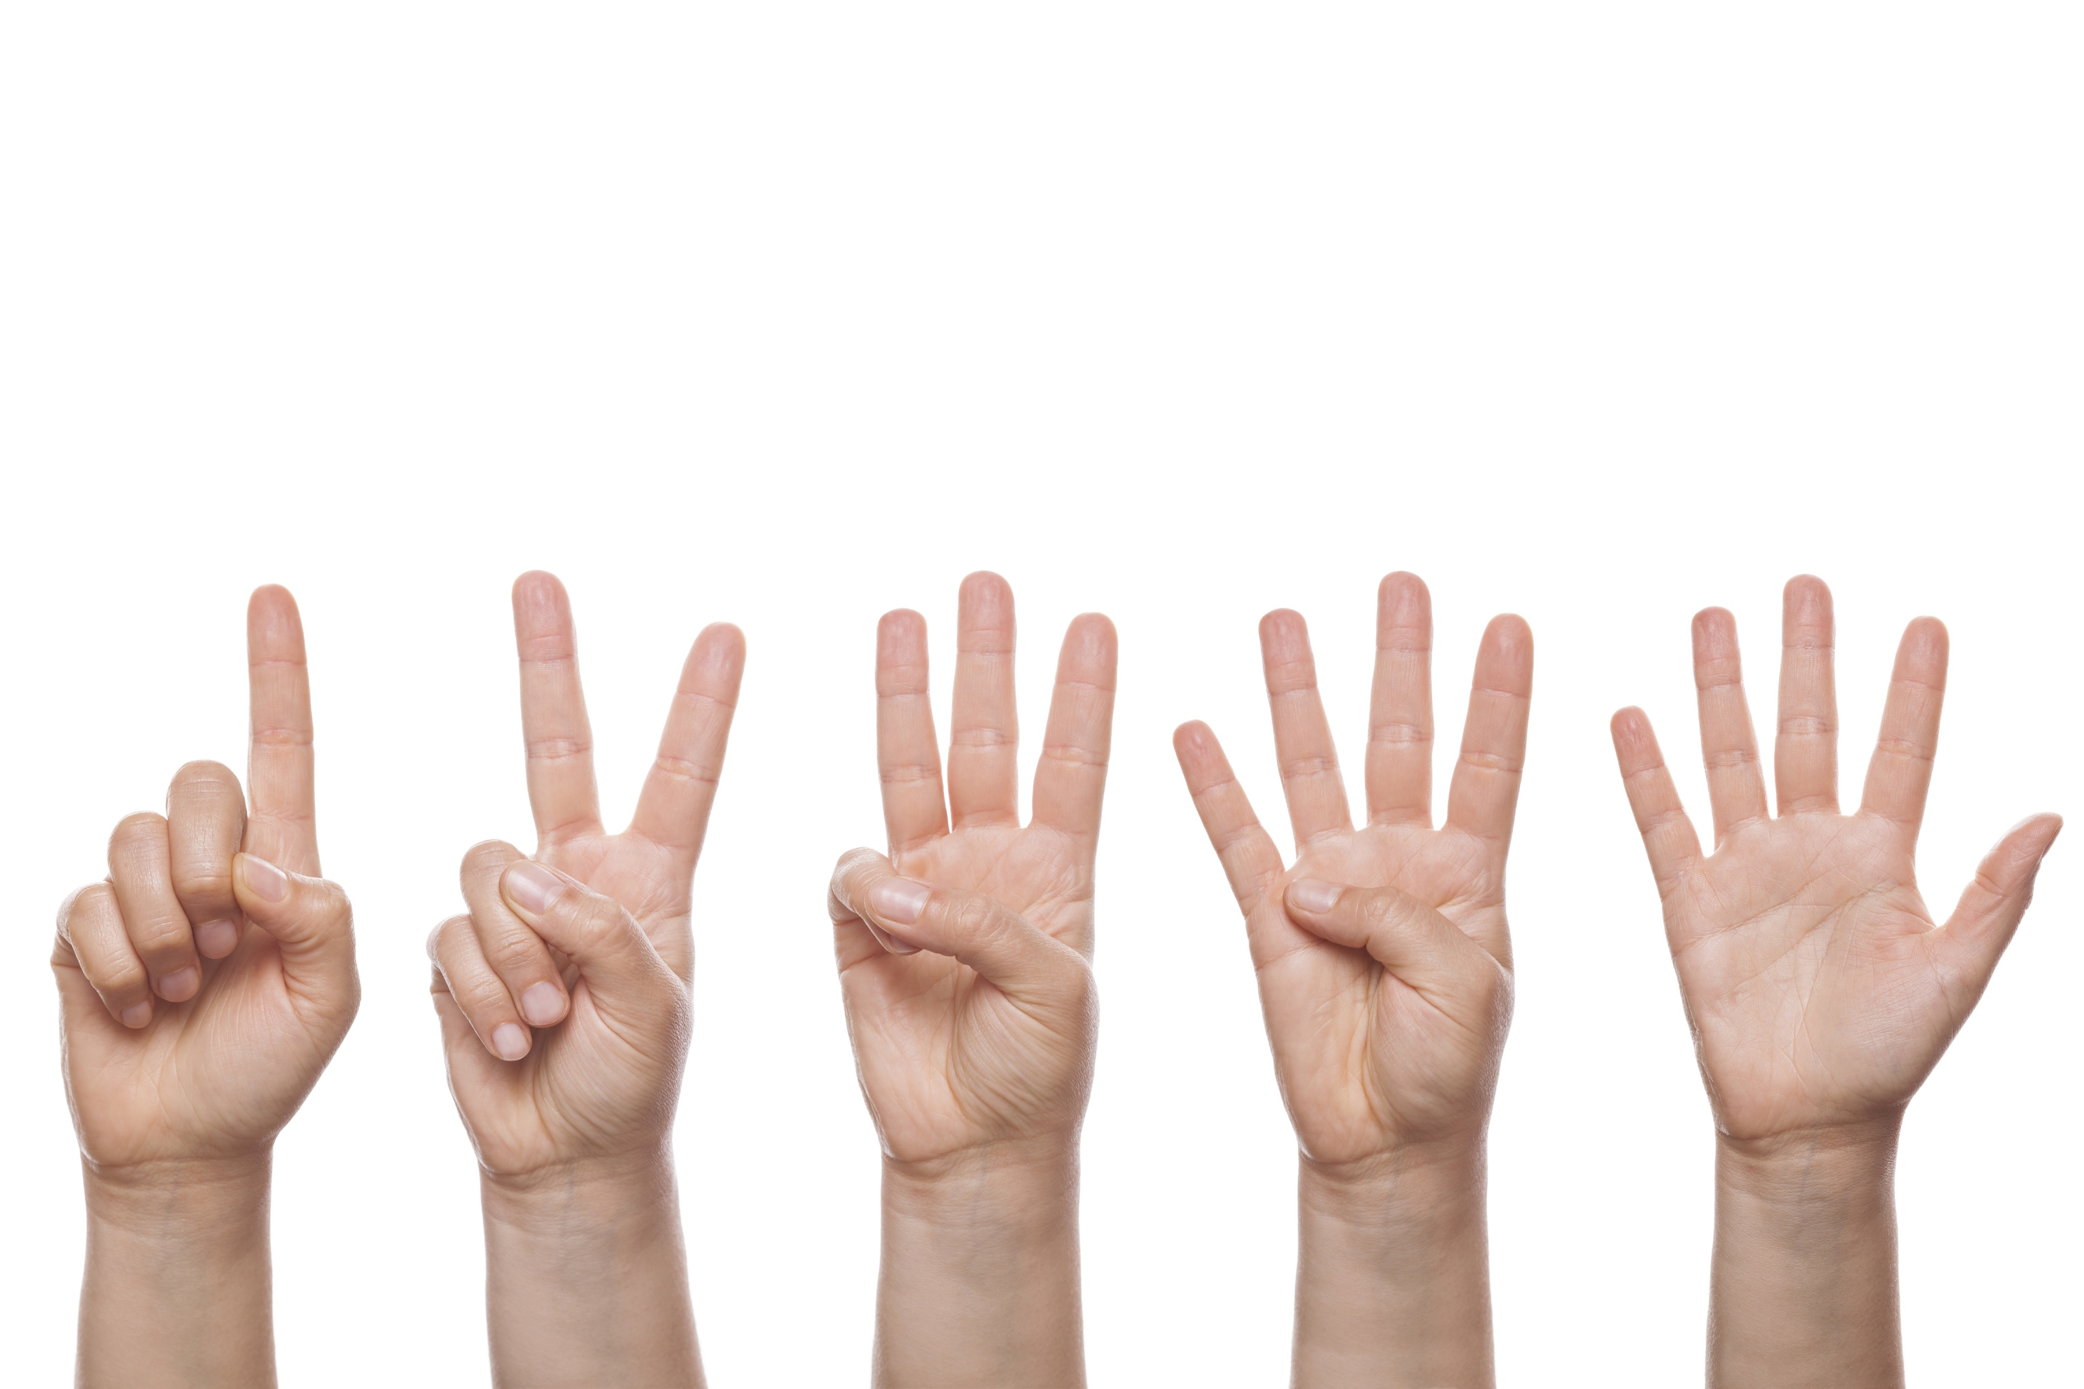
Activity: Count Your Fingers
Instructions:
  Stand up
  Get a partner
  Face your partner
  Put your hands behind your backs

Slide 3
Activity: Count Your Fingers
What was the key to success in this activity?
Why is it so important to make up your mind before you are faced with a choice that will get you into trouble?
Do you feel that you are making decisions today that will impact your future?

Slide 4
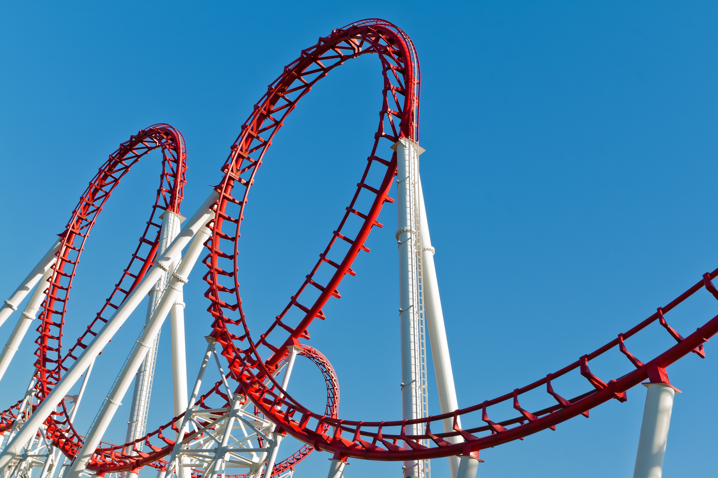
Reality Ride
Roller Coaster Video

Slide 5
Reality Ride
Why do people ride rollercoasters?

Slide 6
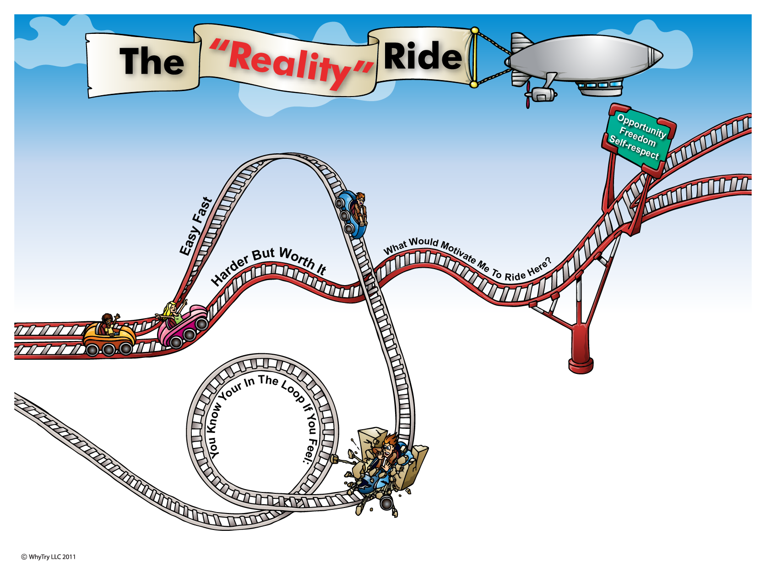
1
2
Goal:
5
Things that get you in trouble . . .
9
What will your reality be when you ride here?
At Home:
At School:
With Peers:
In Future:
What choices will
give you. . .
H
4
Your Challenges . . .
S
P
More Options
Home:
School:
Peers:
7
P
Peers
What problems do you keep having over and over?
Who Can Support You?
H
S
School
Home
8
3
Crash!
6
Frustrate
Confused
Angry
Scared
Keep getting same results
“Reality”
Consequences of the crash . . .
Start ride over
Will these things give you lasting
P
Opportunity?
Freedom?
Self Respect?
“Hit the wall”

Slide 7

Journal Activity
What does “opportunity” mean to you?
What does “freedom” mean to you?
What does “self respect” mean to you?

Slide 8
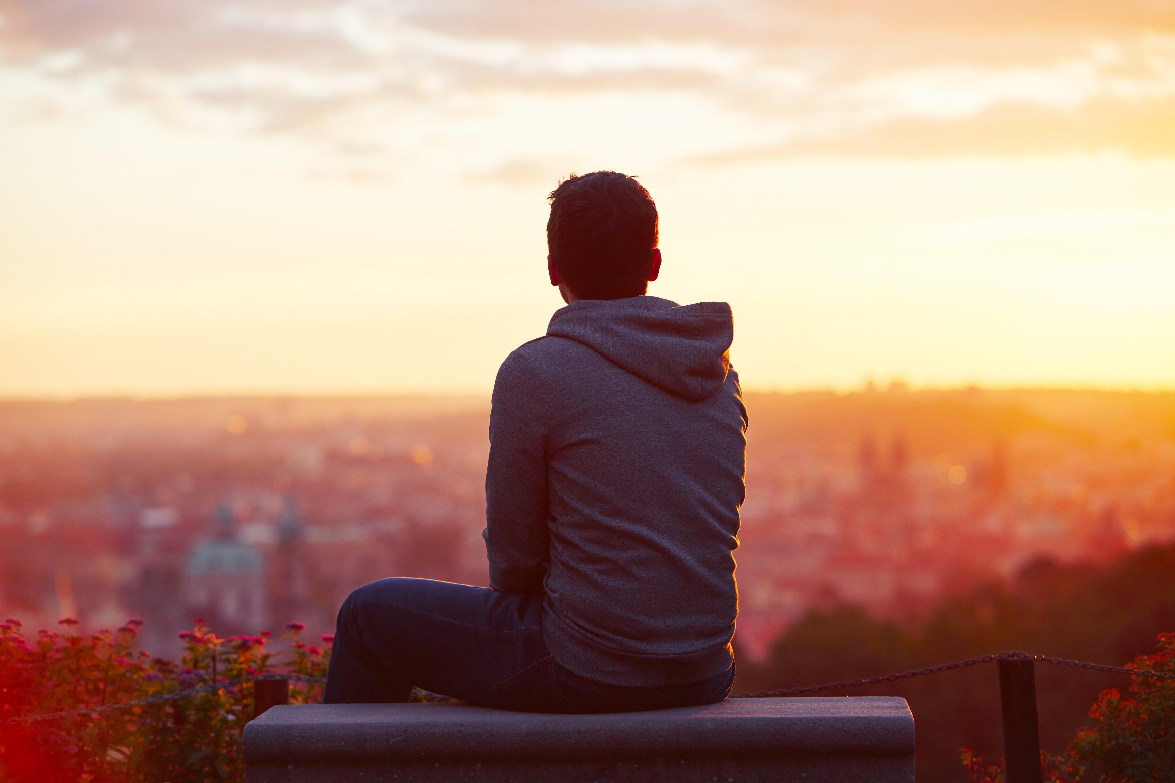
Alternate Activity: Now or Later?
Instructions
  Write down 5 goals you want to accomplish in the next 5 to 10 years.
  Share them with your neighbor.
  Write down which one would make you happiest to accomplish.

Slide 9
Alternate Activity: Now or Later?
Those who chose the box, are you glad you waited?
Why?

Slide 10
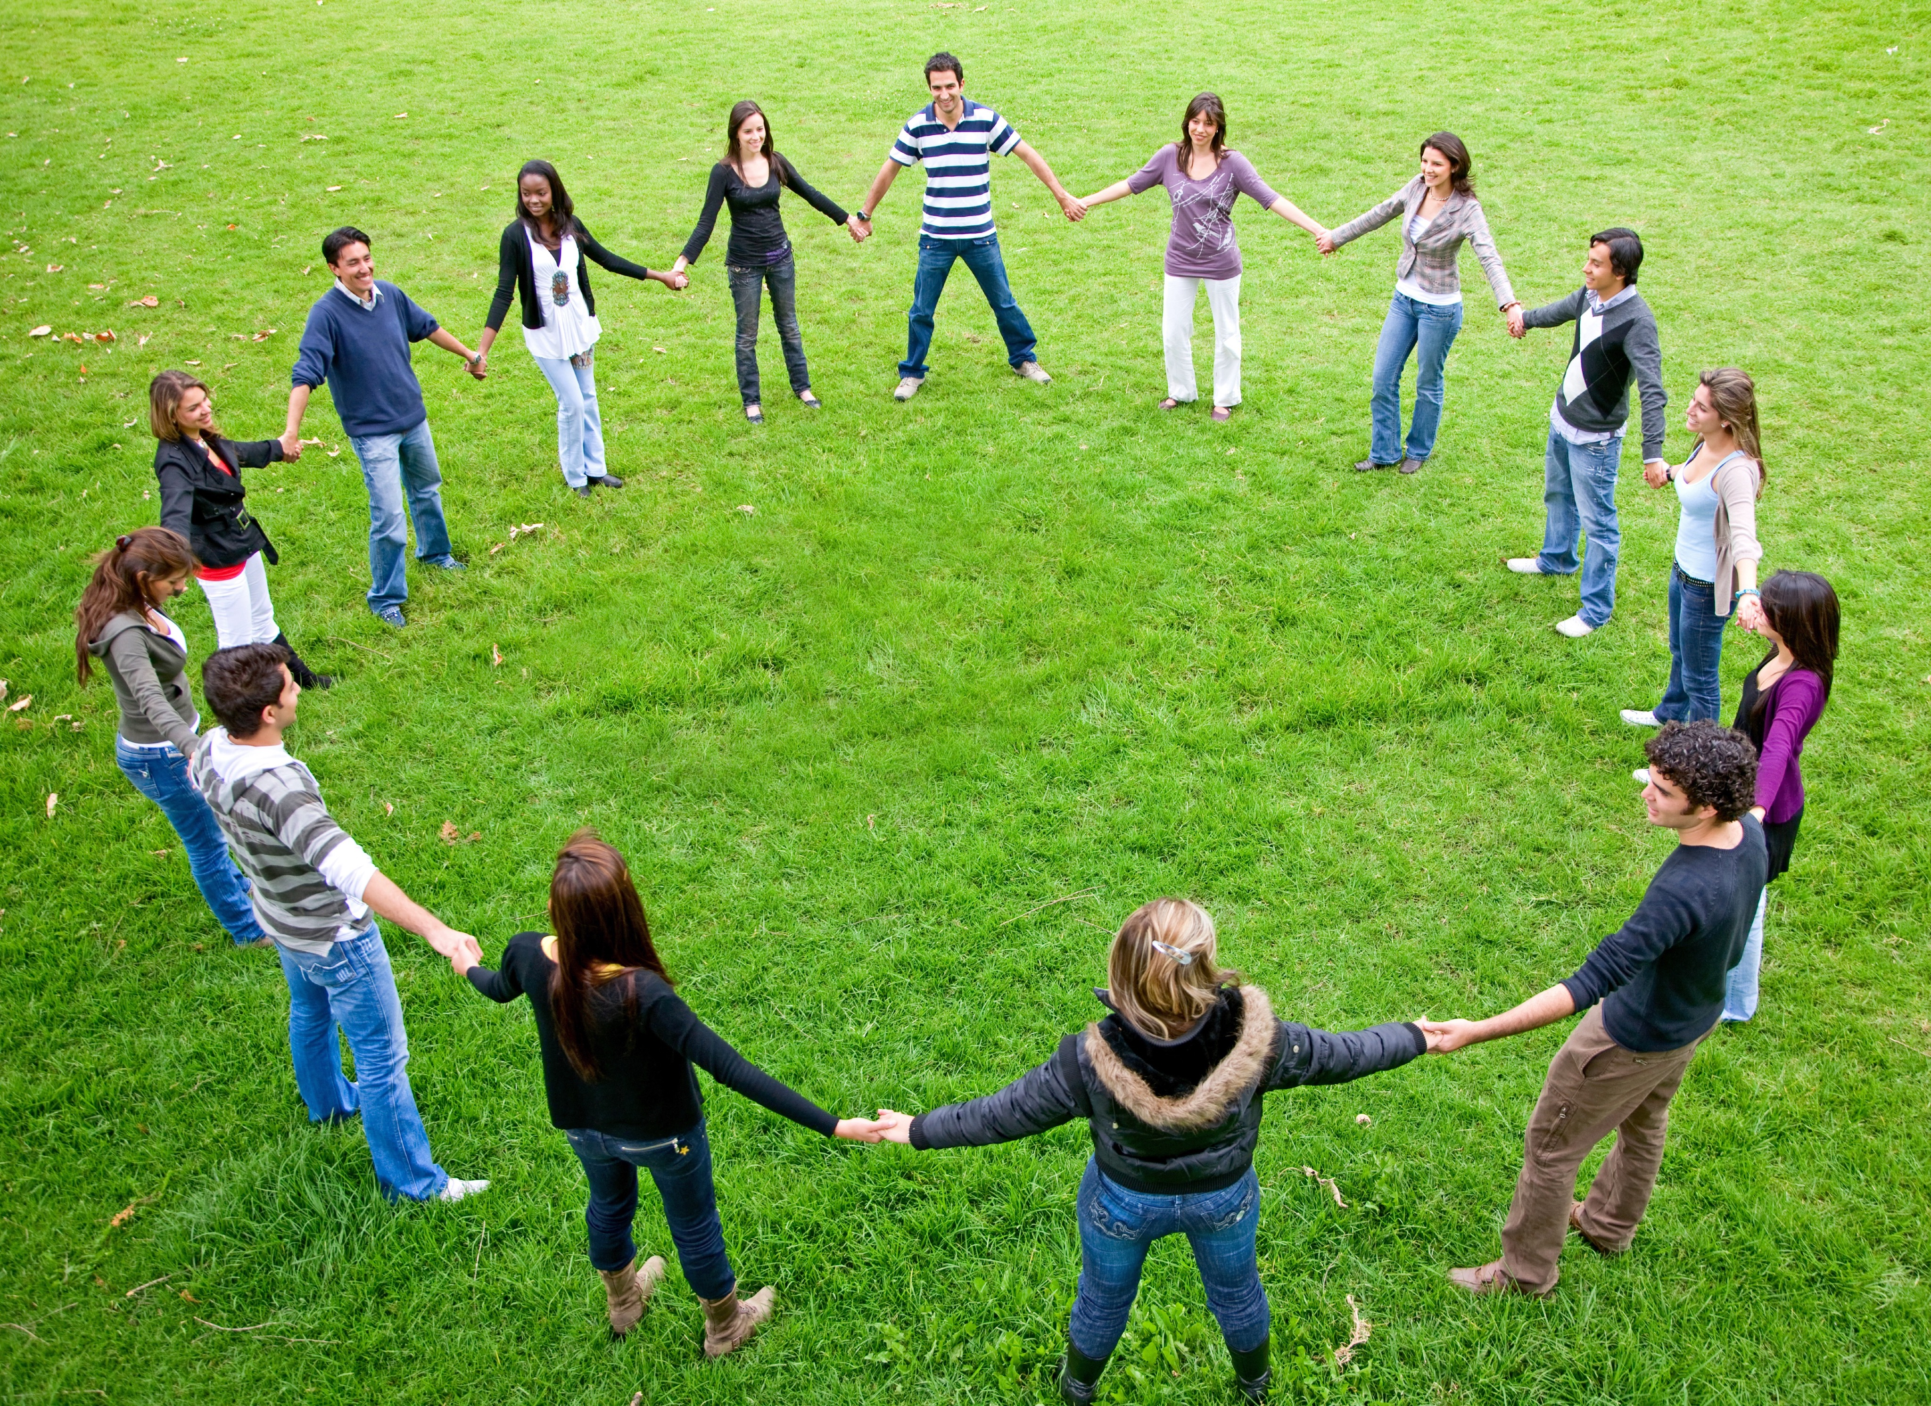
Alternate Activity: Keep Your Eye On The Ball
Instructions
  Form a circle.
  Pass the ball in a continuous pattern in the circle.
  You can not pass to the person next to you on the right or left.
  Everyone must have an opportunity to catch the ball.

