Slide 1

Welcome To Class!
What is your favorite season?

Slide 2


Activity: Stereotypes
Write down as many of the school’s stereotypes as you can in 3 minutes.
Pick a scribe to write for the group.

Slide 3
Activity: Stereotypes
Would you define any of these labels as negative? Why?
Do you feel any of these labels are unfair or inaccurate? Why?
Why do we label people?
In what ways are labels important?
Have you ever given somebody a table based on a first impression and later changed it?
How can labeling be hurtful to others?

Slide 4
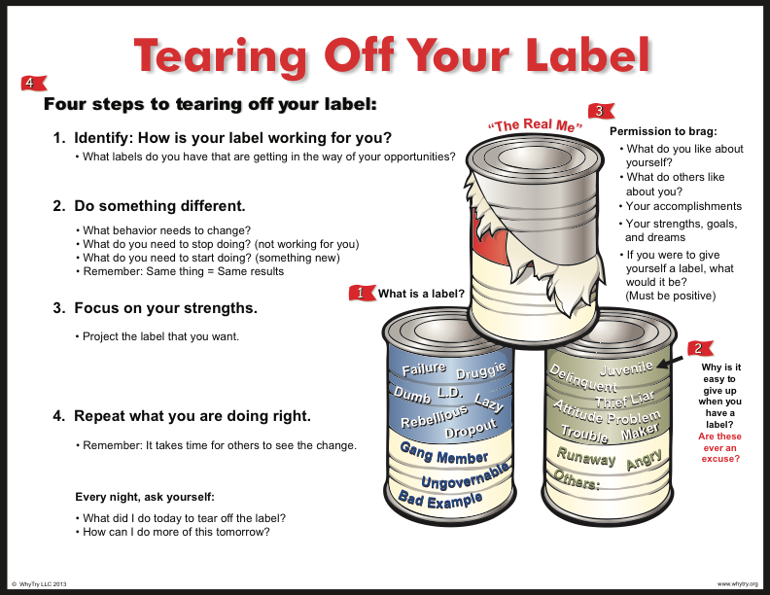

Slide 5
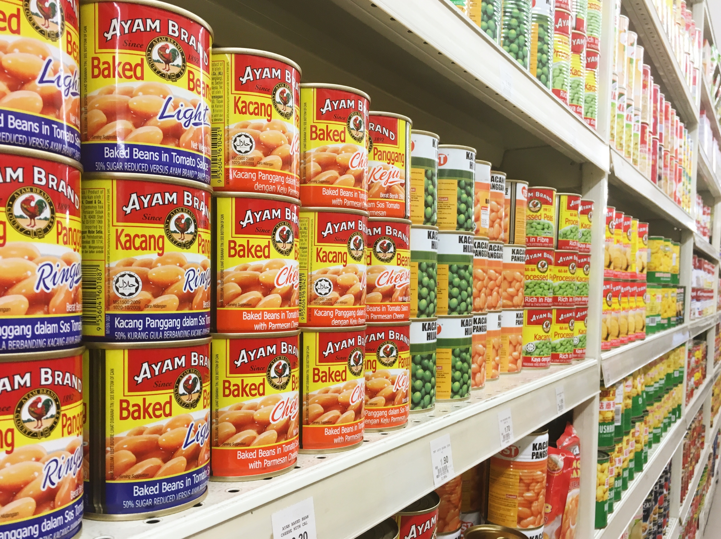
Activity: The Can
What would Happen if we walked int o a grocery store and it was filled with cans that didn't have labels?
Why might it be important to have labels for something like a can?
Create a label for yourself.

Slide 6
Activity: The Can
Was it easy to think of negative Labels that you have been Given? Why?
Was it hard for you to think of positive labels for yourself? Why?
How can you change the way people label you from something that is negative to something that is positive?
How will focusing on our strengths affect the way people label us?

Slide 7

Journal Activity
What are some of the labels you have? Make a list of the positive and negative labels you have.
If you live up to negative labels where will it get you?
If you live up to positive labels where will it get you?
What did you do today to live up to your positive labels
How can I do more of that tomorrow?

Slide 8
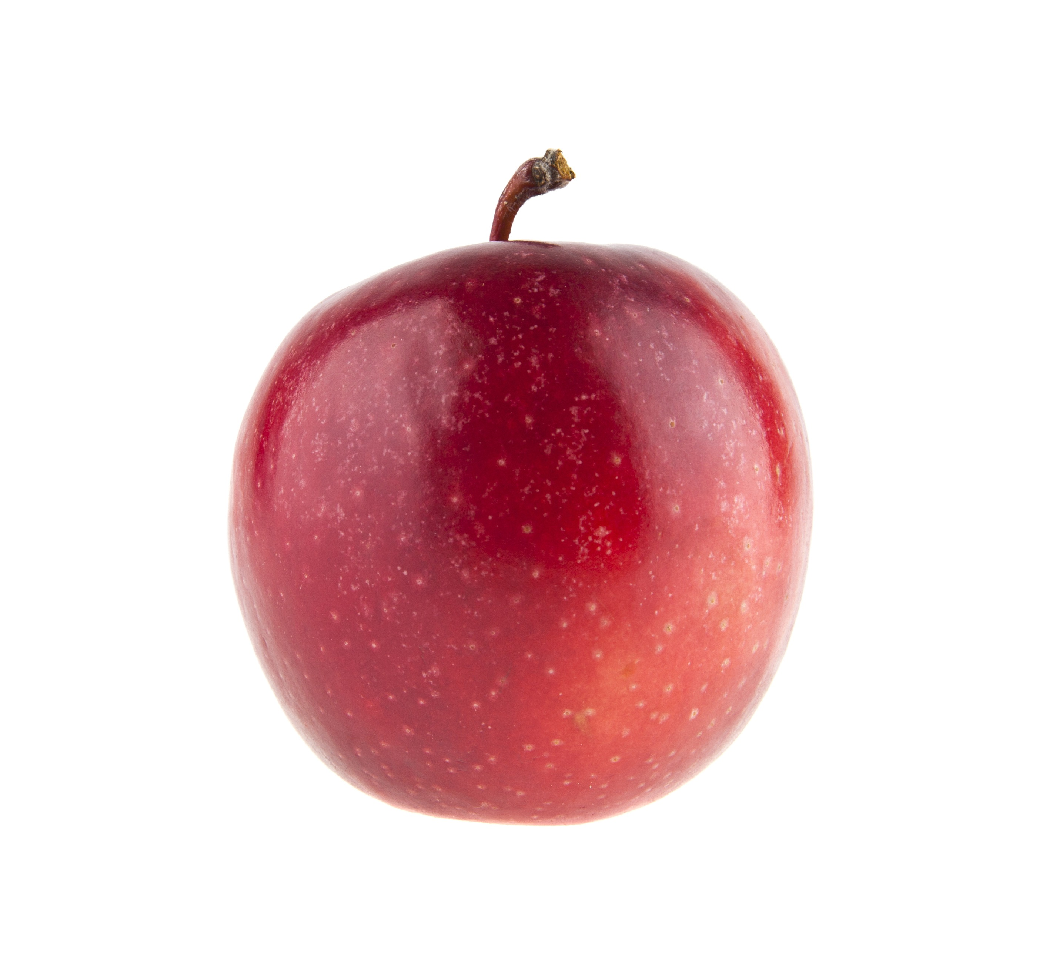
Alternate Activity: Apples
Pick an apple
Write your name on the apple
Write on the apple negative labels others have given you (fair or unfair) and labels you have given yourself
How will focusing on our strengths affect the way people label us?

Slide 9
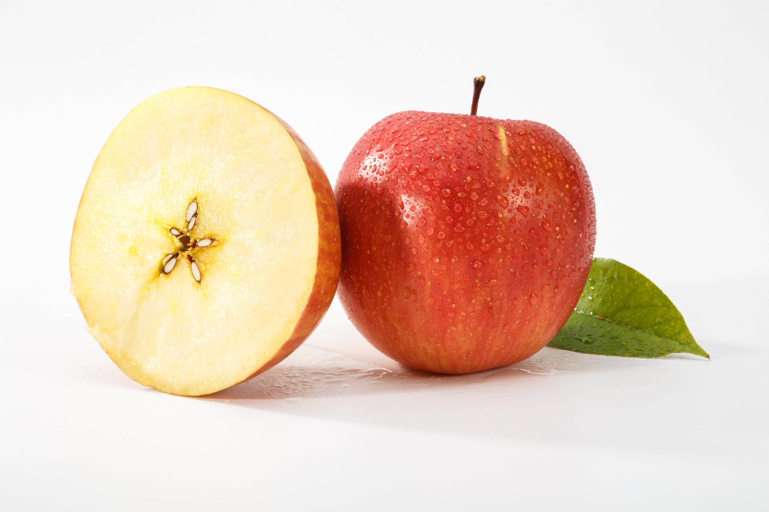
Alternate Activity: Apples
What shape do you see inside?
Do people see you negative labels or the “star inside”?
Who determines if people see what is on the outside or inside of your apple?
Does everyone have a “star” inside? Why or why not?

Slide 10

Alternate Activity: One of a Kind
Fold the paper in half.
Fold in half again in the opposite direction.
completely tear off two of the four corners.
make big tears, small tears, creative tears or any kind of tears as long as the two corners are completely torn off.

Slide 11
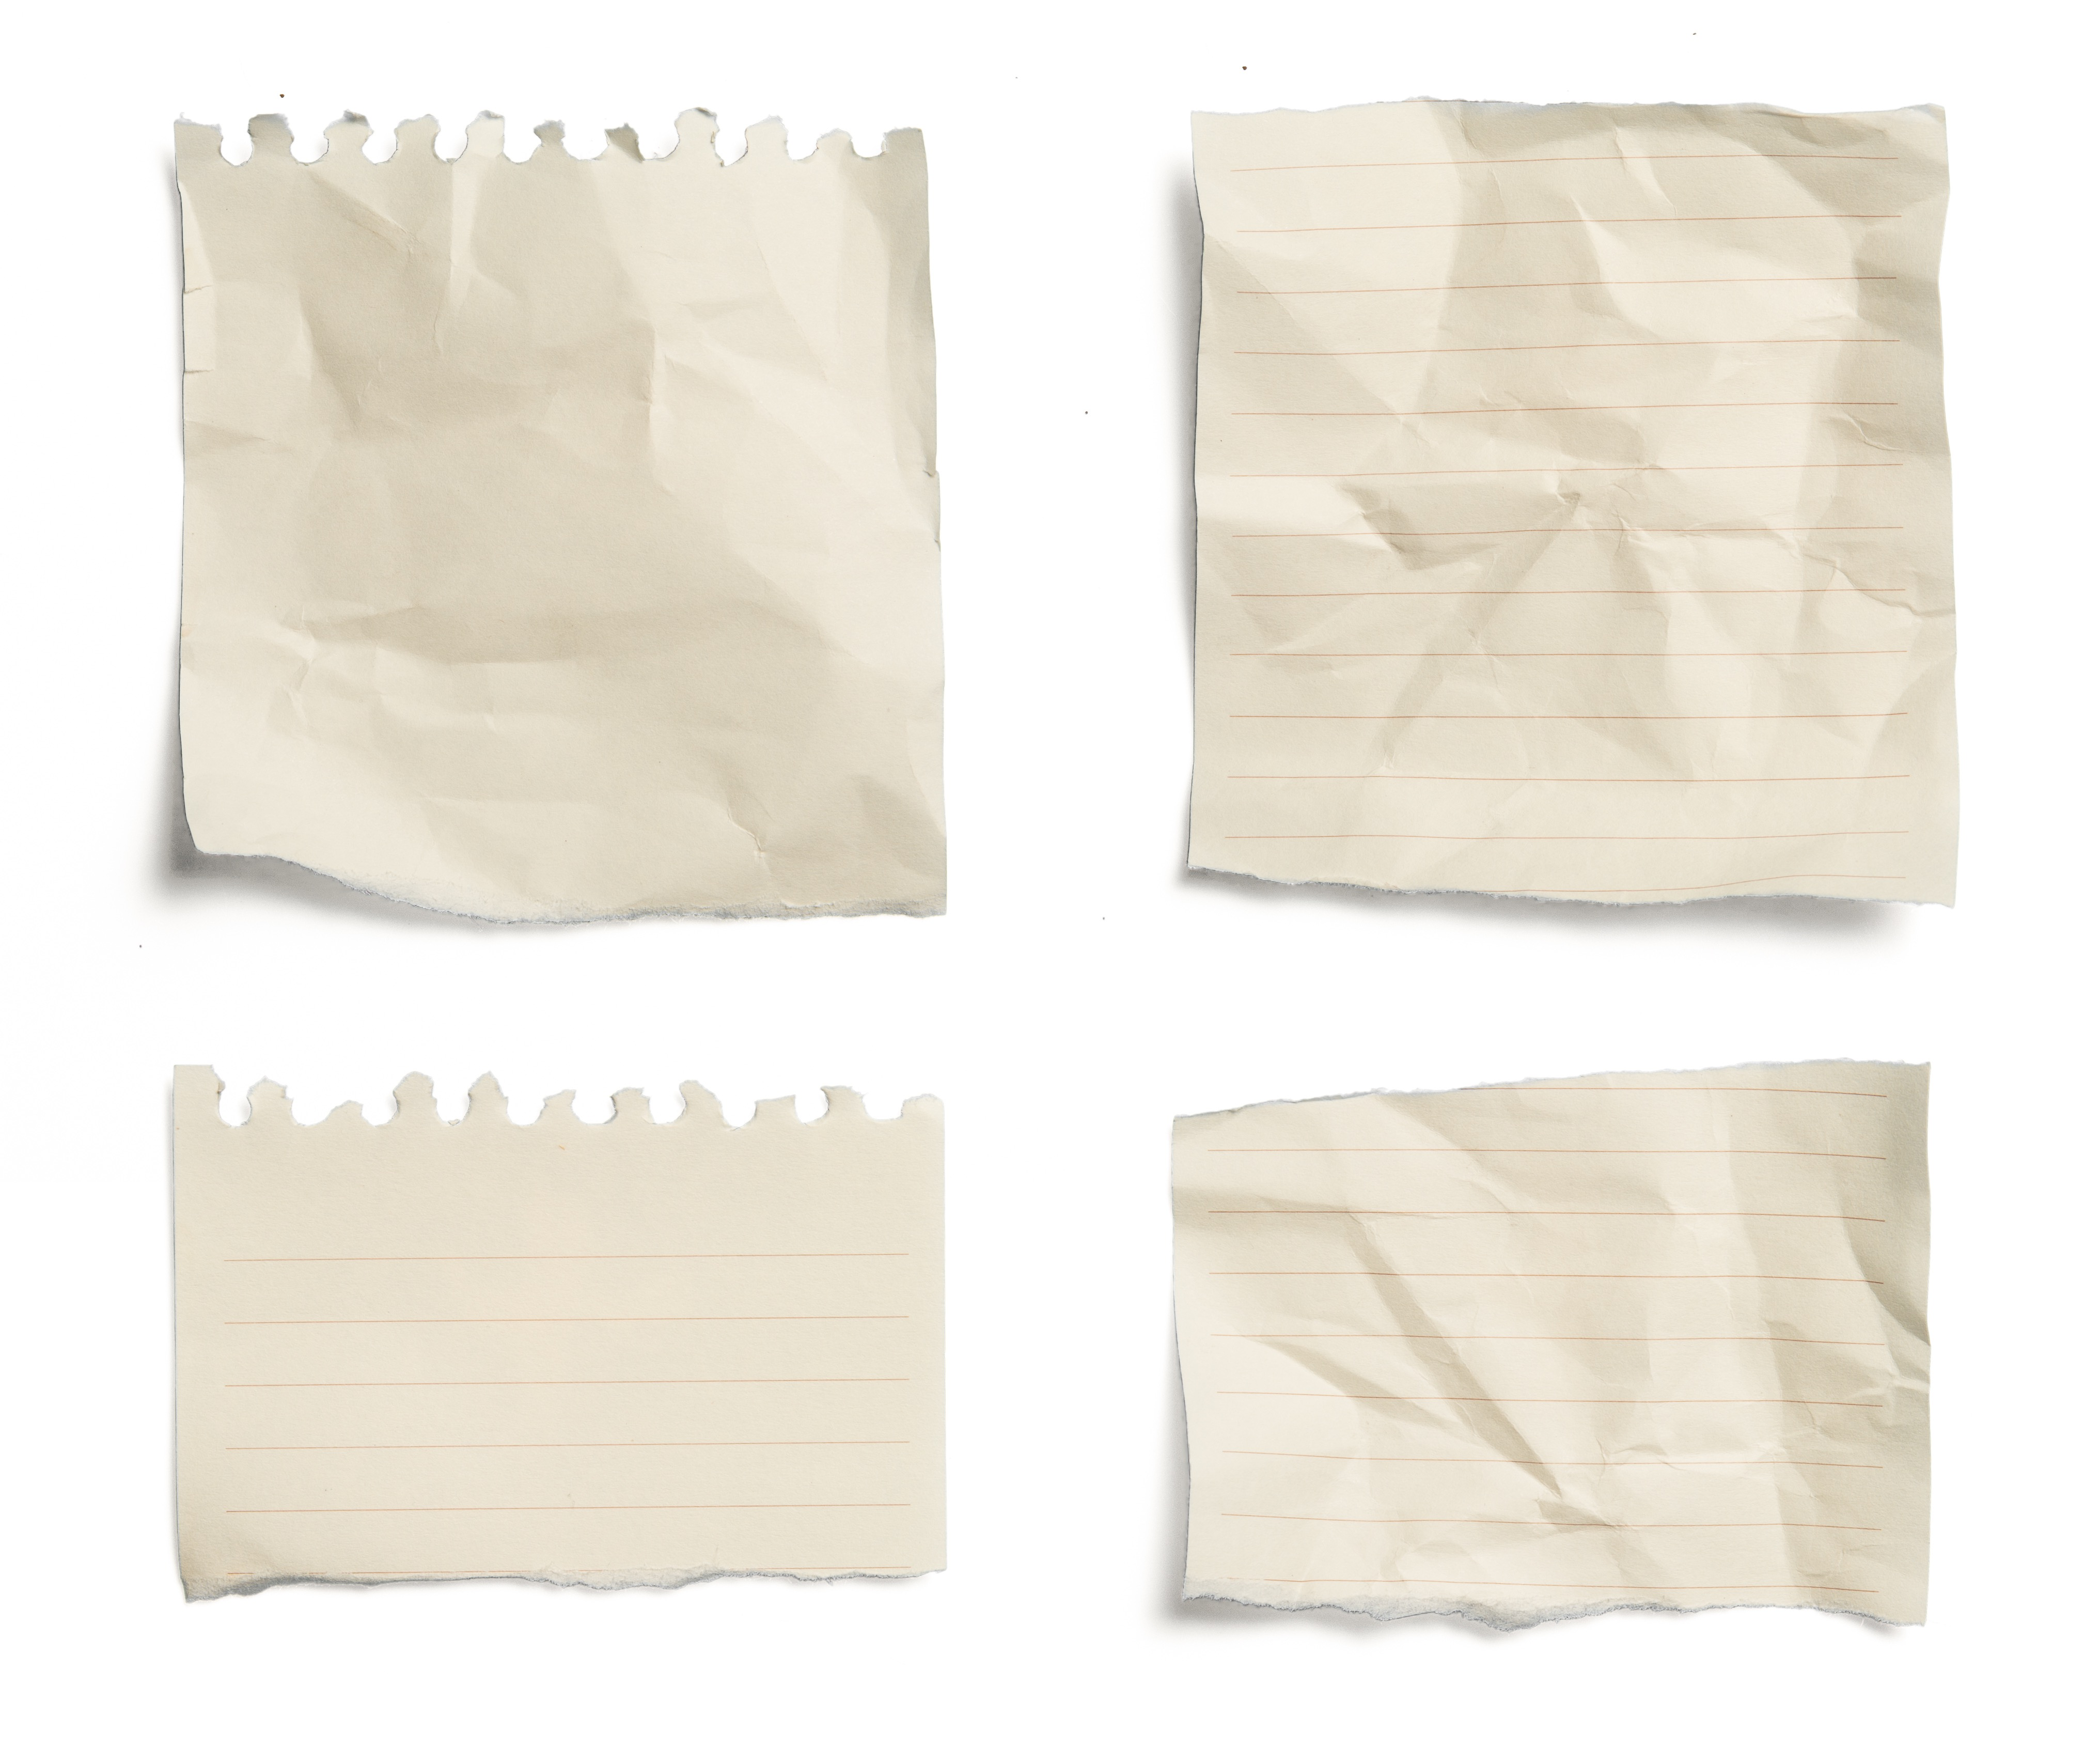
Alternate Activity: One of a kind
Why were all the papers different when everyone received the same instructions?
Even though we do have some similarities, why are we all different?
What positive character traits do you have that set you apart?
How do you let people see “the real me”?
Why is it important to put our energy and effort int our strengths and goals?

Slide 12
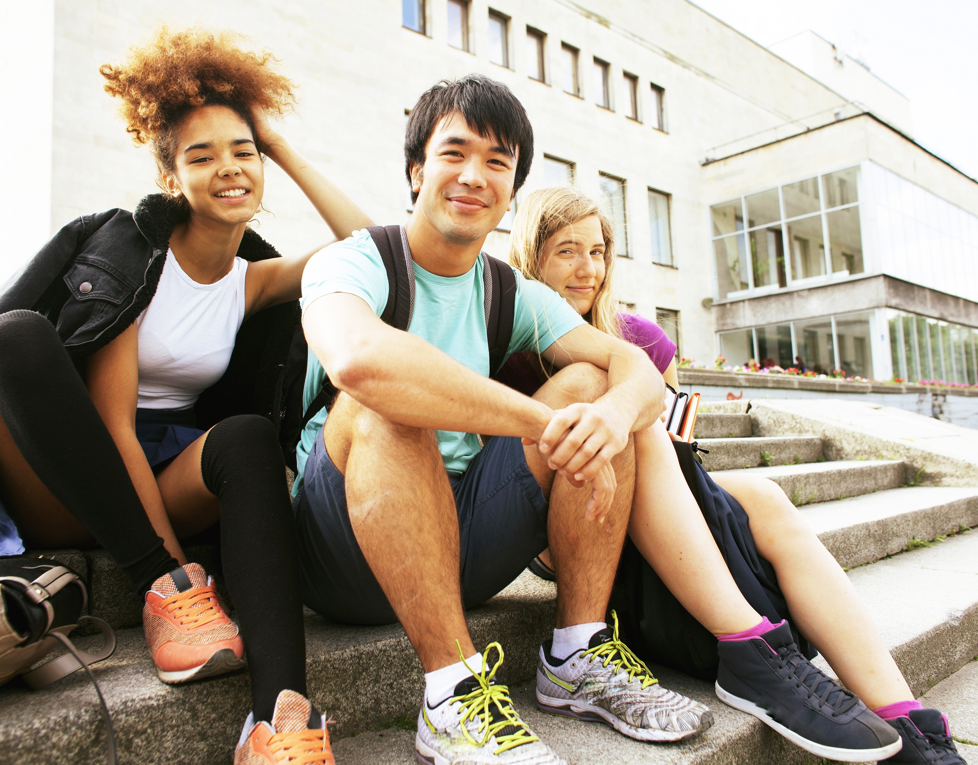
Thank for Coming!

