Slide 1

Welcome To Class!
If you could meet anyone in history who would it be and why?

Slide 2
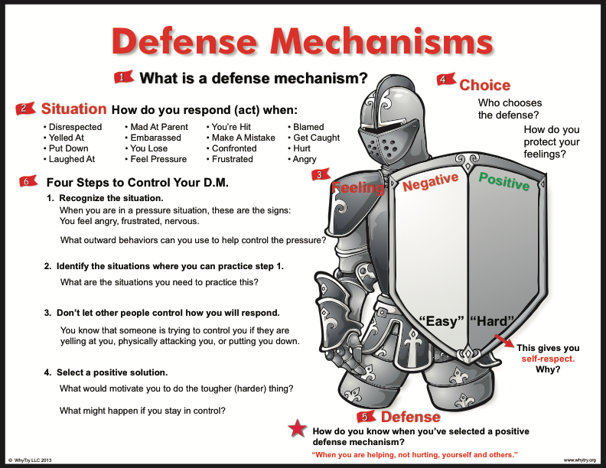

Slide 3


Activity: Name Writing
Write your name on the paper as many times as you can. You have 30 seconds.
Count how many times you were able to write your name.
Did you improve on the 2nd and 3rd time?
Switch hands that you write with.
Can you write your name with your eyes closed?

Slide 4
Activity: Name Writing
Why was it easier to do this activity with the hand that you normally write with?
Why was it harder when you changed hands?
Why is change hard?
What do we usually do in pressure situations?
Why is it hard to do something different?

Slide 5

Journal Activity
What are some of the feelings you feel when you are about to use a defense mechanism?
What are some of the things you can do to calm your feelings before using a defense mechanism?

Slide 6

Alternate Activity: Creative Pyramid
You have two minutes to plan how you will make your pyramid.
You have 1 minute to construct your pyramid.
Come up with a different type of pyramid the 2nd time.
You have one minute to plan and 45 seconds to make your pyramid.
You now have 30 seconds of planning and 15 seconds to make.
Young now have 20 seconds to plan and 10 seconds to make.

Slide 7
Alternate Activity: Creative Pyramid
What was challenging about this activity?
Why was it difficult to “think outside the box” and create a different kind of pyramid?
Did it become more difficult as there was more pressure with less time?
How is this like real-life pressure situations?
Why do we often respond in negative ways when confronted with pressure situations? What are the results when we respond this way?
Why is it difficult to do something different?
What approaches can you use to respond in positive ways next time you are in a pressure situation?

Slide 8

Thank for Coming!

