Slide 1

Welcome To Class!
What is your favorite Holiday?

Slide 2

Video: Jason McElwain
https://www.youtube.com/watch?v=OpRoMAboXmc

Slide 3
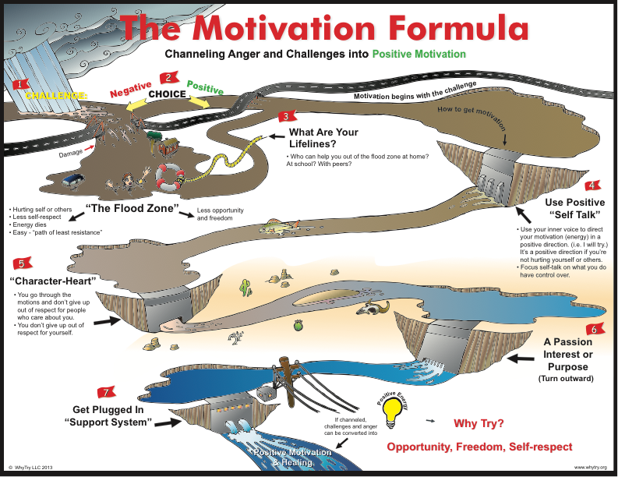

Slide 4
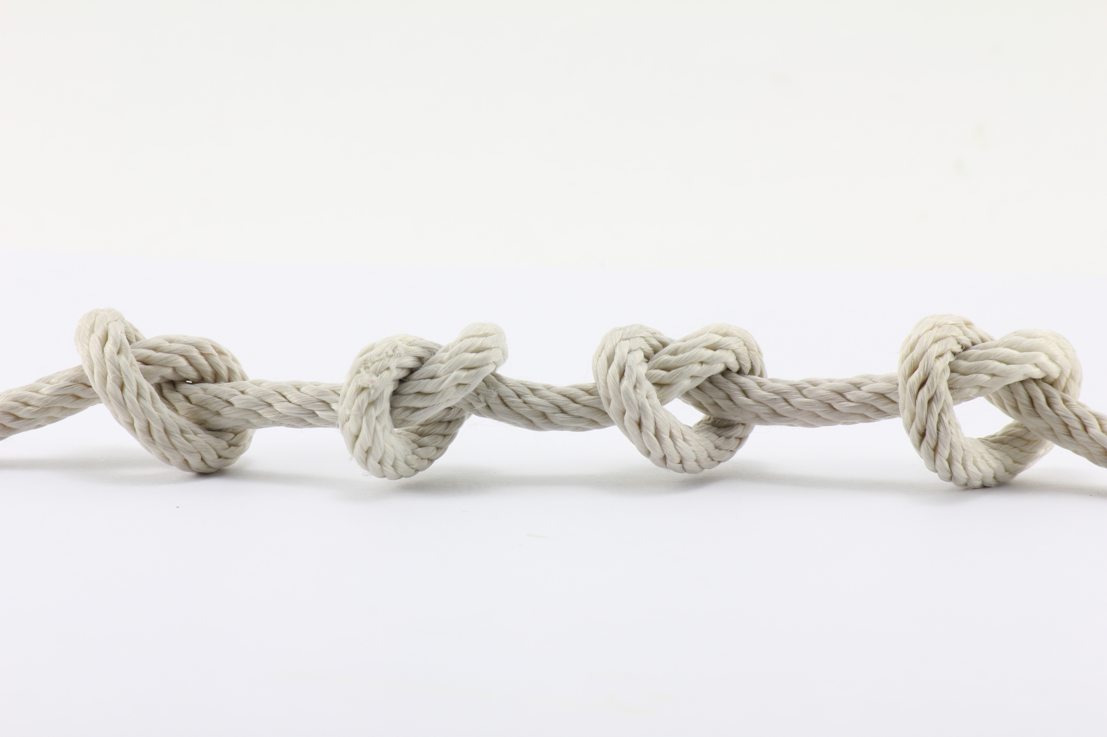
Activity: Human Tangle
Stand in a circle facing the center.
Hold your right hand out in front of you.
Walk forward forming a tight circle with your right hands still facing forward.
One person grab the right hand of another person across from you with your left hand go around.
Continue this going around the circle till everyone is holding hands.
Now untangle yourselves without letting go of each others hands.

Slide 5
Activity: Human Tangle
What was the biggest challenge of this activity?
Did anything frustrate you in this activity?
What motivated you to get untangled?
Why ding you give up?
How did you solve the problem?
What resources did you use?
What might the tangle represent in a person’s life?
What might getting untangled represent?

Slide 6

Journal Activity
Create your own creed or motto. It should represent something pbsotivie that you want to become or achieve. It can be something to tell yourself (your self-talk) When things are getting intense. Remember that you can’t control everything that happens; you can only control what you do about it. Put your creed or motto somewhere where you can see it every day (your locker, bed-room, or your mirror.)
Write down one reason not to give up. It could be a person you care about, or something you believe in.
Write down one thing that you feel passionately about.

Slide 7

Alternate Activity: Mind Over Matter
Hold the string in front of your face so that the lifesaver hangs about 6 inches from their eyes.
Your arms, elbows, and hands must not be touching anything.
Make sure the lifesaver is still and not swinging.
Make the lifesaver start to swing just by using your mind power.
Focus carefully on the lifesaver and think “left, right,” while imagining it moving from left to right.

Slide 8
Alternate Activity: Mind Over Matter
How many of you were able to make the lifesaver follow my commands?
How powerful is our mind?
How do our actions influence what we think and say to ourselves?
In what kinds of activities do your thoughts or self talk impact your behavior?
How can our thoughts and self talk impact our goals?

Slide 9
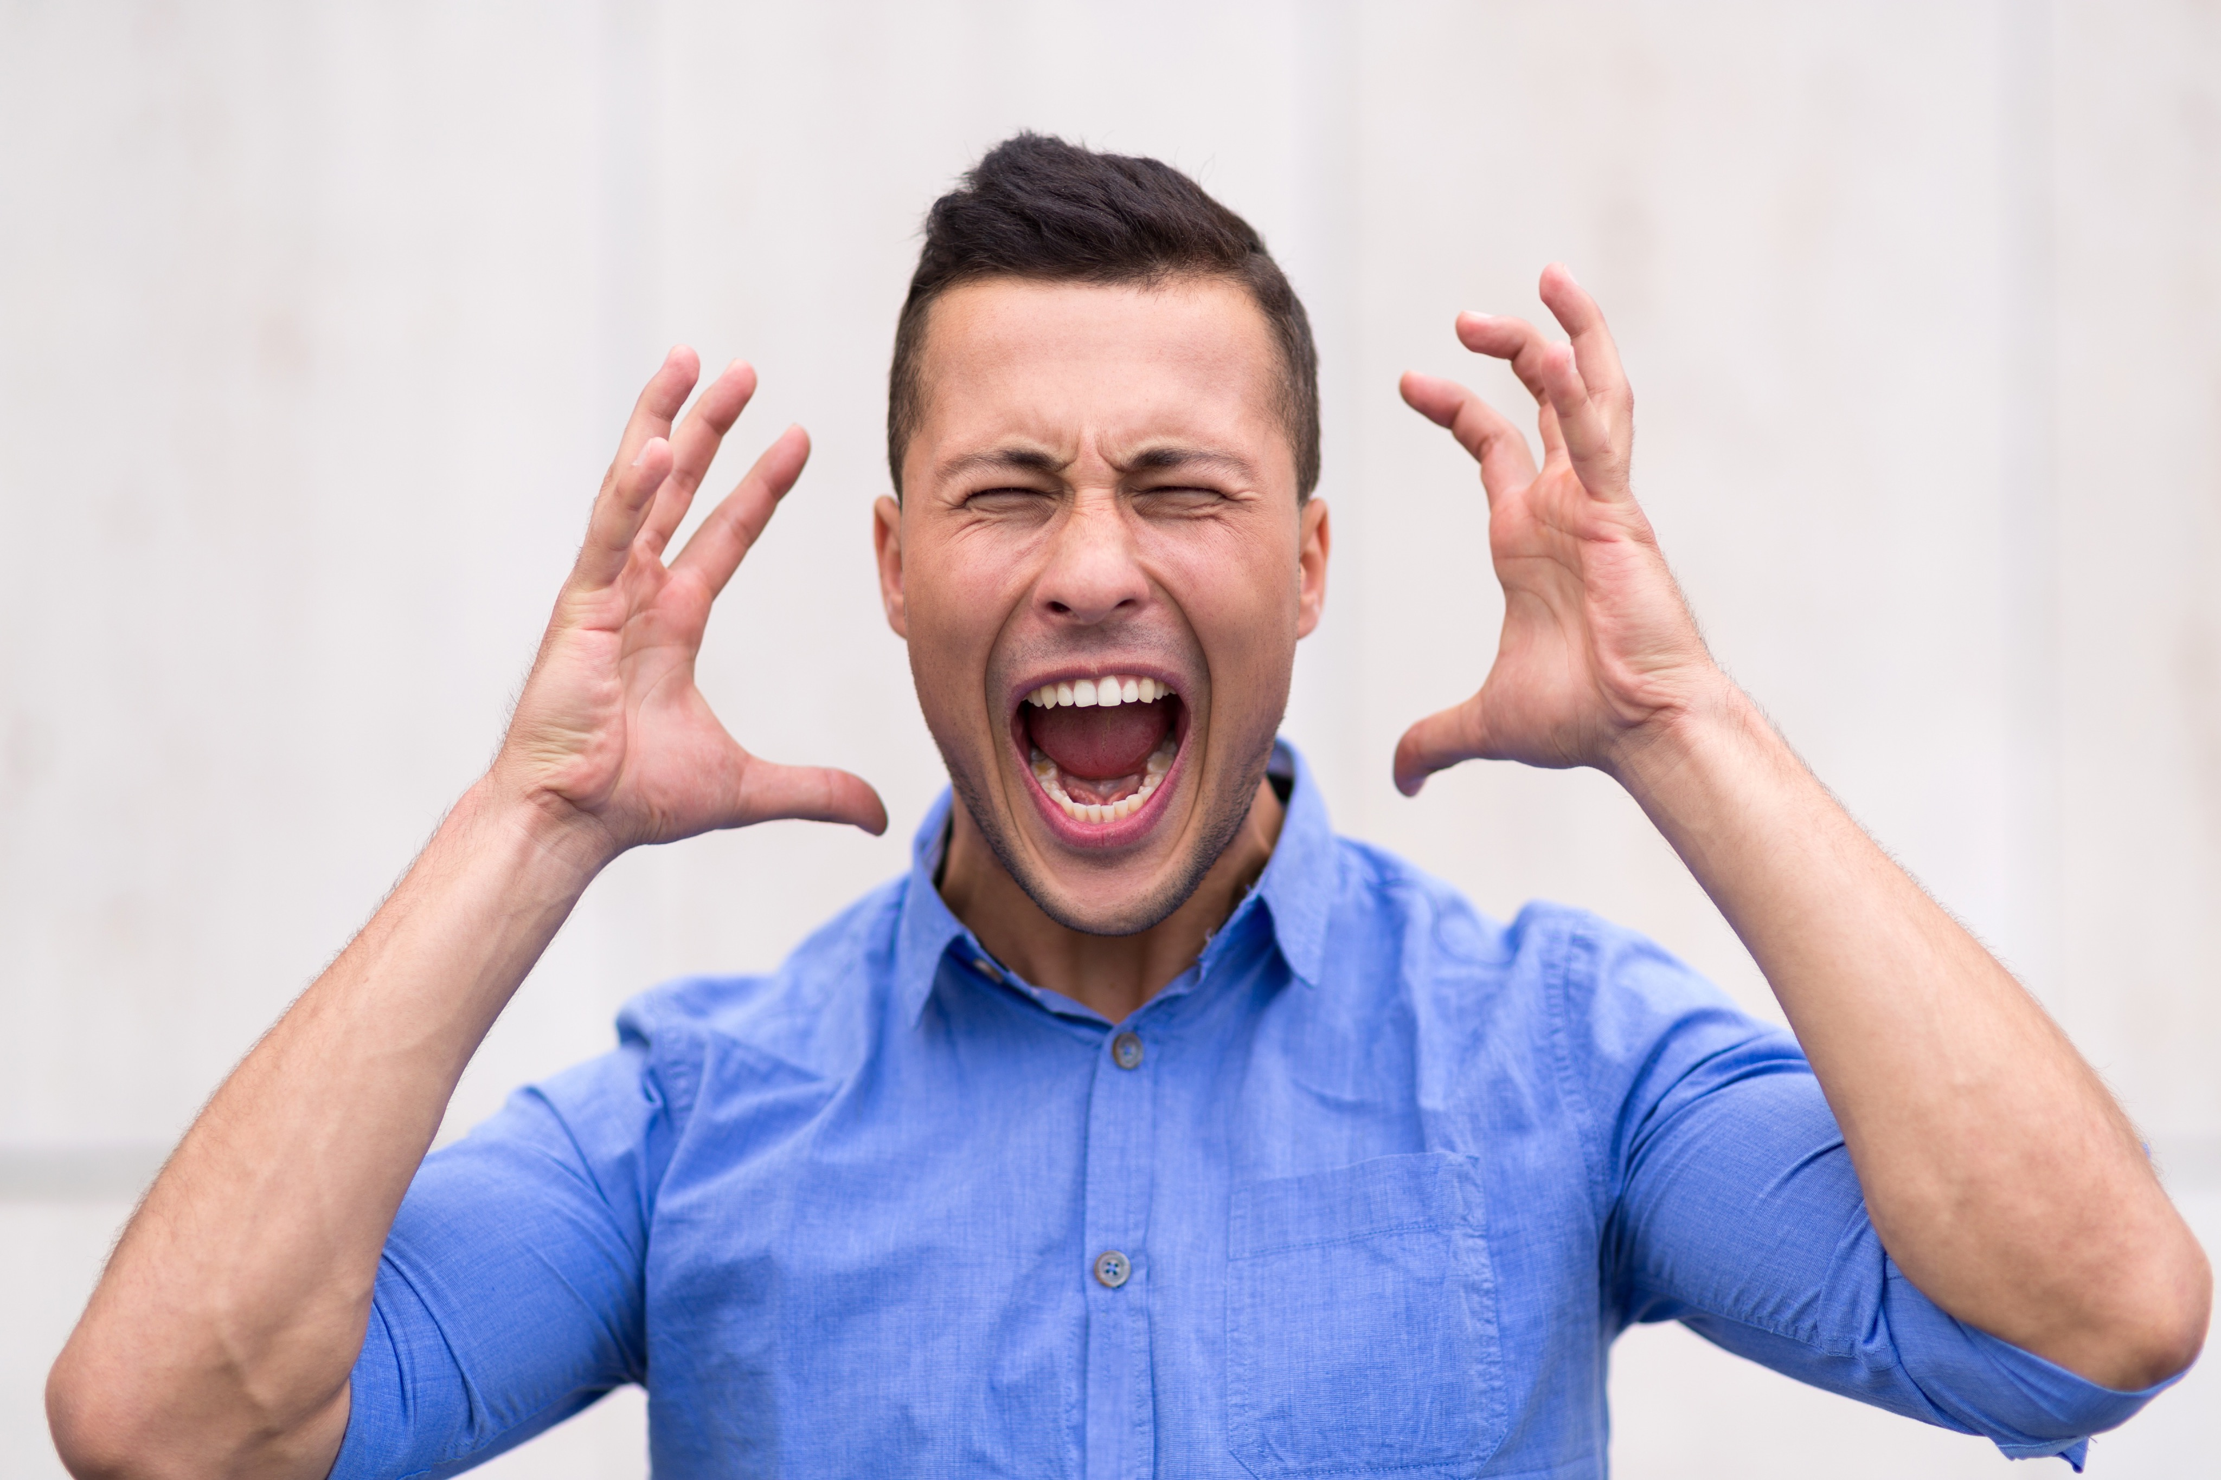
Alternate Activity: Balloon Pop
What are some of the things that make you angry, upset, mad, or frustrated?
Why did the balloon pop?
What happens to opportunities, freedom, and self respect when we lose control and wind up in “The Flood Zone”?
Which of the items listen the board make you mad? Why or Why not?
why do some people react to the items on the board in a negative way, and others do in a positive way?
Is it OK to be angry? Why or why not?
When is anger not OK?

Slide 10

Alternate Activity: Balloon Pop
What are things that can help channel the anger from the items listed into positive energy?
What happens when we change our anger in positive ways?
How do you get motivated to channel anger in a positive way?
Why do we need to channel our anger?
How would your life be different if your anger was controlled?
What kind of opportunities will you have if you challenges are channeled in a positive direction?

Slide 11
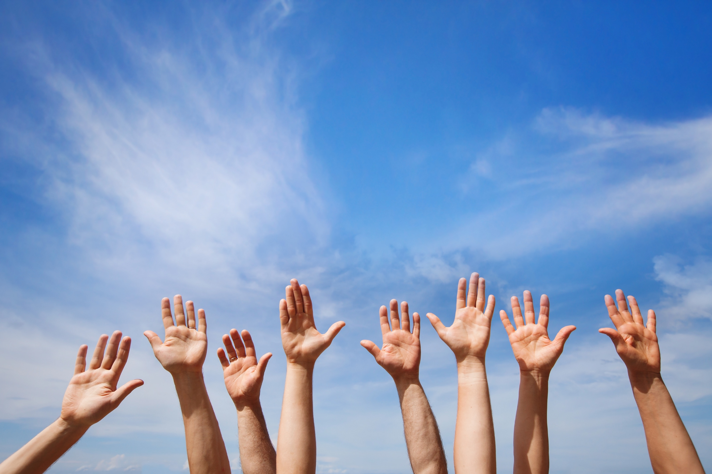
Thank for Coming!

