Slide 1
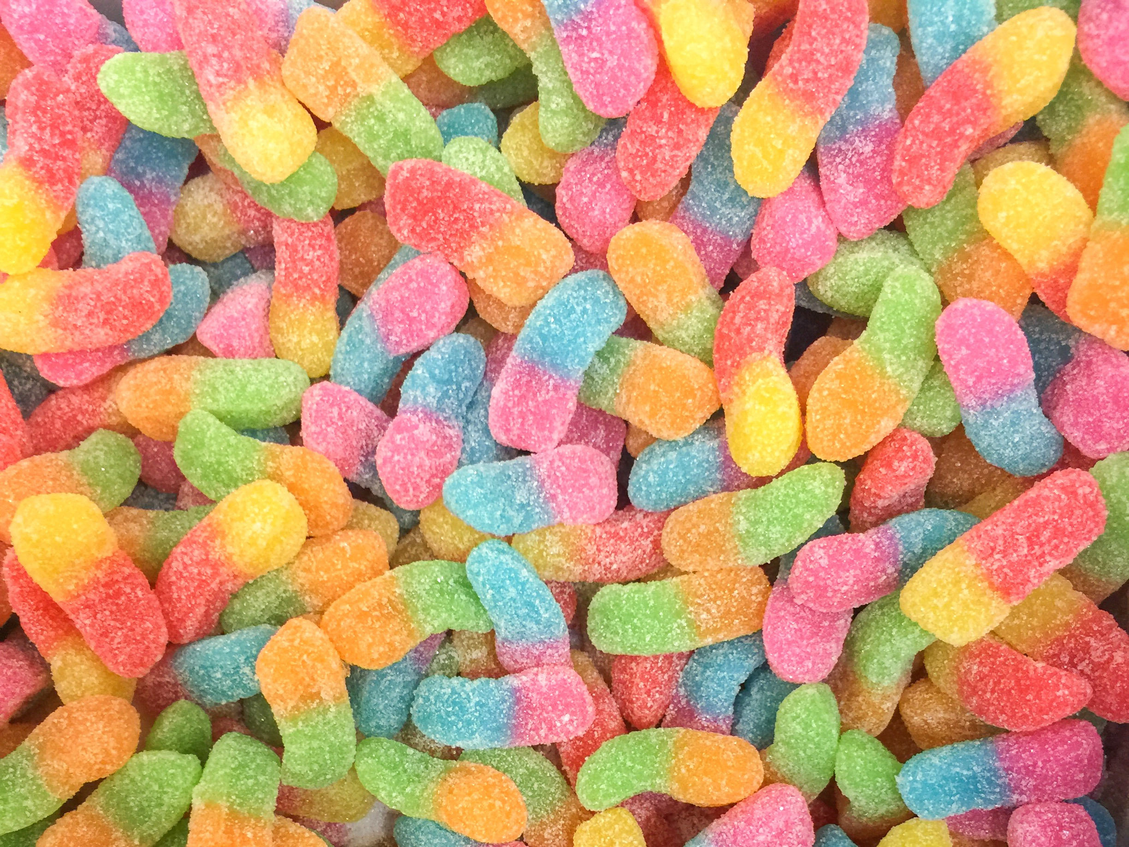

Welcome To Class!
What’s your favorite candy?

Slide 2
Video Crabs Climbing out

Slide 3
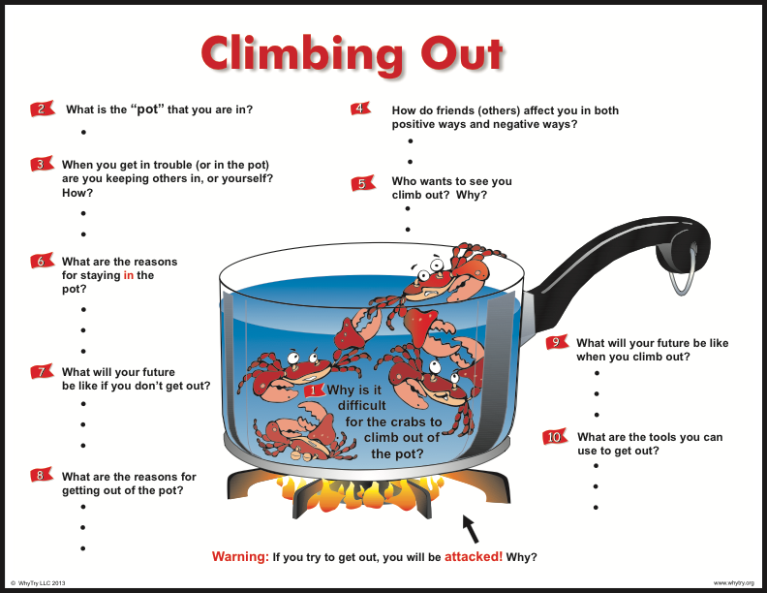

Slide 4
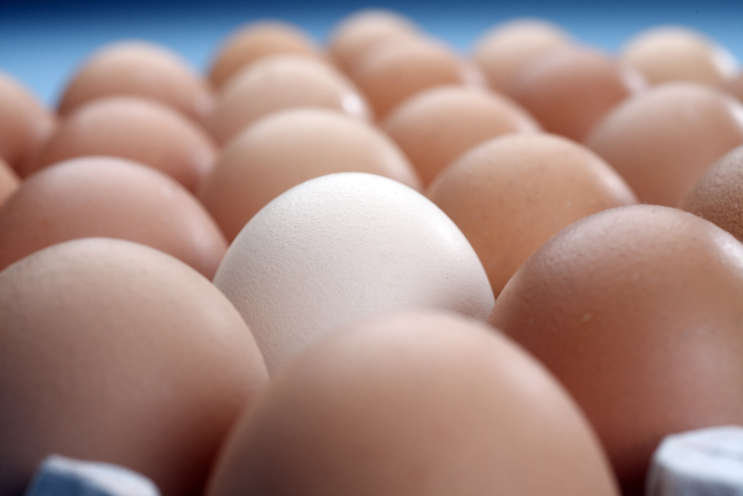
Activity: Sucked In
Who thinks they can force the egg into the bottle without breaking it?

Slide 5
Activity: Sucked In
Why do you think the egg went into the bottle when the flame was used?
How is this activity like peer pressure? What is an example of a situation where it is difficult to say no?
Are we more susceptible to peer pressure by being in the wrong place at the wrong time? How?
Is it harder to say no the longer you are in a situation? Why?
What can you do to help yourself resist the pressure to do something that might be harmful to you?
How do you get out of negative peer pressure?

Slide 6

Journal Activity
Write 5 words that you could use to complete the phrase: “A good friend is_____________.
Do any of the words also describe you?
What words would you use to describe a false friend?
How would you describe your friend?

Slide 7
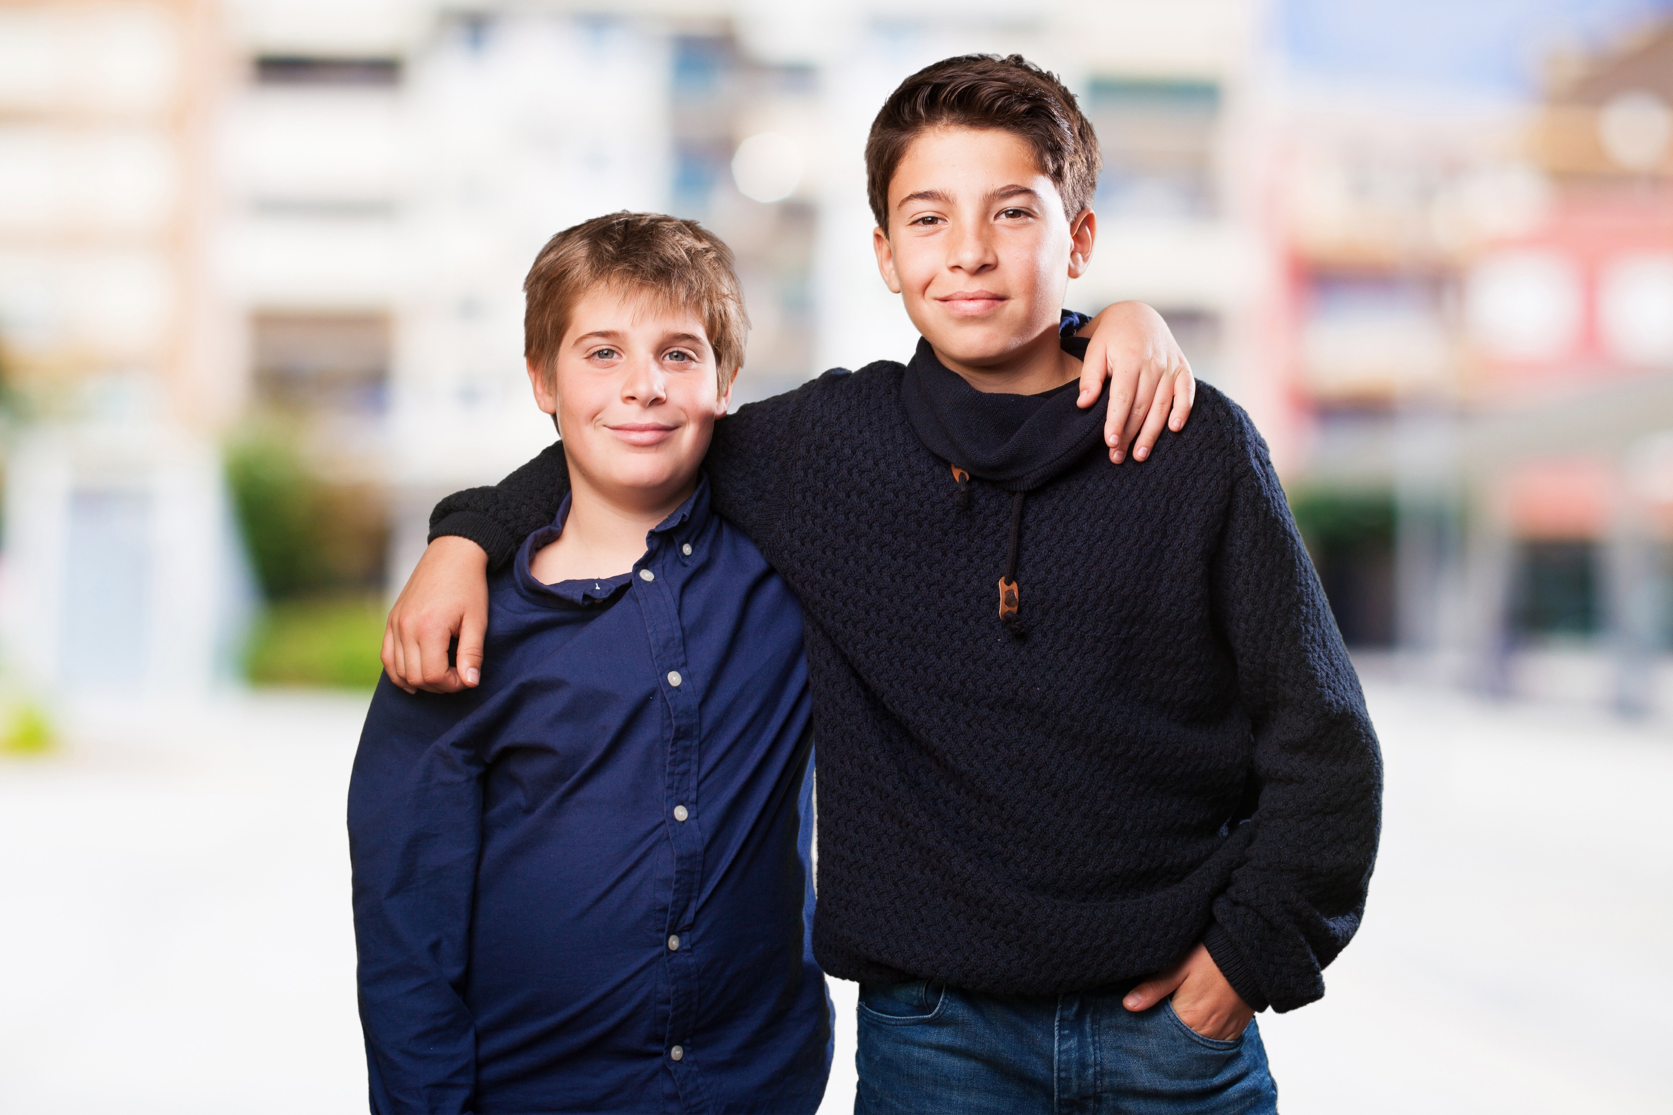
Alternate Activity:The Friend Protector
Form a circle.
One person in the middle of the circle.
Those making up the circle try to hit the person in the middle with the ball (ball only thrown below the chest).
Two people in the middle, one is to be the bodyguard of the other.

Slide 8
Alternate Activity:The Friend Protector
How did it feel when everyone was trying to hit you with the ball without protection?
How Did it feel when you had a friend to protect you?
What does it mean to be a true friend?
What does it mean to be a false friend?
Why are true friends so important?
How can true friends protect you from negative peer pressure?

Slide 9
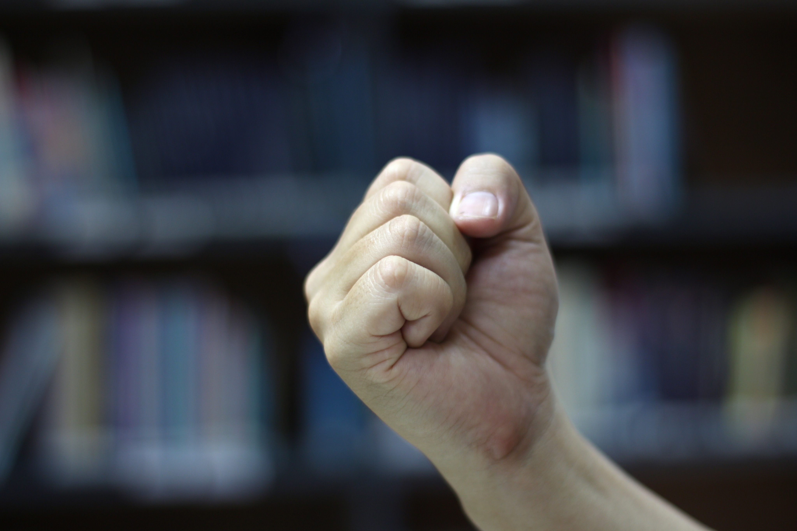
Alternate Activity: Paper Clip, Eraser, Penny
One volunteer come to the front of the room.

Slide 10
Alternate Activity: Paper Clip, Eraser, Penny
How was I able to make the prediction?
What is manipulation?
Is manipulation good or bad? why?
Have you ever been in a situation with friends where you were “manipulated” to do something that you probably would not have done if you were by yourself? what is it?
How did you feel after you figure out what was going on?
Do true friends manipulate? Why?

Slide 11
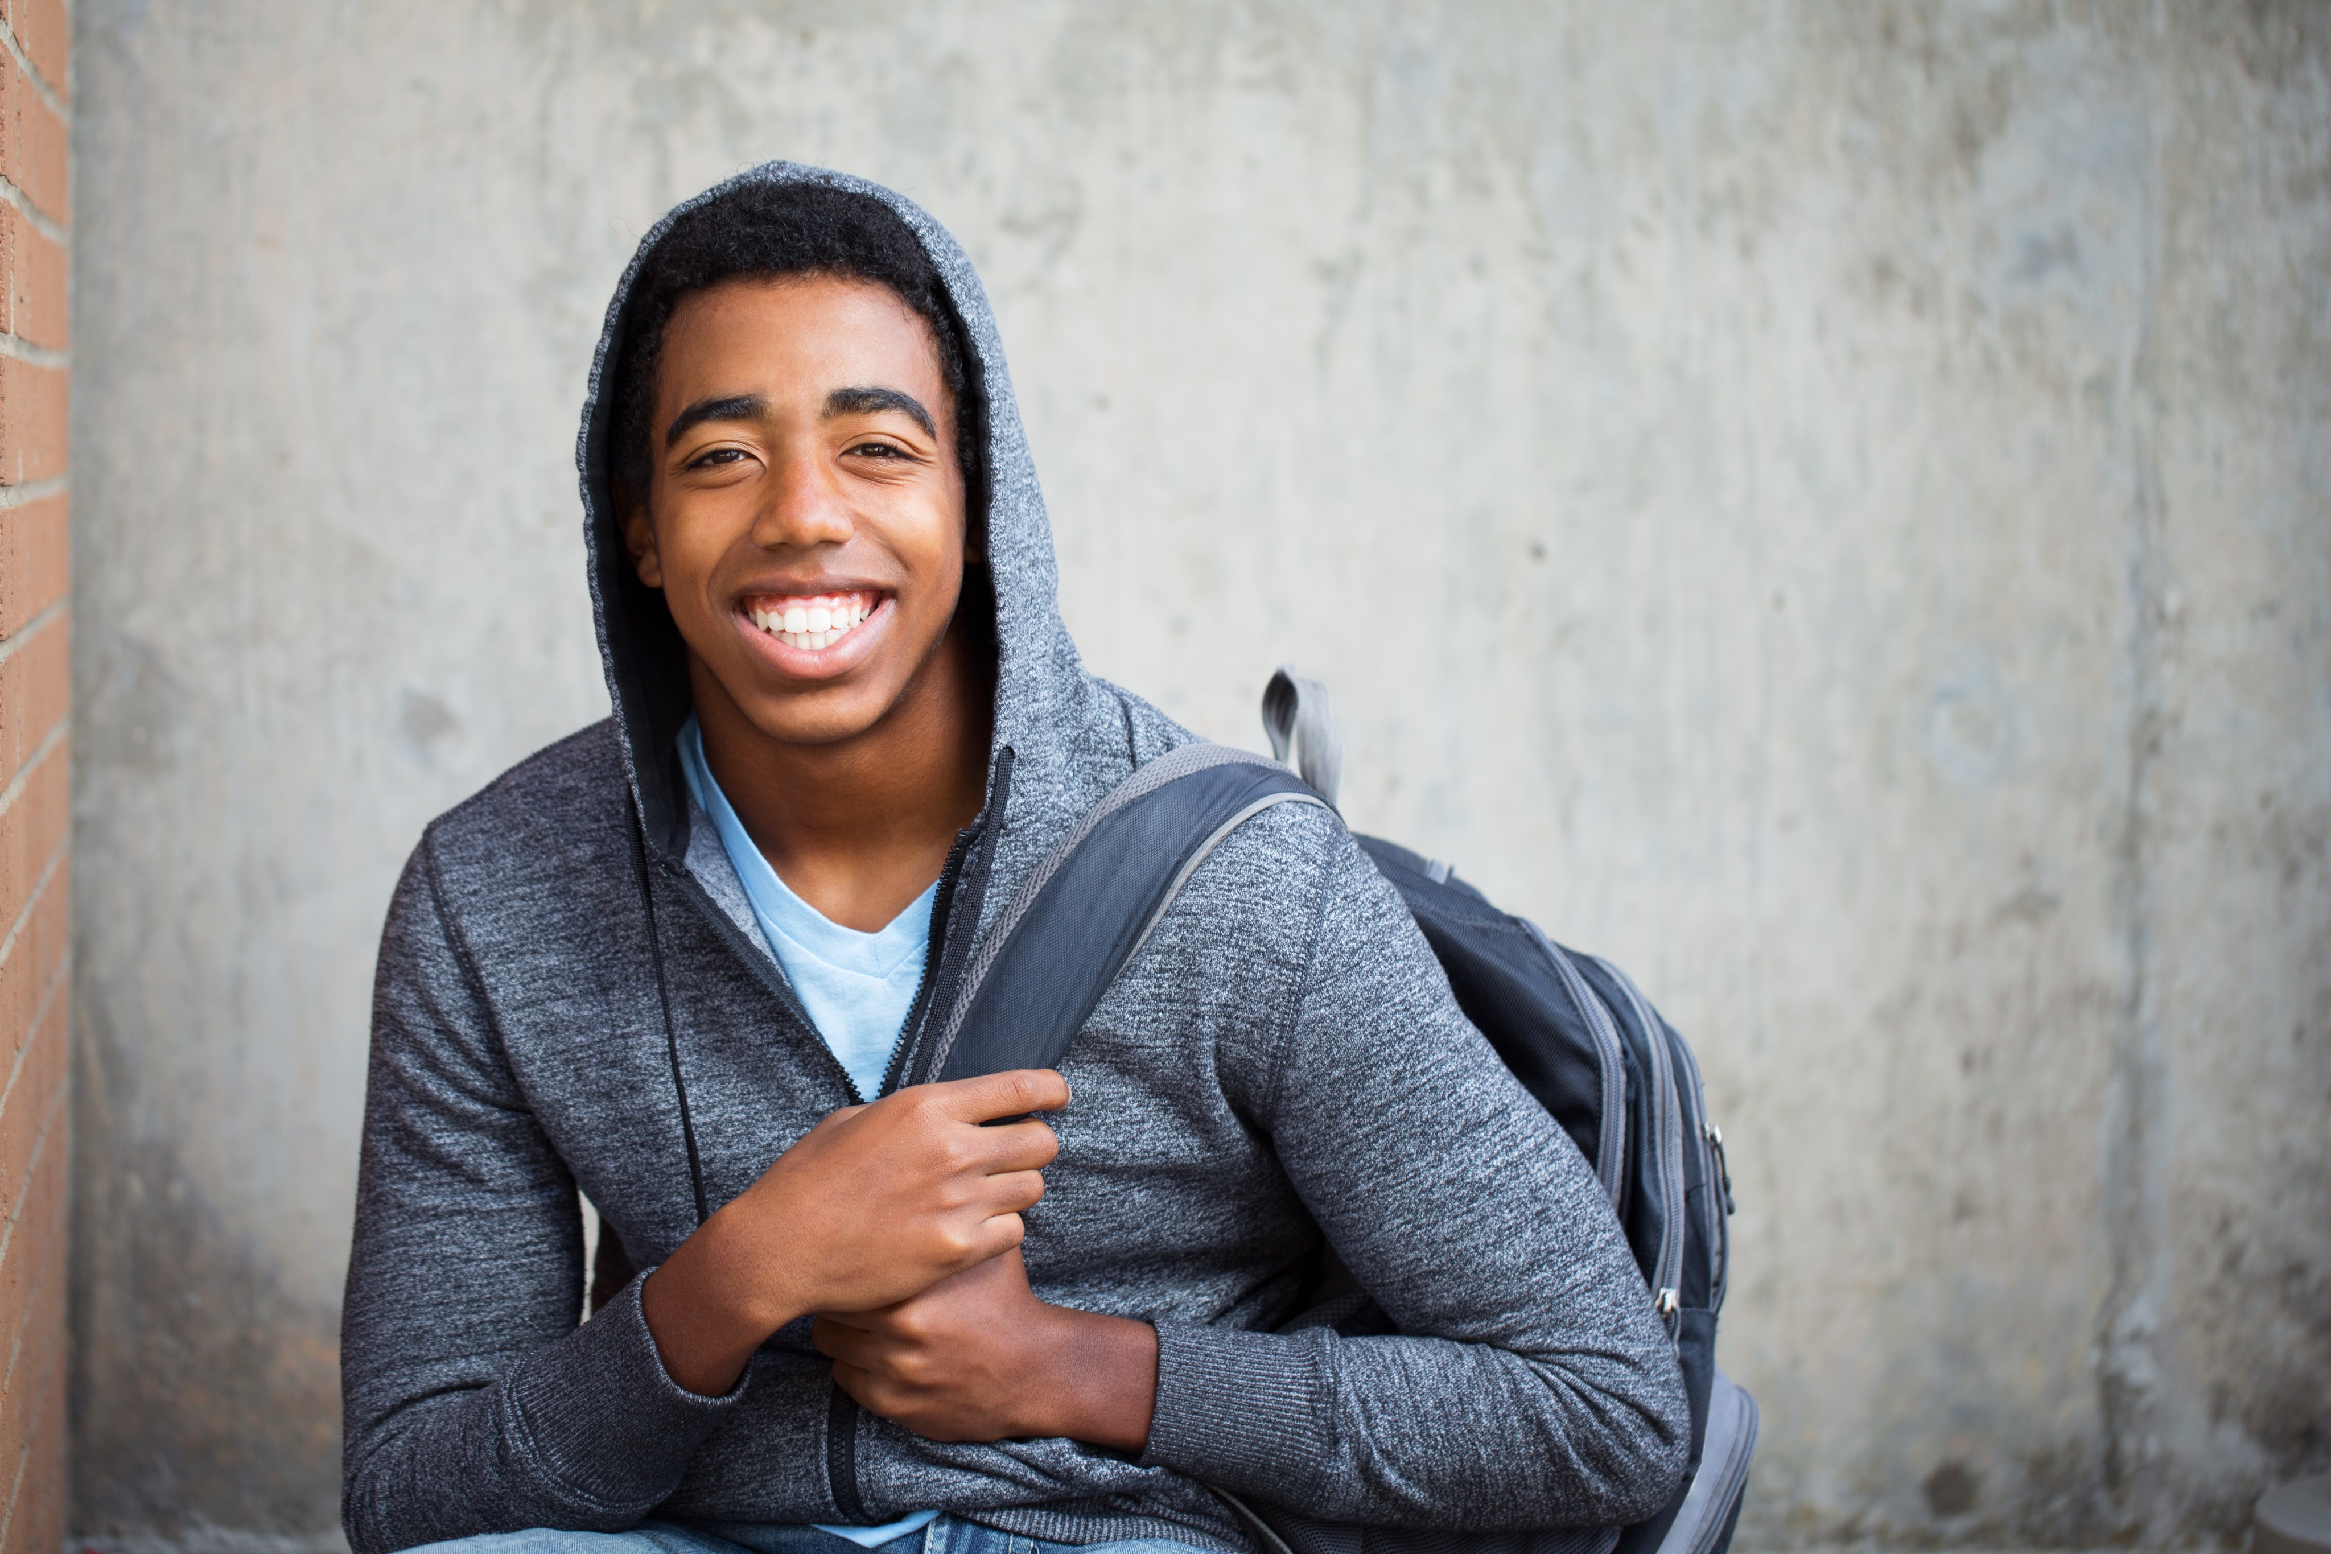
Thank for Coming!

