Slide 1
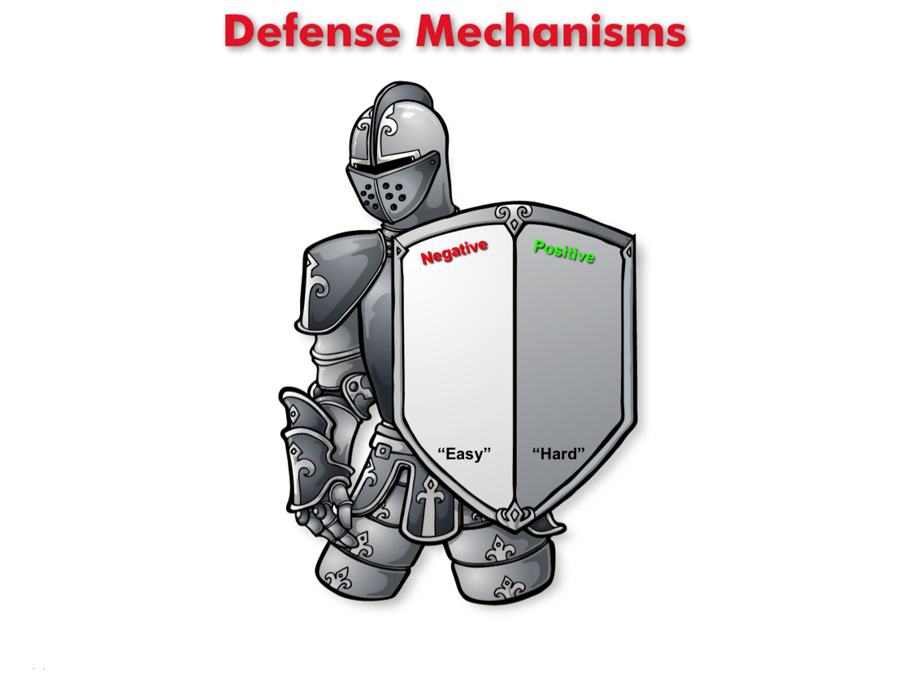
Defense Mechanisms
(Lesson Plan Template)

Slide 2

ATTENTION GETTER
Create your own attention-getter slide to start today’s lesson. This slide may include music, a story, an object lesson, a "Surrendering the One-up" activity, a group poll, or a brief movie clip.

Slide 3




Defense Mechanisms
Complete Metaphor
Animated Metaphor Walkthrough
Music
Learning
Journal
Video

Slide 4
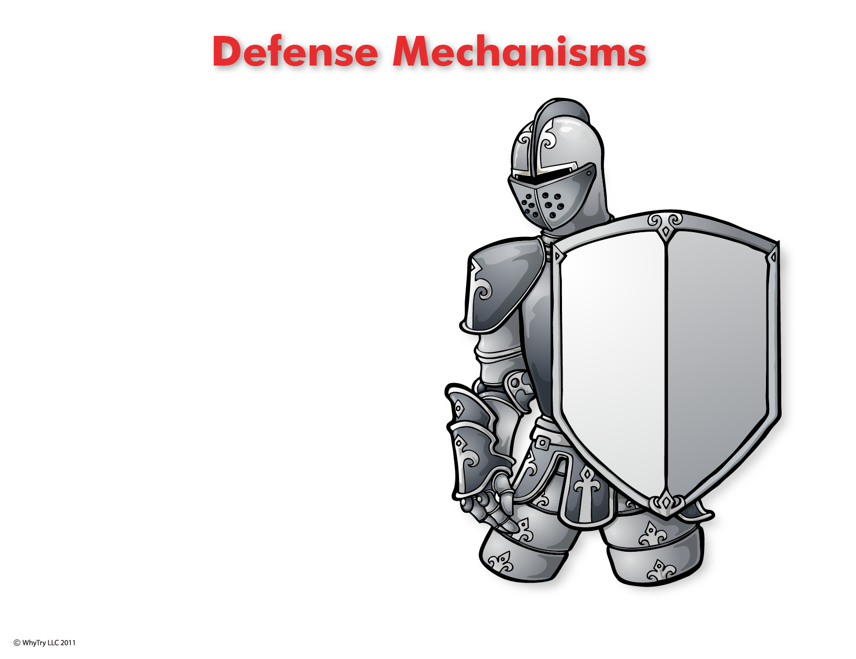
1
What is a defense mechanism?
4
Choice
2
Situation:
How do you respond (act) when . . .
Who chooses the defense?
Disrespected
Yelled at
Put down
Laughed at
Mad at parent
Embarrassed
Make a mistake
Feel pressure
You’re hit
You lose
Confronted
Frustrated
Blamed
Get caught
Hurt
Angry
How do you protect your feelings?
6
Four steps to control your defense mechanisms
Negative
Positive
3
Feeling
1. Recognize the situation.
When you are in a pressure situation, these are the signs:
You feel angry, frustrated, nervous.
What outward behaviors can you use to help control
the pressure?
2. Identify the situations where you can practice step 1.
What are the situations you need to practice this?
“Easy” “Hard”
3. Don’t let other people control how you will respond.
You know someone is trying to control you if they are
yelling at you, physically attacking you, or putting you down.
This gives you
self-respect.
Why?
4. Select a positive solution.
What would motivate you to do the tougher (harder) thing?
What might happen when you stay in control?
5
Defense
How do you know when you’ve selected a positive Defense mechanism?. . .
“When you are helping (not hurting) yourself and others.”

Slide 5
1
What is a defense mechanism?
4
Choice
2
Situation:
How do you respond (act) when . . .
Who chooses the defense?
Disrespected
Yelled at
Put down
Laughed at
Mad at parent
Embarrassed
Make a mistake
Feel pressure
You’re hit
You lose
Confronted
Frustrated
Blamed
Get caught
Hurt
Angry
How do you protect your feelings?
6
Four steps to control your defense mechanisms
Negative
Positive
3
Feeling
1. Recognize the situation.
When you are in a pressure situation, these are the signs:
You feel angry, frustrated, nervous.
What outward behaviors can you use to help control
the pressure?
2. Identify the situations where you can practice step 1.
What are the situations you need to practice this?
“Easy” “Hard”
3. Don’t let other people control how you will respond.
You know someone is trying to control you if they are
yelling at you, physically attacking you, or putting you down.
This gives you
self-respect.
Why?
4. Select a positive solution.
What would motivate you to do the tougher (harder) thing?
What might happen when you stay in control?
5
Defense
How do you know when you’ve selected a positive Defense mechanism?. . .
“When you are helping (not hurting) yourself and others.”

Slide 6
Music
Create your own music activity slide. This may include a WhyTry music video, a song of your own, or a song a student has shared.

Slide 7
Activity
Create your own learning activity slide. This may include either an object lesson, a group activity, or a group / movement activity. This slide may include instructions /rules for the activity or a relevant visual prompt to introduce the activity.

Slide 8
Journal
Create your own journal activity slide. This slide may include an art activity, observation activity, or game plan exercise from the WhyTry student journal. This slide may contain the actual journal page or a relevant visual prompt to introduce the journal activity.

Slide 9
Video
Create your own video activity slide. This slide may include one of WhyTry’s recommended YouTube clips that you have downloaded and embedded here, or any other relevant video clip reinforcing some aspect of today’s lesson. Videos may be funny, serious, documentary style, etc. This is a good opportunity to differentiate your approach to best meet your student’s needs.

