Slide 1
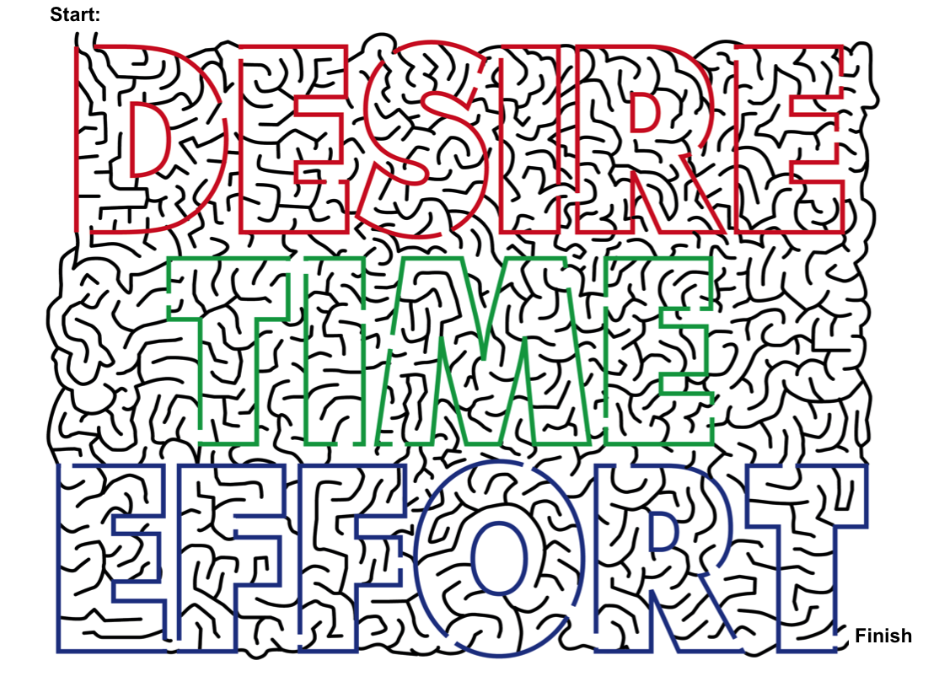
Desire-Time-Effort
(Lesson Plan Template)

Slide 2

ATTENTION GETTER
Create your own attention-getter slide to start today’s lesson. This slide may include music, a story, an object lesson, a "Surrendering the One-up" activity, a group poll, or a brief movie clip.

Slide 3




Desire-Time-Effort
Complete Metaphor
Animated Path Through The Maze
Music
Learning
Journal
Video

Slide 4
Start:
Finish

Slide 5
Start:
Finish

Slide 6
Music
Create your own music activity slide. This may include a WhyTry music video, a song of your own, or a song a student has shared.

Slide 7
Activity
Create your own learning activity slide. This may include either an object lesson, a group activity, or a group / movement activity. This slide may include instructions /rules for the activity or a relevant visual prompt to introduce the activity.

Slide 8
Journal
Create your own journal activity slide. This slide may include an art activity, observation activity, or game plan exercise from the WhyTry student journal. This slide may contain the actual journal page or a relevant visual prompt to introduce the journal activity.

Slide 9
Video
Create your own video activity slide. This slide may include one of WhyTry’s recommended YouTube clips that you have downloaded and embedded here, or any other relevant video clip reinforcing some aspect of today’s lesson. Videos may be funny, serious, documentary style, etc. This is a good opportunity to differentiate your approach to best meet your student’s needs.

