Slide 1
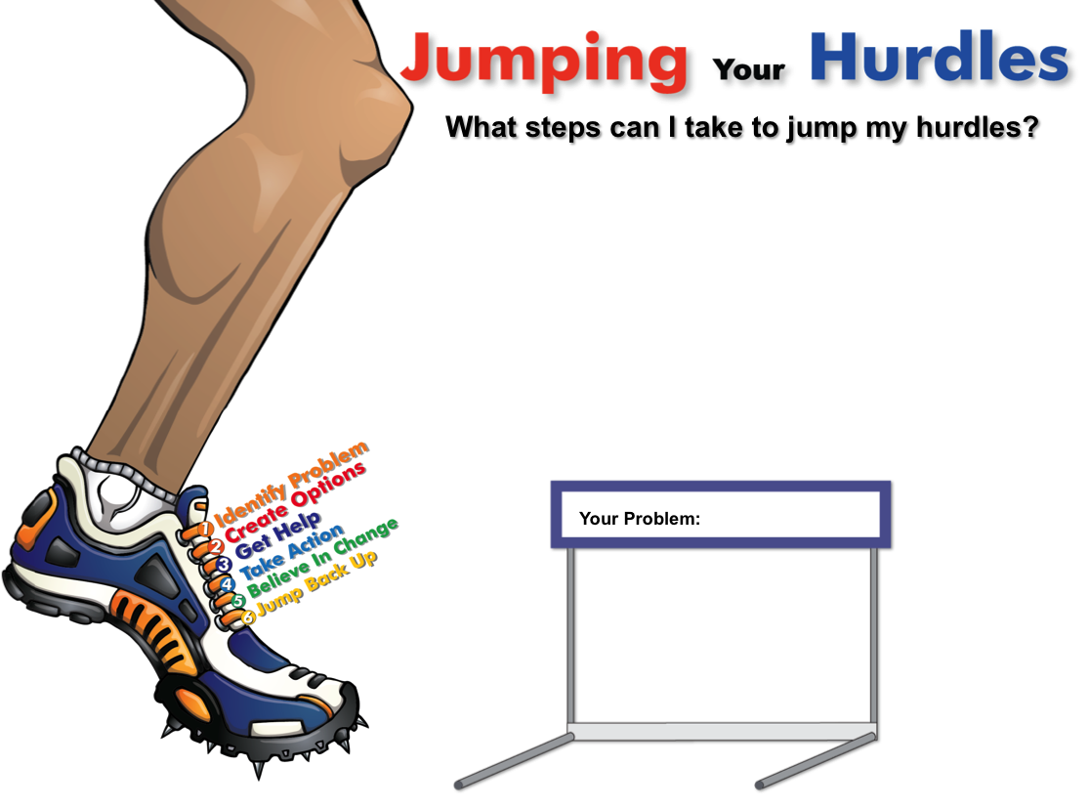
Jumping Your Hurdles
(Lesson Plan Template)

Slide 2

ATTENTION GETTER
Create your own attention-getter slide to start today’s lesson. This slide may include music, a story, an object lesson, a "Surrendering the One-up" activity, a group poll, or a brief movie clip.

Slide 3




Jumping Your Hurdles
Complete Metaphor
Animated Metaphor Walkthrough
Music
Learning
Journal
Video

Slide 4
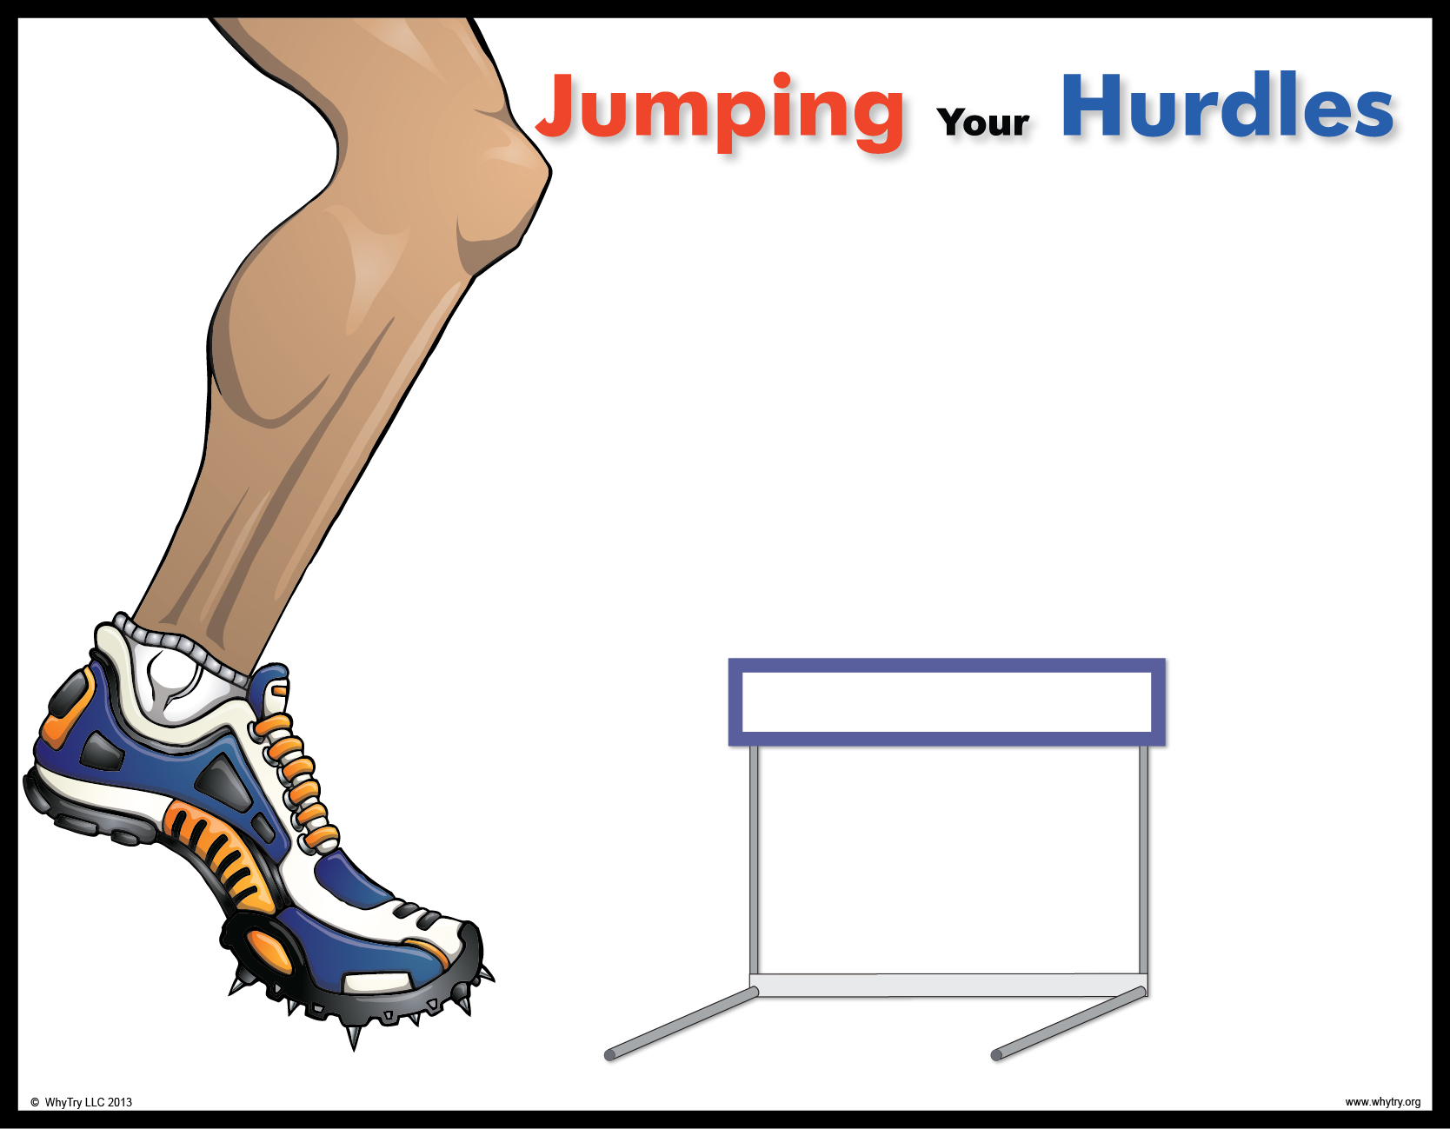

2
What have you
jumped over?
6
1. Identify Problem:
4. Take Action:
3
What can you jump over?
What problem do you really want to overcome?
What specific behaviors (actions) do you need to stop or add to jump my hurdle?
Stopped Behaviors Added Behaviors
4
Why should you try to jump your hurdle?
2. Create Options:
What are some options you can create?
5. Believe in Change:
On a scale from one to ten, circle where you are in believing change will happen.
“I can’t
change”
“Maybe”
“I know I have
the strength”
3. Get Help:
1. 2. 3. 4. 5. 6. 7. 8. 9. 10.
Who can help you get over your hurdle?
Who can you help?
6. Jump Back Up:
If you trip, how will jumping back up make you stronger?
1
Your Problem:
You Only Lose
If You
Give
Up!
What should your “self-talk” be telling you as you try to jump your hurdle?
5
Strengths:
© WhyTry, LLC 2013
www.whytry.org

Slide 5
2
What have you
jumped over?
6
1. Identify Problem:
4. Take Action:
3
What can you jump over?
What problem do you really want to overcome?
What specific behaviors (actions) do you need to stop or add to jump my hurdle?
Stopped Behaviors Added Behaviors
4
Why should you try to jump your hurdle?
2. Create Options:
What are some options you can create?
5. Believe in Change:
On a scale from one to ten, circle where you are in believing change will happen.
“I can’t
change”
“Maybe”
“I know I have
the strength”
3. Get Help:
1. 2. 3. 4. 5. 6. 7. 8. 9. 10.
Who can help you get over your hurdle?
Who can you help?
6. Jump Back Up:
If you trip, how will jumping back up make you stronger?
1
Your Problem:
You Only Lose
If You
Give
Up!
What should your “self-talk” be telling you as you try to jump your hurdle?
5
Strengths:
© WhyTry, LLC 2013
www.whytry.org

Slide 6
Music
Create your own music activity slide. This may include a WhyTry music video, a song of your own, or a song a student has shared.

Slide 7
Activity
Create your own learning activity slide. This may include either an object lesson, a group activity, or a group / movement activity. This slide may include instructions /rules for the activity or a relevant visual prompt to introduce the activity.

Slide 8
Journal
Create your own journal activity slide. This slide may include an art activity, observation activity, or game plan exercise from the WhyTry student journal. This slide may contain the actual journal page or a relevant visual prompt to introduce the journal activity.

Slide 9
Video
Create your own video activity slide. This slide may include one of WhyTry’s recommended YouTube clips that you have downloaded and embedded here, or any other relevant video clip reinforcing some aspect of today’s lesson. Videos may be funny, serious, documentary style, etc. This is a good opportunity to differentiate your approach to best meet your student’s needs.

