Slide 1
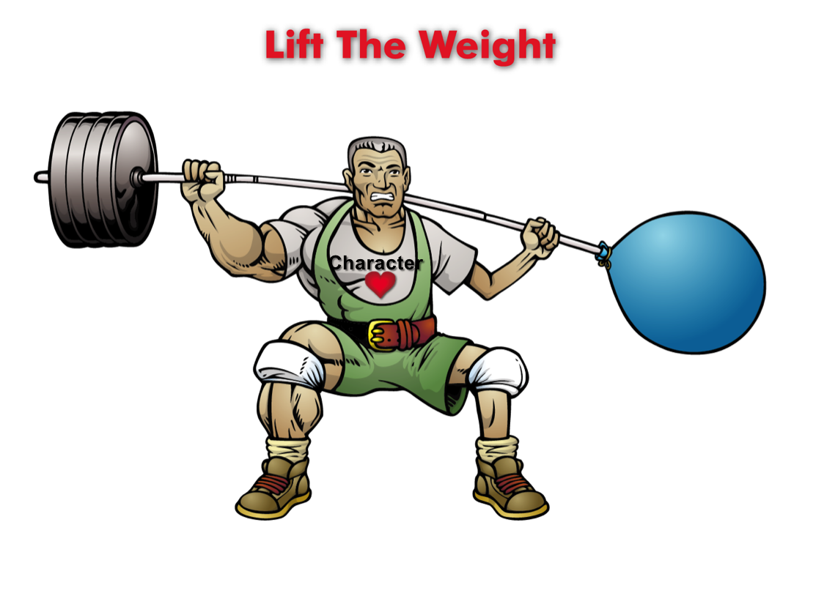
Lift The Weight
(Lesson Plan Template)

Slide 2

ATTENTION GETTER
Create your own attention-getter slide to start today’s lesson. This slide may include music, a story, an object lesson, a "Surrendering the One-up" activity, a group poll, or a brief movie clip.

Slide 3




Lift The Weight
Complete Metaphor
Animated Metaphor Walkthrough
Music
Learning
Journal
Video

Slide 4
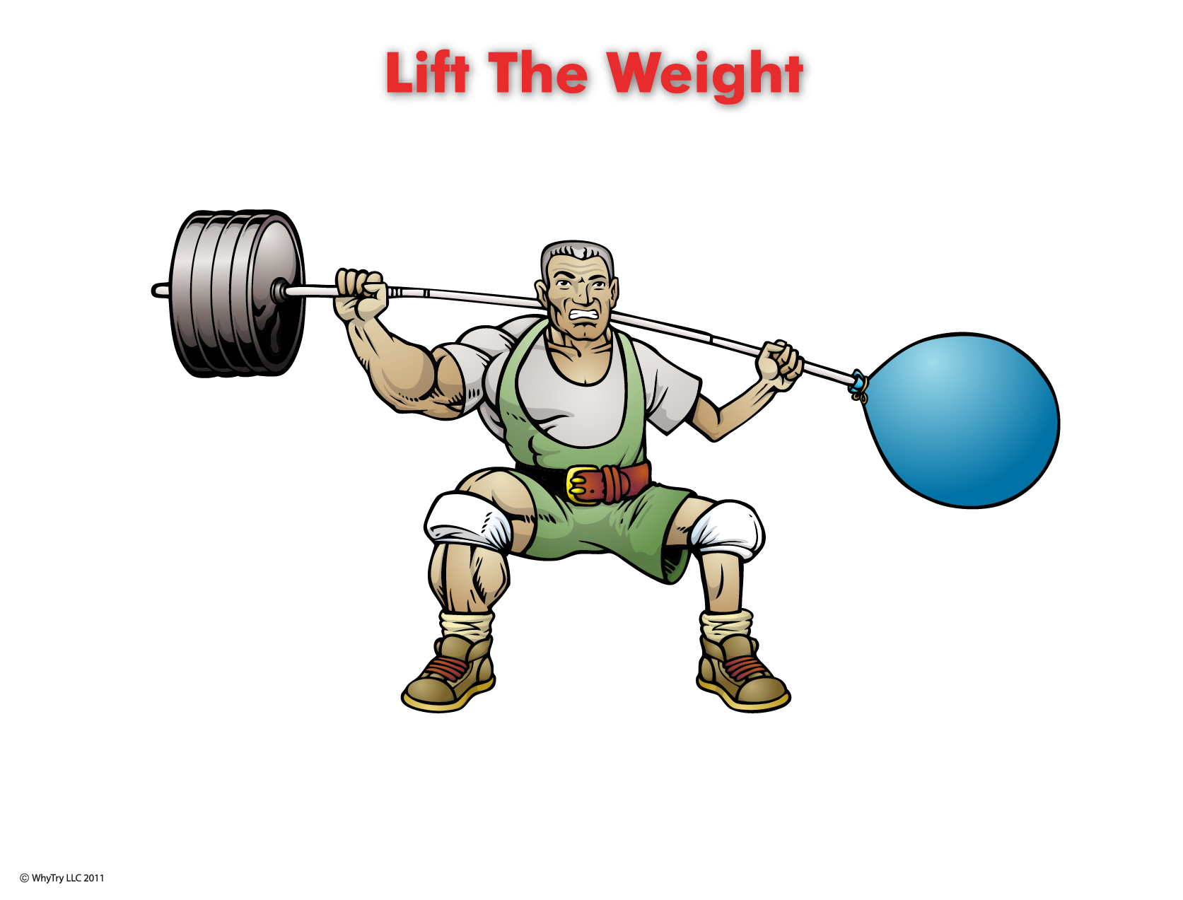

1
Why do you need resistance to become stronger?
2
What is expected of you from?
Parents: (rules)
School: (rules)
Society: (laws)
Yourself: (self-discipline)
6
Why does this need to be your strongest muscle?
Choice
3
What things get you into the most trouble?
Character
Challenge
What have you given up on?
“Hard”
A lot of resistance
“Easy”
No resistance
4
What are three things that you put most of your time and effort into?
Why does giving up make you weak?
1.
2.
3.
5
What are three new things you could do with your time that will make you stronger?
Do any of these things
give you Opportunity,
Freedom, and Self-Respect?
1.
2.
3.
If “yes,” keep lifting . . . If “no,” create a new workout

Slide 5
1
Why do you need resistance to become stronger?
2
What is expected of you from?
Parents: (rules)
School: (rules)
Society: (laws)
Yourself: (self-discipline)
6
Why does this need to be your strongest muscle?
Choice
3
What things get you into the most trouble?
Character
Challenge
What have you given up on?
“Hard”
A lot of resistance
“Easy”
No resistance
4
What are three things that you put most of your time and effort into?
Why does giving up make you weak?
1.
2.
3.
5
What are three new things you could do with your time that will make you stronger?
Do any of these things
give you Opportunity,
Freedom, and Self-Respect?
1.
2.
3.
If “yes,” keep lifting . . .
if “no,” create a new workout

Slide 6
Music
Create your own music activity slide. This may include a WhyTry music video, a song of your own, or a song a student has shared.

Slide 7
Activity
Create your own learning activity slide. This may include either an object lesson, a group activity, or a group / movement activity. This slide may include instructions /rules for the activity or a relevant visual prompt to introduce the activity.

Slide 8
Journal
Create your own journal activity slide. This slide may include an art activity, observation activity, or game plan exercise from the WhyTry student journal. This slide may contain the actual journal page or a relevant visual prompt to introduce the journal activity.

Slide 9
Video
Create your own video activity slide. This slide may include one of WhyTry’s recommended YouTube clips that you have downloaded and embedded here, or any other relevant video clip reinforcing some aspect of today’s lesson. Videos may be funny, serious, documentary style, etc. This is a good opportunity to differentiate your approach to best meet your student’s needs.

