Slide 1
ATTENTION GETTER
Create your own attention-getter slide to start today’s lesson. This slide may include music, a story, an object lesson, a "Surrendering the One-up" activity, a group poll, or a brief movie clip.

Slide 2
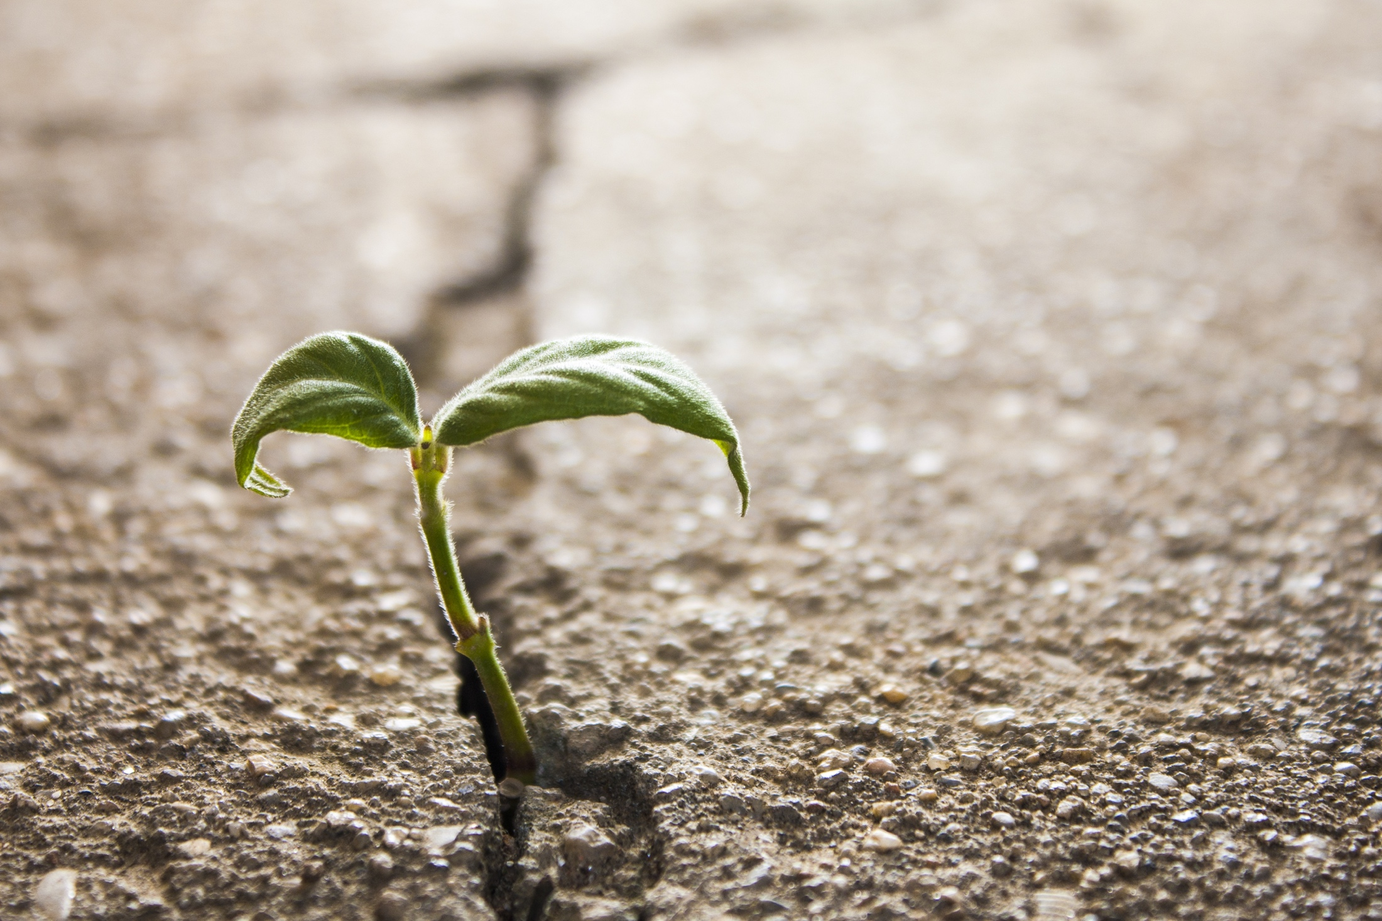
RESILIENCE

Slide 3





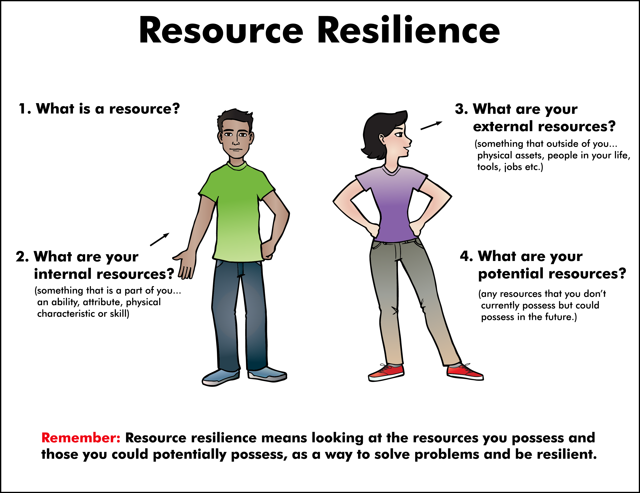
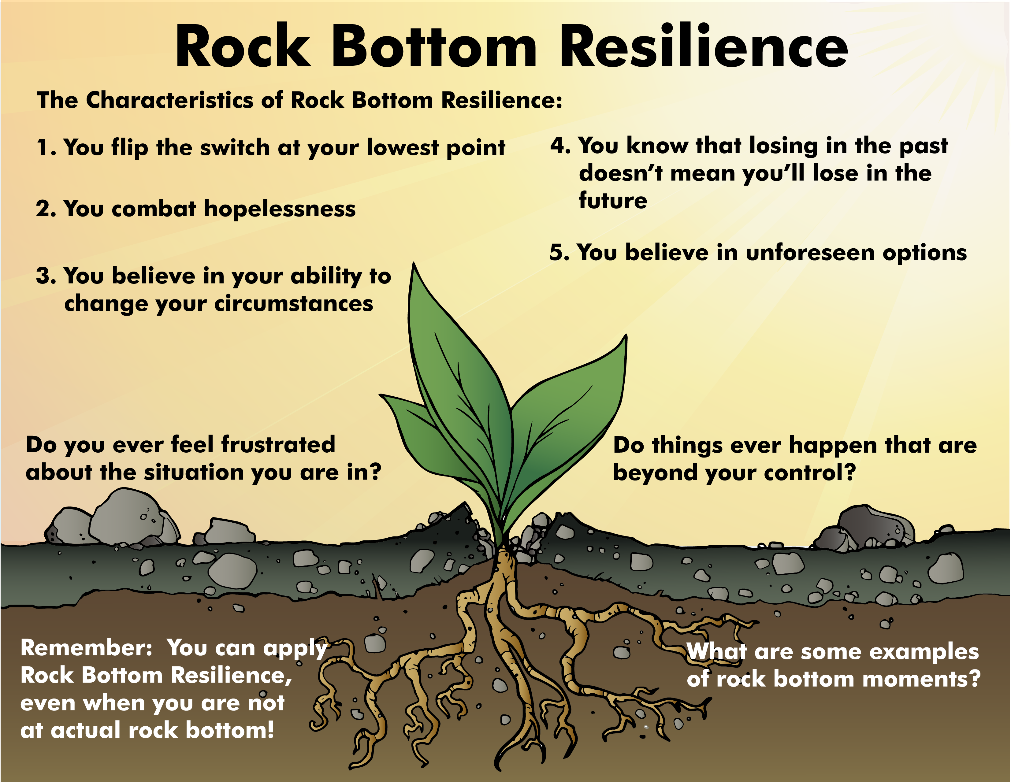
THE 4 SOURCES OF RESILIENCE
RELATIONAL RESILIENCE
STREET RESILIENCE
RESOURCE RESILIENCE
ROCK BOTTOM RESILIENCE

Slide 4






Relational
Rock Bottom
Street
Resource
Animated Metaphor Walkthrough
Single Picture Metaphor (non animated)
Learning Activities
Journal Prompt
Video Clip

Slide 5


Relational
Rock Bottom
Resource
Street

Slide 6
Relational
Rock Bottom
Resource
Street

Slide 7
Activity
Create your own learning activity slide. This may include either an object lesson, a group activity, or a group / movement activity. This slide may include instructions /rules for the activity or a relevant visual prompt to introduce the activity.

Slide 8
Journal
Create your own journal activity slide. This slide may include an art activity, observation activity, or game plan exercise from the WhyTry student journal. This slide may contain the actual journal page or a relevant visual prompt to introduce the journal activity.

Slide 9
Video
Create your own slide with a video clip embedded from our list of videos from youtube or other online resources. *note this will require that you download the clip in order to insert it into your presentation. There are some free apps listed on the website that you can use to download online video clips for your lesson.

