Slide 1
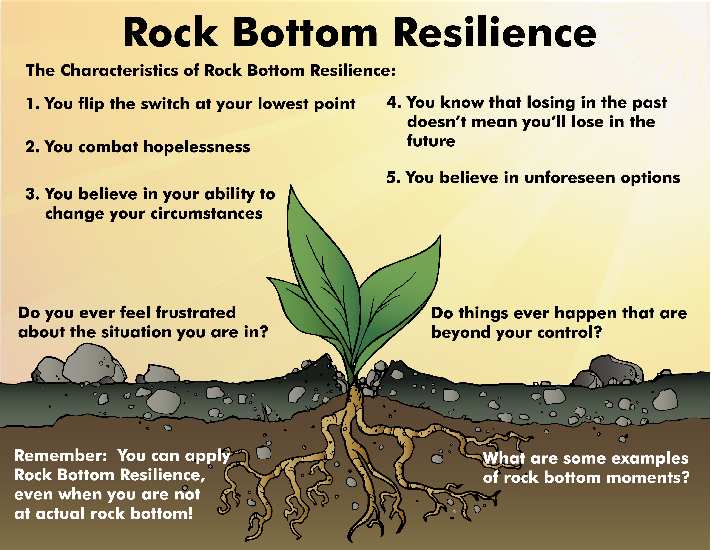

Slide 2
ATTENTION GETTER
Create your own attention-getter slide to start today’s lesson. This slide may include music, a story, an object lesson, a "Surrendering the One-up" activity, a group poll, or a brief movie clip.

Slide 3



Animated Metaphor Walkthrough
Single Picture Metaphor (non animated)
Learning Activities
Journal Prompt
Video Clip

Slide 4


Rock Bottom Resilience
When you’re at your lowest point, you believe in your ability to change your circumstances, combat hopelessness, and fight on.
You take control of the present, knowing that losing in the past does not equal losing in the future.
You refuse to be defined by the negative labels you’ve been given, whether by yourself or others.
You are able to believe in potential unforeseen options even during your most difficult times.
(You put one foot in front of another when you have every reason to give up)

Slide 5
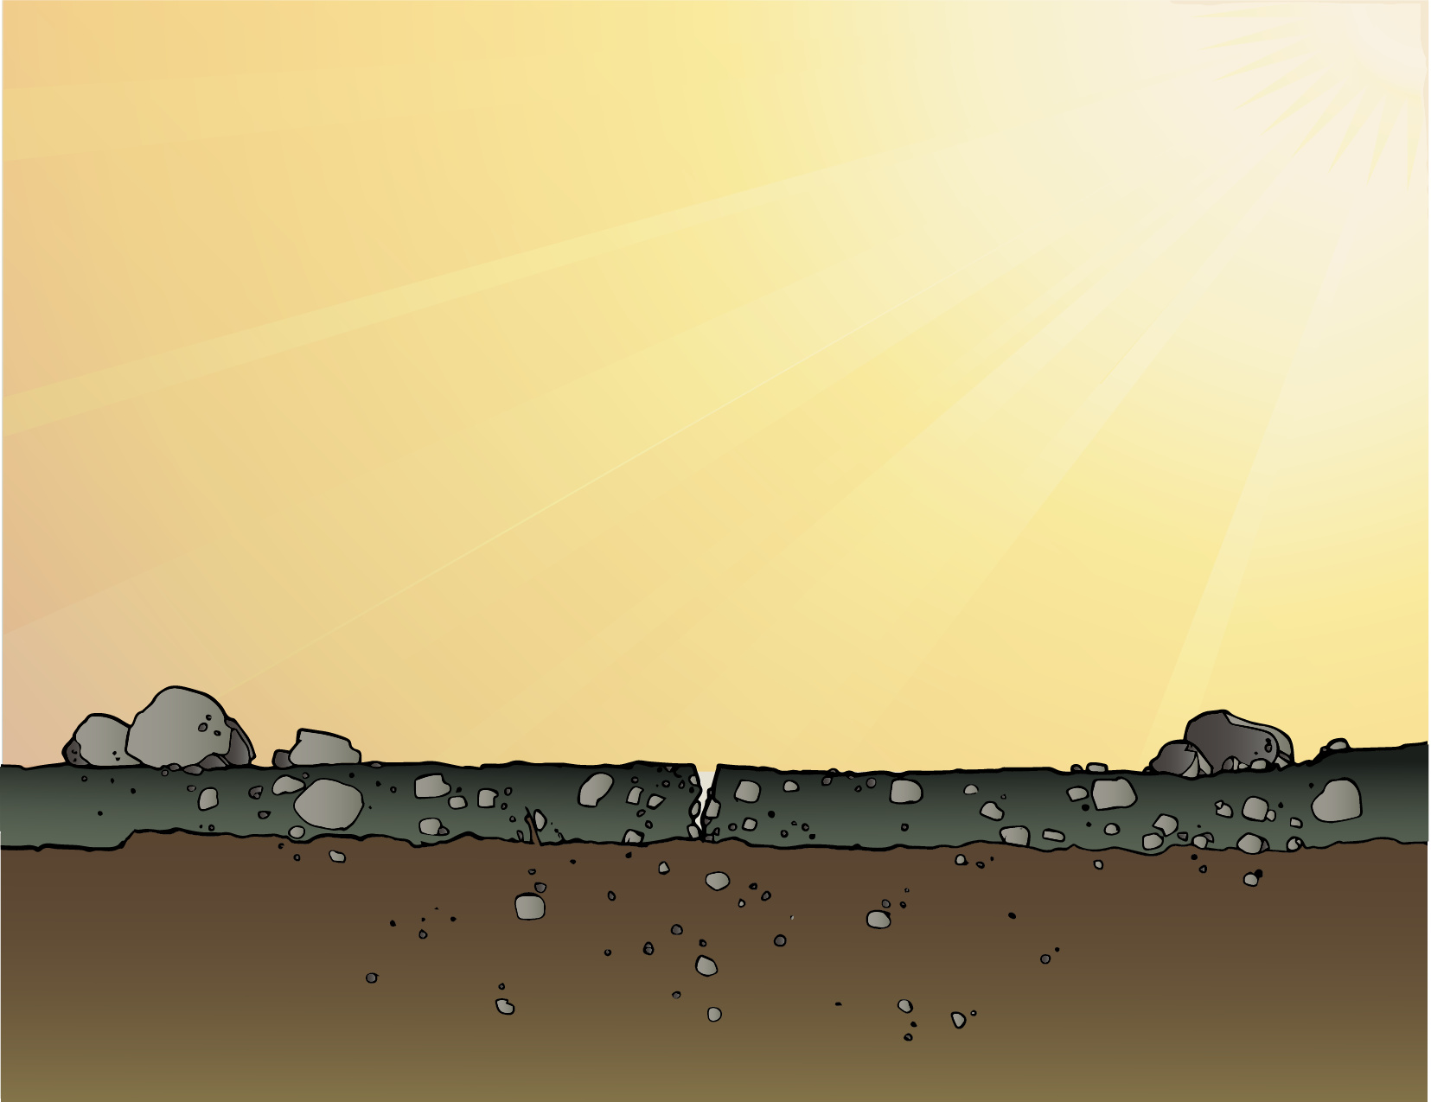
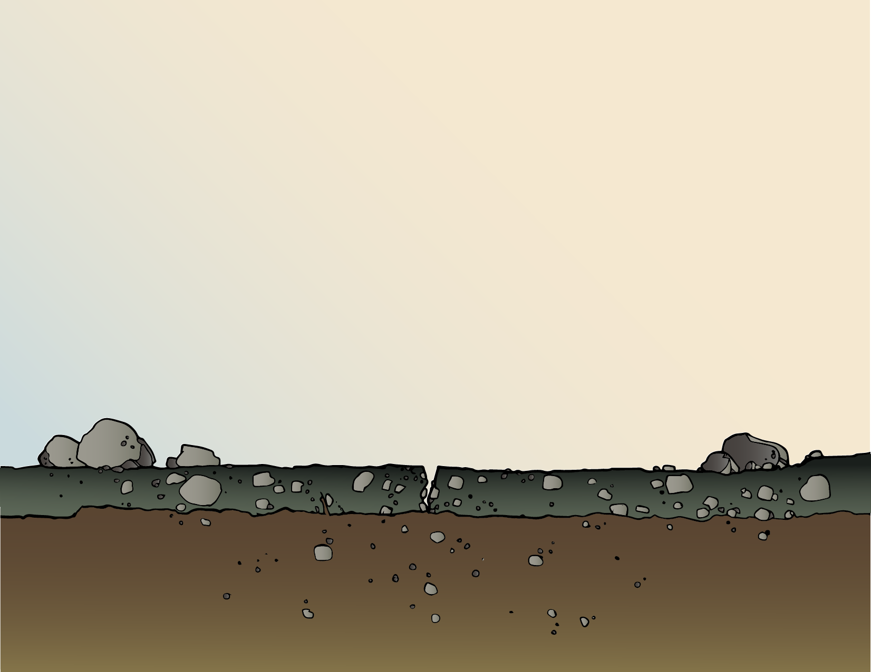

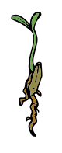

Rock Bottom Resilience
Have you ever seen a seed blowing in the wind and wondered where it will end up?
Can a seed control the environment it ends up in?
Do things ever happen that are beyond your control?
What does a seed need to grow?
Do you ever feel frustrated about the
situation you are in?
What is the difference between
actual rock bottom and your
personal rock bottom?
What are some examples of
rock bottom moments?

Slide 6
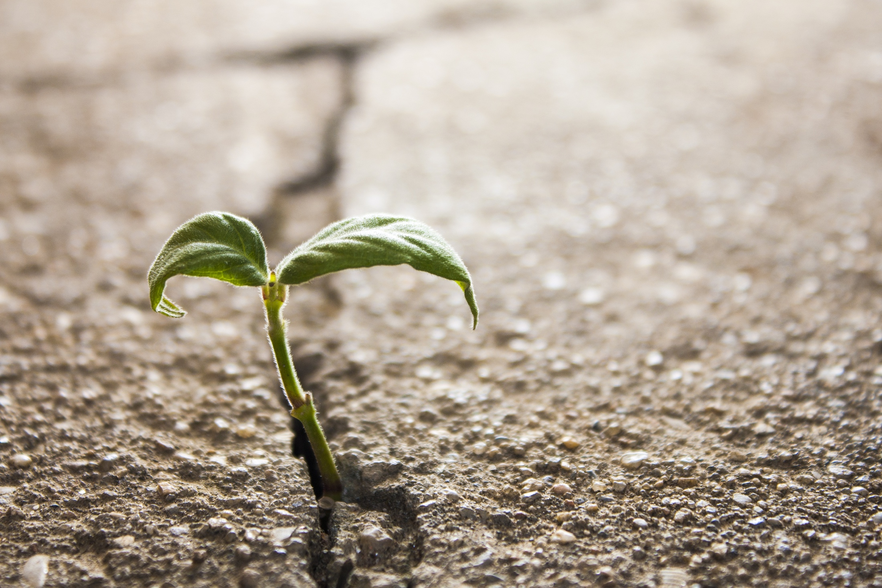

Slide 7
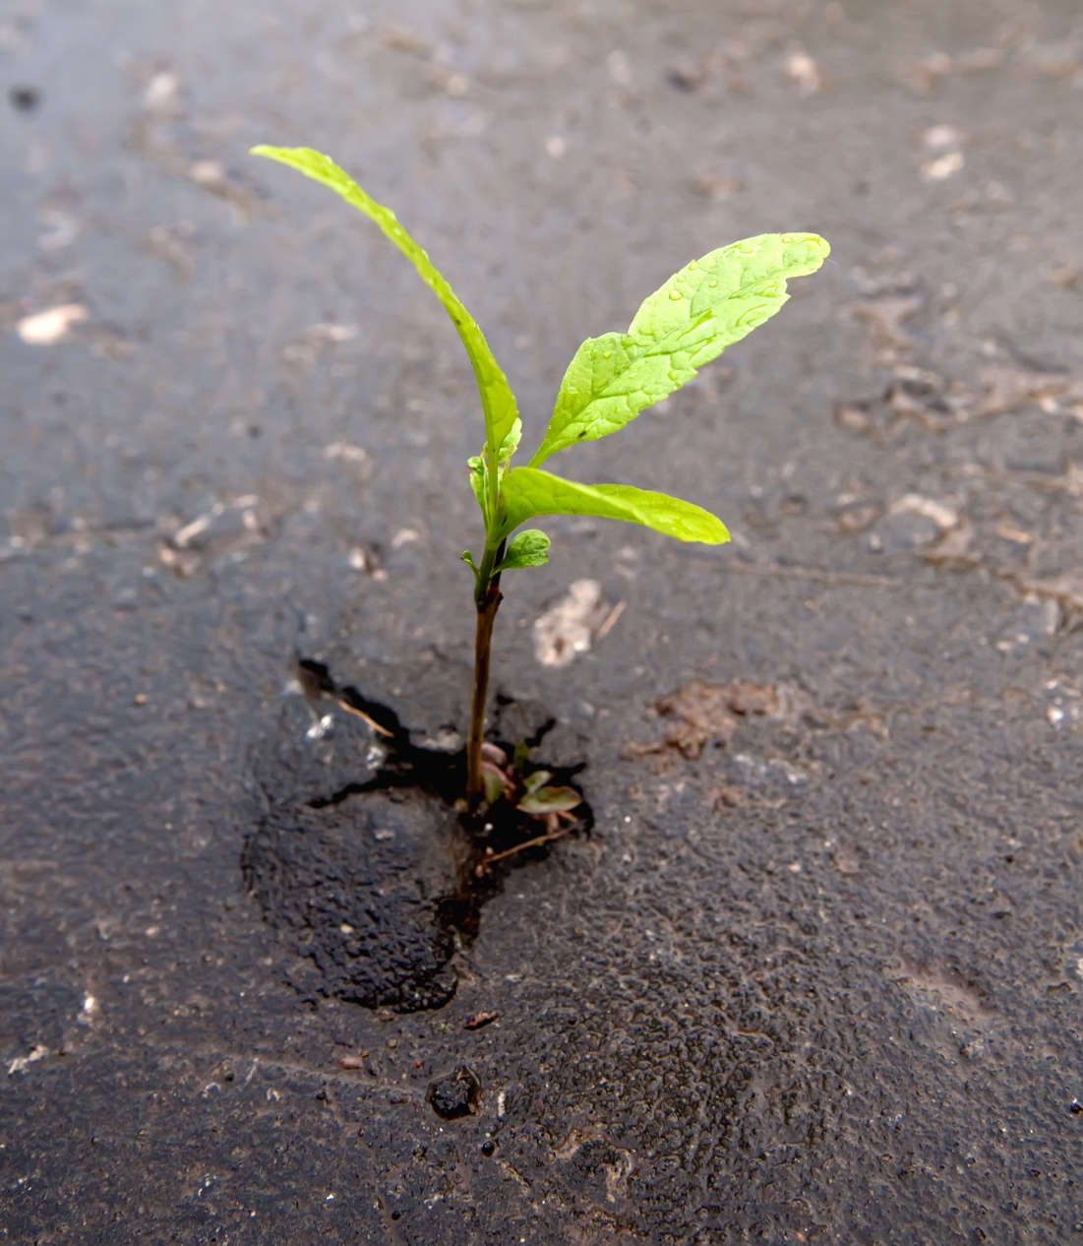

Slide 8
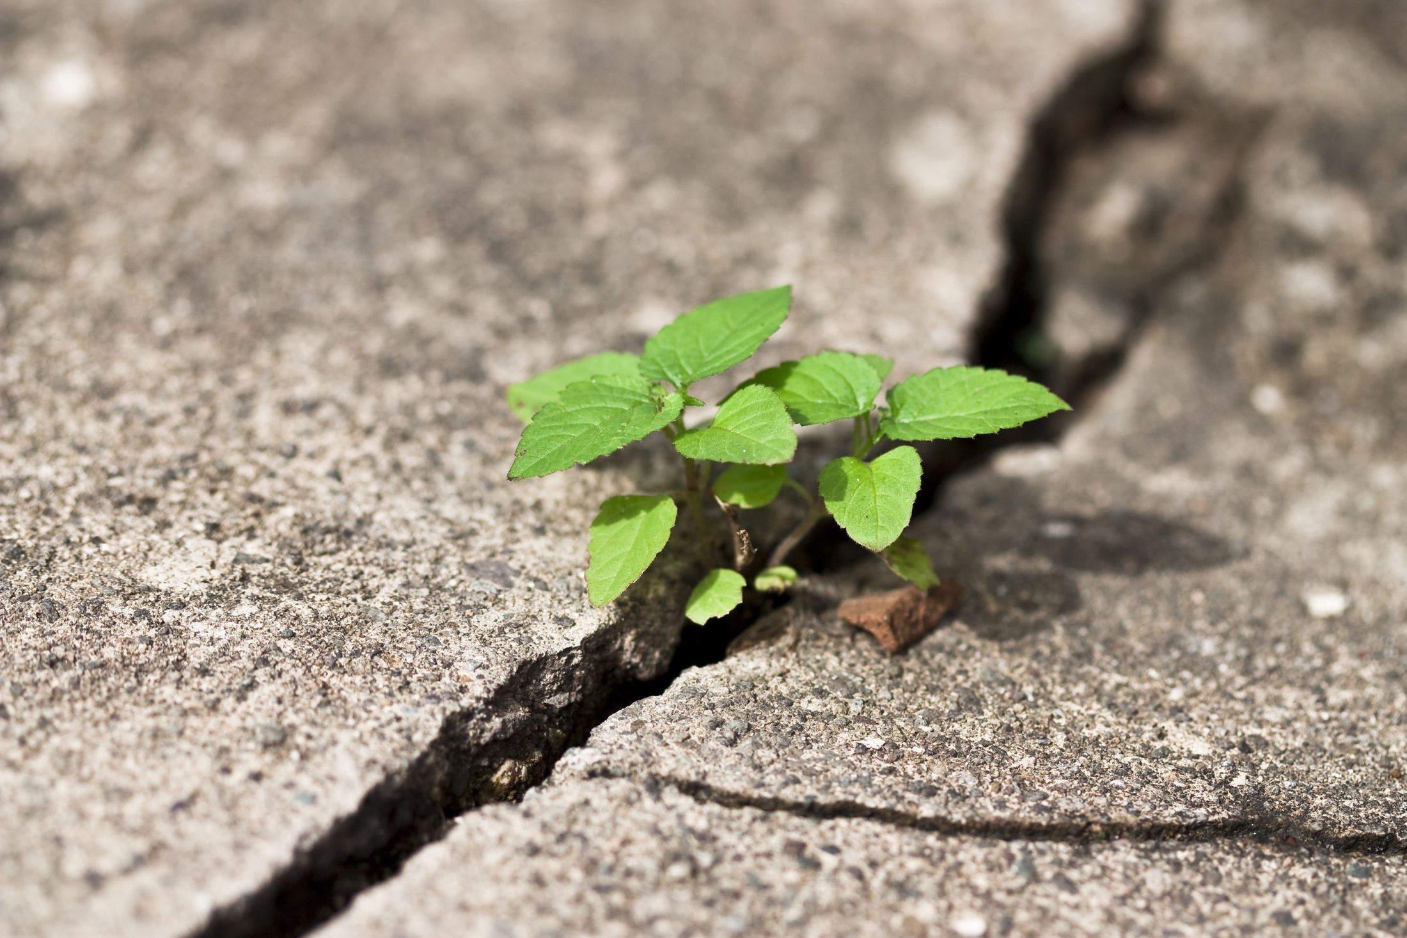

Slide 9


Rock Bottom Resilience
The Characteristics of Rock Bottom Resilience:
You flip the switch at your lowest point
4. You know that losing in the past
doesn’t mean you’ll lose in the future
2. You combat hopelessness
5. You believe in unforeseen options
3. You believe in your ability to
change your circumstances
Remember:
You can apply Rock Bottom Resilience even when you’re not at actual rock bottom!

Slide 10
Notes:
Change Up H

Slide 11
Activity
Create your own learning activity slide. This may include either an object lesson, a group activity, or a group / movement activity. This slide may include instructions /rules for the activity or a relevant visual prompt to introduce the activity.

Slide 12
Journal
Create your own journal activity slide. This slide may include an art activity, observation activity, or game plan exercise from the WhyTry student journal. This slide may contain the actual journal page or a relevant visual prompt to introduce the journal activity.

Slide 13
Video
Create your own Video Activity slide. This slide may include one of WhyTry’s recommended YouTube clips that you have downloaded and embedded into this slide, or any other relevant video clip reinforcing some aspect of today’s lesson. Videos may be funny, serious, documentary style, etc. This is a good opportunity to differentiate your approach to best meet your student’s needs.
*note this will require that you download the clip in order to insert it into your presentation. There are some free apps listed on the website that you can use to download online video clips for your lesson.

