Slide 1
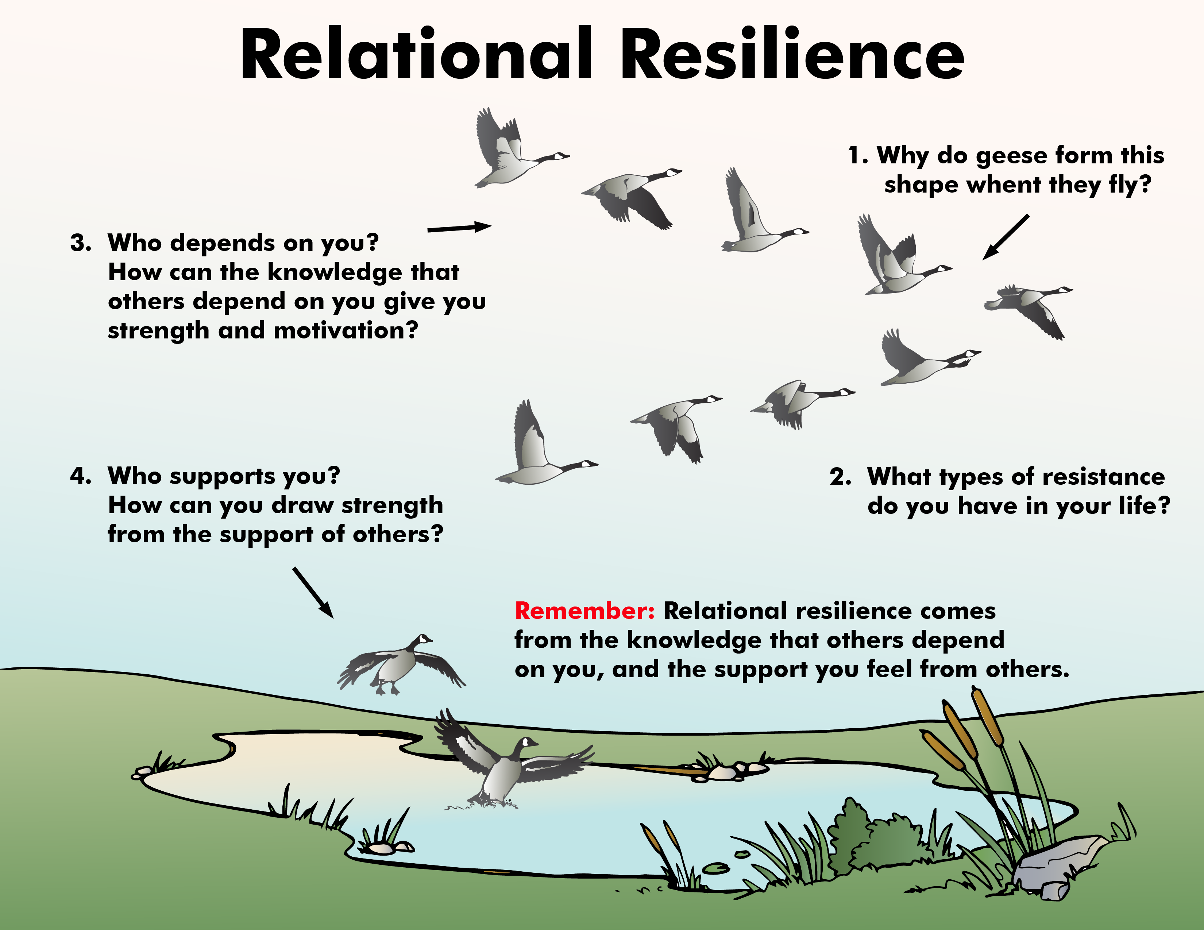

Slide 2
ATTENTION GETTER
Create your own attention-getter slide to start today’s lesson. This slide may include music, a story, an object lesson, a "Surrendering the One-up" activity, a group poll, or a brief movie clip.

Slide 3



Animated Metaphor Walkthrough
Single Picture Metaphor (non animated)
Learning Activities
Journal Prompt
Video Clip

Slide 4
Relational Resilience
Your greatest motivation to not give up is the knowledge that others depend on you.
Insert a picture of you and your family, a friend or significant other
You draw strength from the emotional support of others.
You realize that your greatest power comes from human connection.

Slide 5
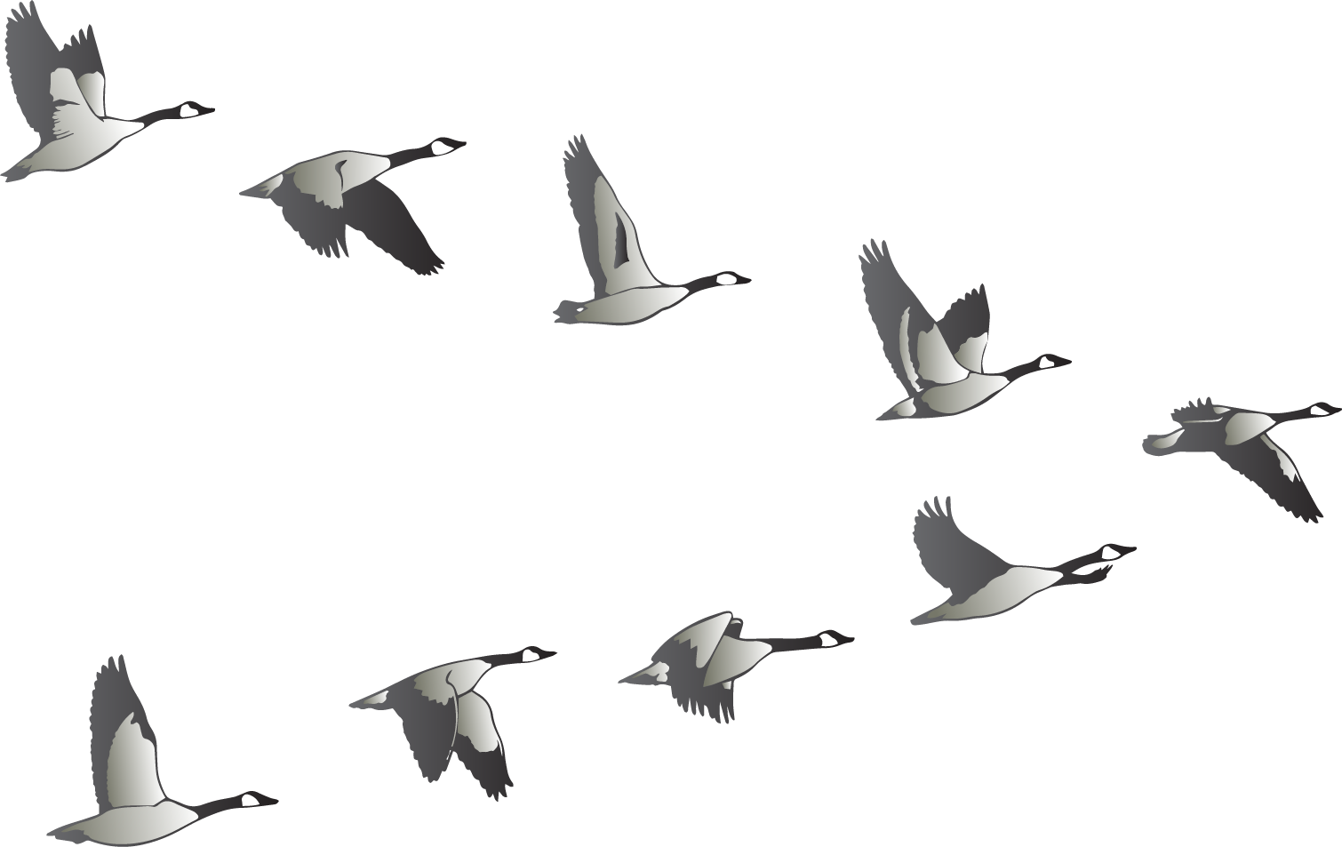
Relational Resilience
Have you ever been amazed watching birds fly?
What do you call a flock of geese?
Have you ever noticed a gaggle of geese flying?
What shape do geese form when they fly?

Slide 6
Relational Resilience
2. What types of resistance
do you have in your life?
1. Why do geese form this
shape when they fly?
What motivates you to move forward when you experience resistance in your life?

Slide 7
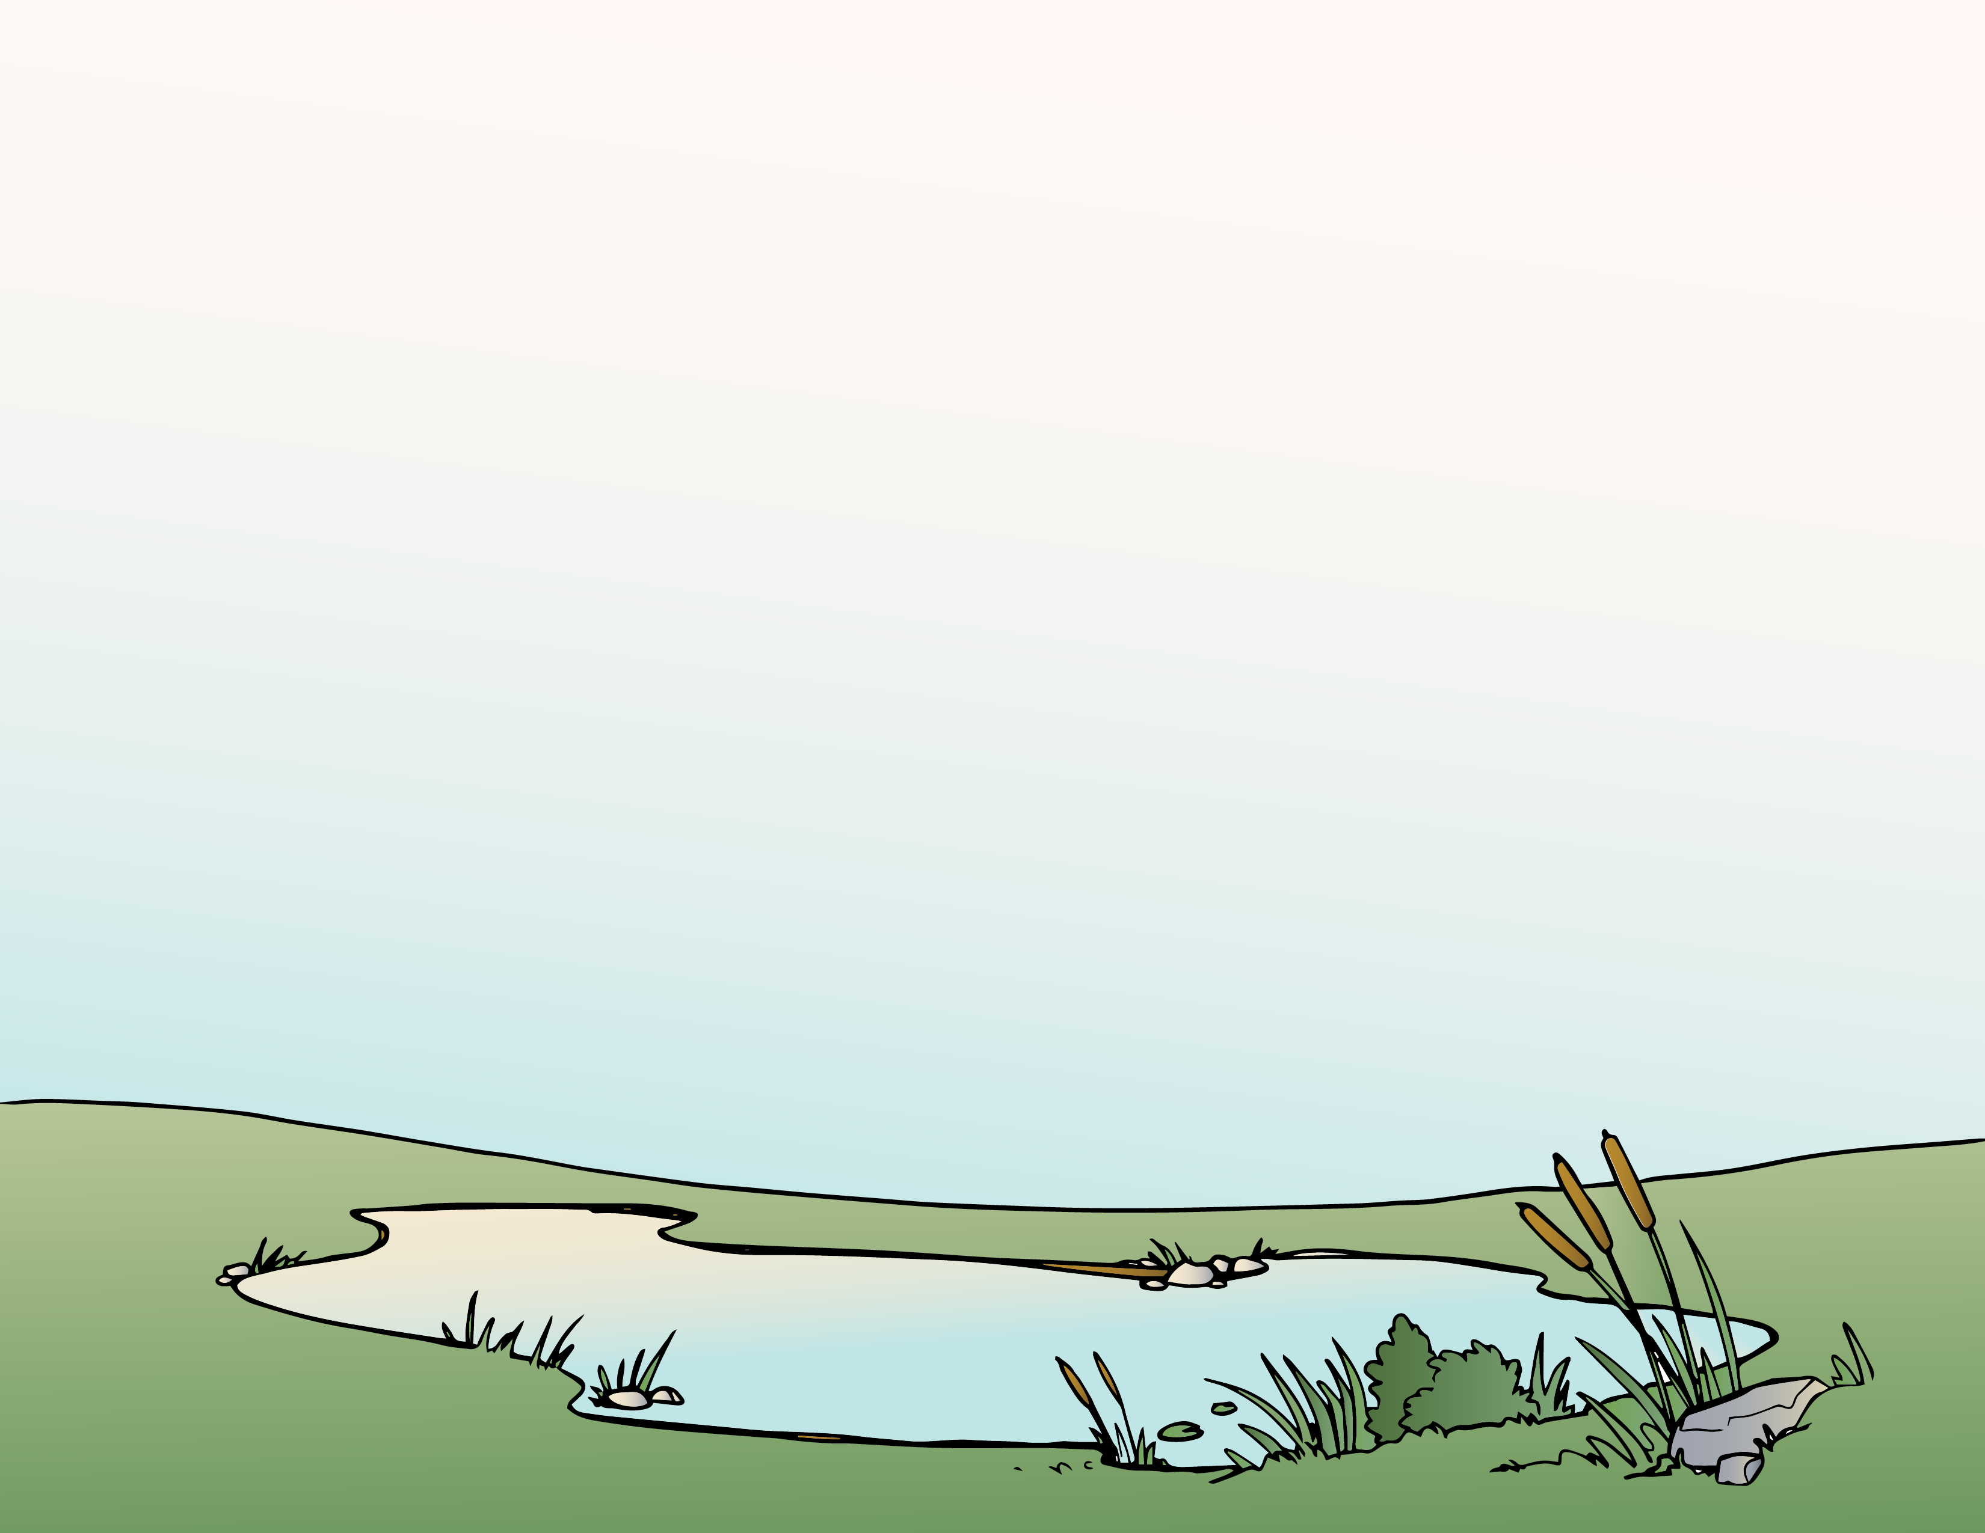

Relational Resilience
3. Who depends on you?
How can the knowledge that others depend on you give you strength and motivation?
4. Who supports you?
How can you draw strength from the support of others?

Slide 8
Relational Resilience
Remember: Relational resilience comes from the knowledge that others depend on you, and the support you feel from others.

Slide 9
Notes:
Change Up H

Slide 10
Activity
Create your own learning activity slide. This may include either an object lesson, a group activity, or a group / movement activity. This slide may include instructions /rules for the activity or a relevant visual prompt to introduce the activity.

Slide 11
Journal
Create your own journal activity slide. This slide may include an art activity, observation activity, or game plan exercise from the WhyTry student journal. This slide may contain the actual journal page or a relevant visual prompt to introduce the journal activity.

Slide 12
Video
Create your own Video Activity slide. This slide may include one of WhyTry’s recommended YouTube clips that you have downloaded and embedded into this slide, or any other relevant video clip reinforcing some aspect of today’s lesson. Videos may be funny, serious, documentary style, etc. This is a good opportunity to differentiate your approach to best meet your student’s needs.
*note this will require that you download the clip in order to insert it into your presentation. There are some free apps listed on the website that you can use to download online video clips for your lesson.

