Slide 1
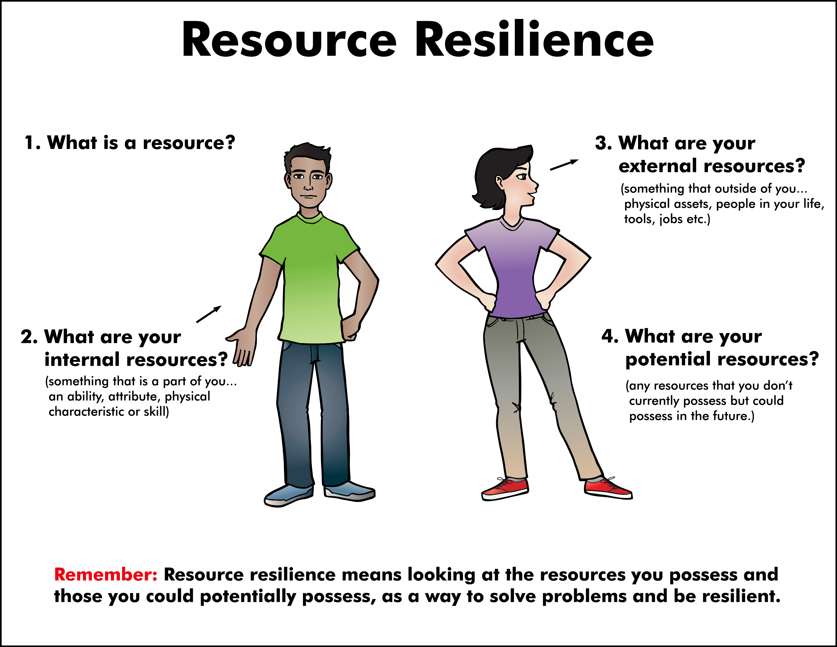

Slide 2
ATTENTION GETTER
Create your own attention-getter slide to start today’s lesson. This slide may include music, a story, an object lesson, a "Surrendering the One-up" activity, a group poll, or a brief movie clip.

Slide 3



Animated Metaphor Walkthrough
Single Picture Metaphor (non animated)
Learning Activities
Journal Prompt
Video Clip

Slide 4
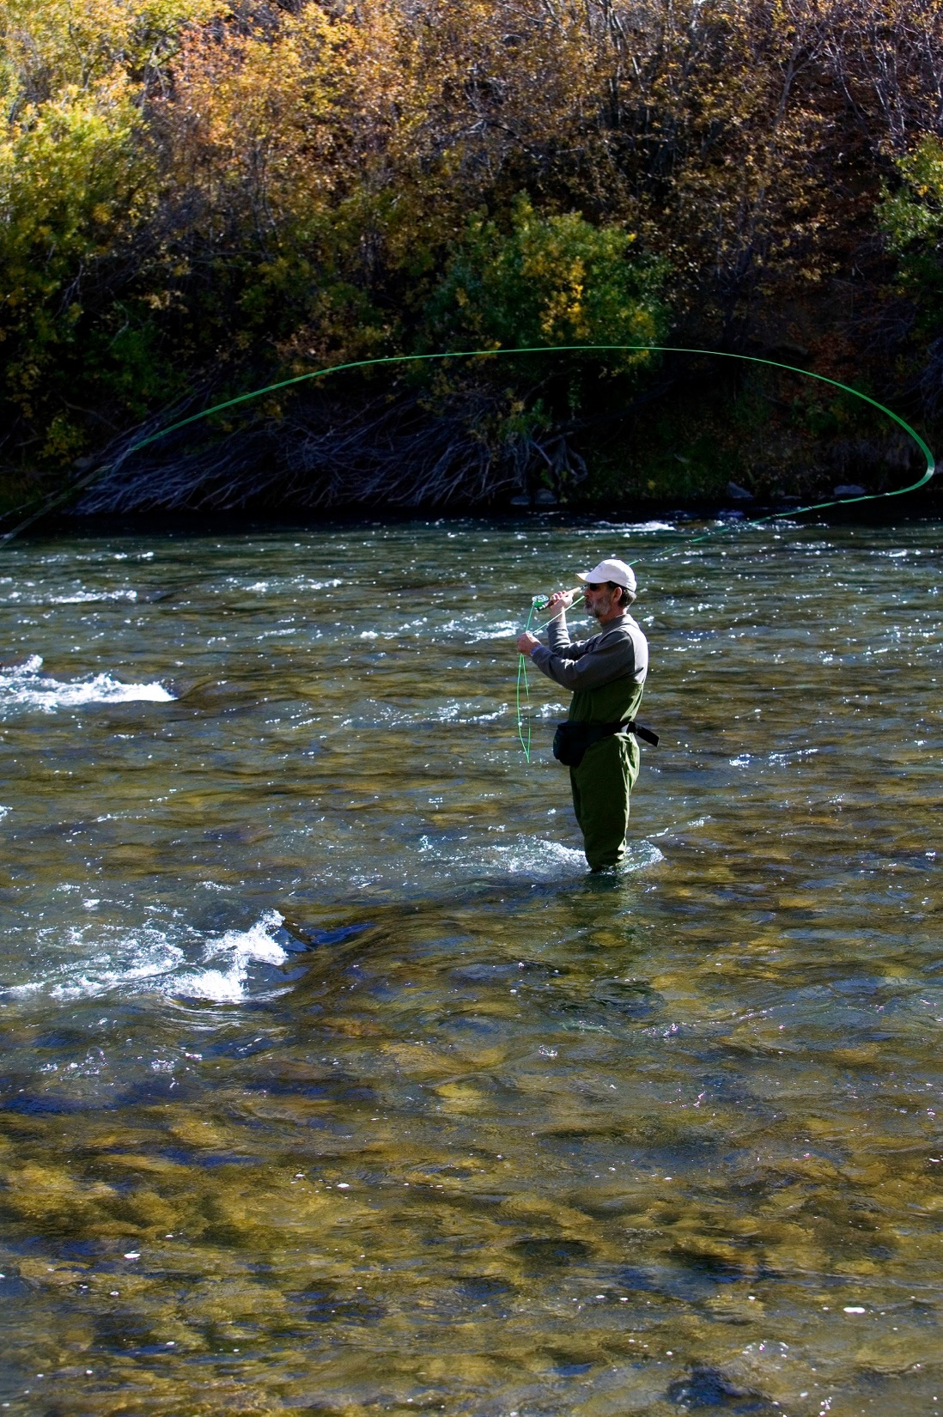

Resource Resilience
You recognize that your resilience can be increased by tapping into the resources available to you.
You fight resignation with spontaneity.
You realize that you have undeveloped talents and untapped capabilities that you can also use or develop.
You recognize that your resources include talents, relationships, physical assets, personality traits, and work ethic.

Slide 5


Resource Resilience
Make a list of as many things that you can think of that you are thankful for.
What items on that list could be considered resources?
Put a star next to the resources that are internal.
Put a check mark next to the resources that are external.

Slide 6
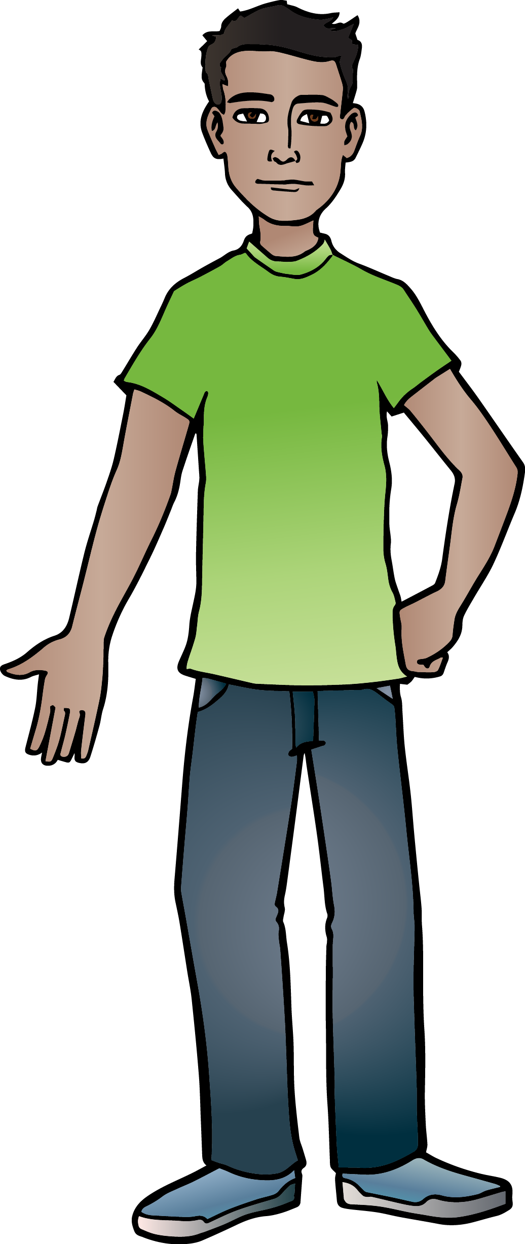
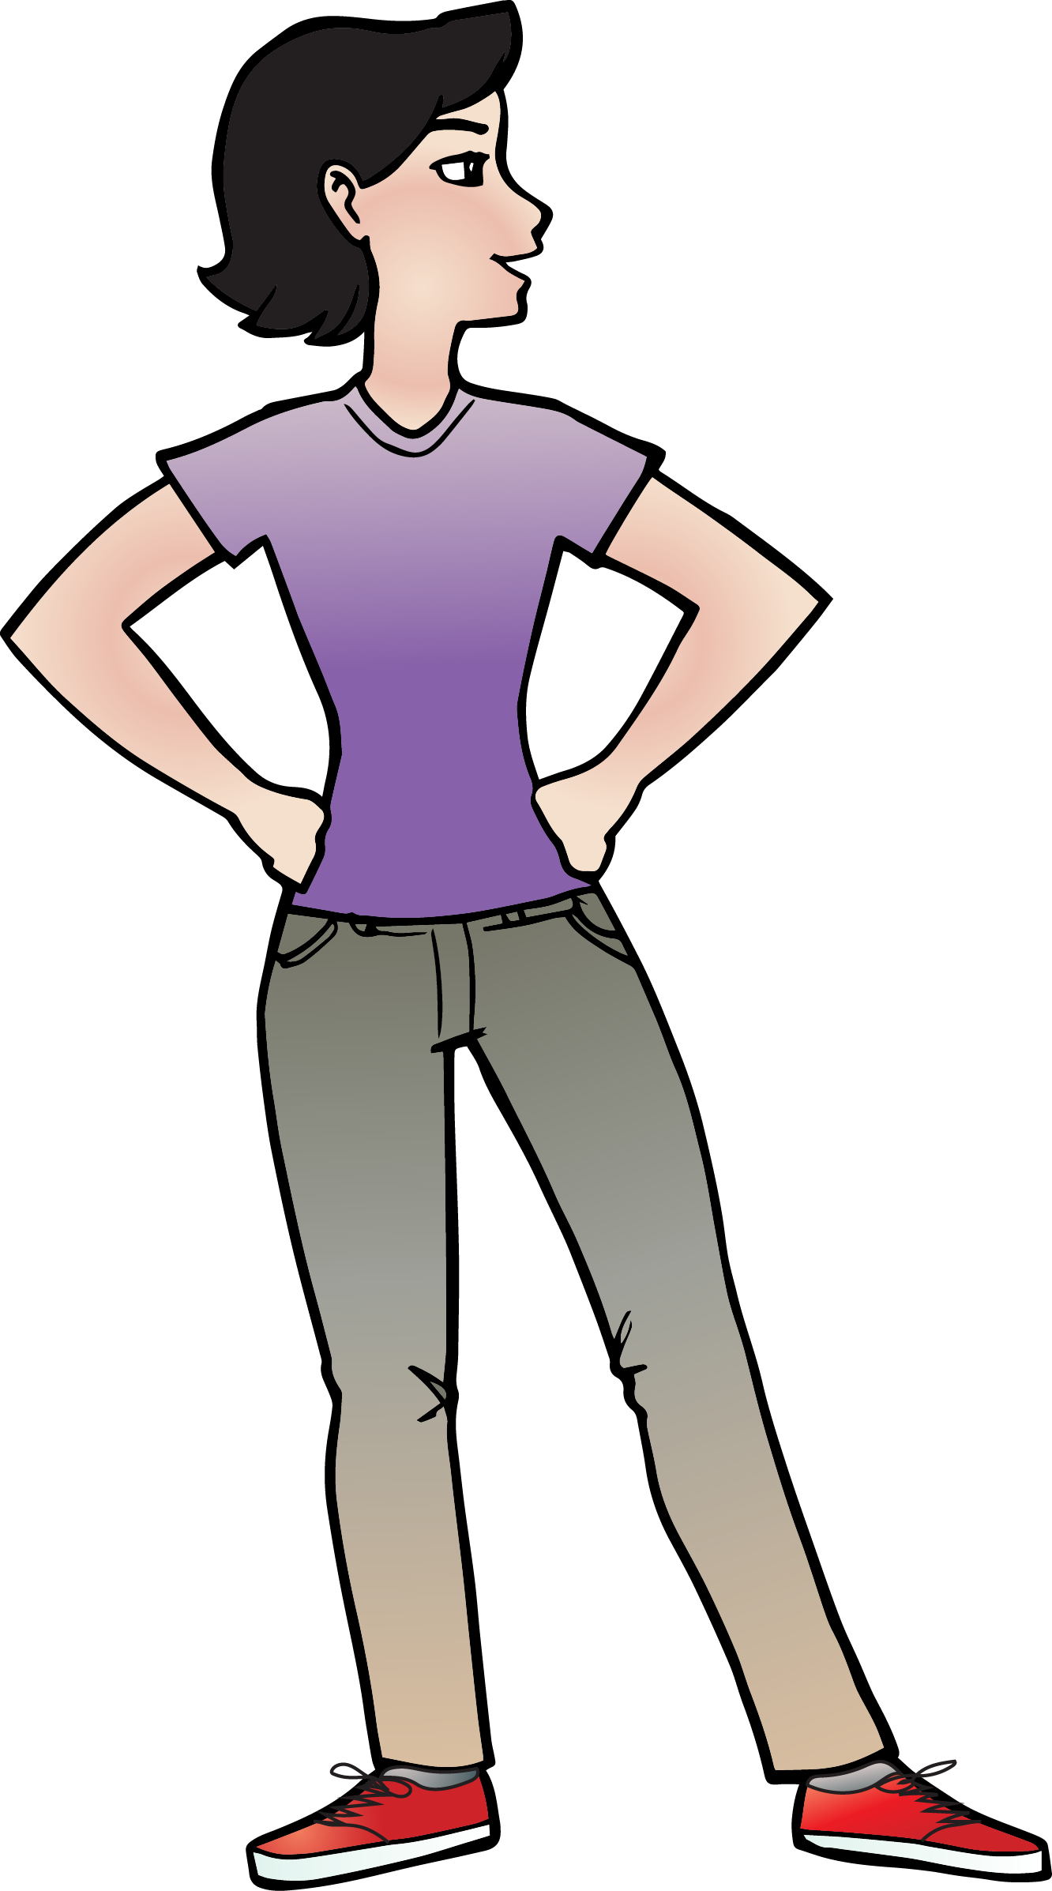
Resource Resilience
What is a resource?
re.source
[rēˌsôrs]
Noun
a source of supply, support or aid, especially one that can be readily drawn upon when needed.
capability in dealing with a
situation or in meeting
difficulties.

Slide 7
Resource Resilience
Internal Resources
External Resources
(something that is a part of you – an ability, attribute, physical characteristic or skill)
(something that outside of you – physical assets, people in your life, tools, jobs etc.)
Potential Resources
(any resources that you don’t currently possess but could possess in the future.)

Slide 8
Resource Resilience
How are your eyes
a resource?
How is your brain a resource?
How are your ears
a resource?
Internal Resources
How is your mouth
a resource?
How are your arms and hands a resource?
How are your legs and feet
a resource?
What can you do if you are weak in one of these resources?

Slide 9









Resource Resilience
External Resources
What things can you do with these resources that will help you to be resilient?
What type of physical assets might serve as an external resource?

Slide 10
Resource Resilience
Potential Resources
What are three things that you are good at?
Were you always good at those things?
What did you have to do to become strong in these areas?
Do you believe, at this moment, that you have all the resources you will ever possess?
Do you believe in your ability to acquire even more resources in life?

Slide 11
Resource Resilience
Remember: Resource resilience means looking at the resources you possess and the ones you could potentially possess, as a way to solve problems and be resilient.

Slide 12
Resource Resilience
Remember: Resource resilience means looking at the resources you possess and the ones you could potentially possess, as a way to solve problems and be resilient.

Slide 13
Notes:
Change Up H

Slide 14
Activity
Create your own learning activity slide. This may include either an object lesson, a group activity, or a group / movement activity. This slide may include instructions /rules for the activity or a relevant visual prompt to introduce the activity.

Slide 15
Journal
Create your own journal activity slide. This slide may include an art activity, observation activity, or game plan exercise from the WhyTry student journal. This slide may contain the actual journal page or a relevant visual prompt to introduce the journal activity.

Slide 16
Video
Create your own Video Activity slide. This slide may include one of WhyTry’s recommended YouTube clips that you have downloaded and embedded into this slide, or any other relevant video clip reinforcing some aspect of today’s lesson. Videos may be funny, serious, documentary style, etc. This is a good opportunity to differentiate your approach to best meet your student’s needs.
*note this will require that you download the clip in order to insert it into your presentation. There are some free apps listed on the website that you can use to download online video clips for your lesson.

