Slide 1
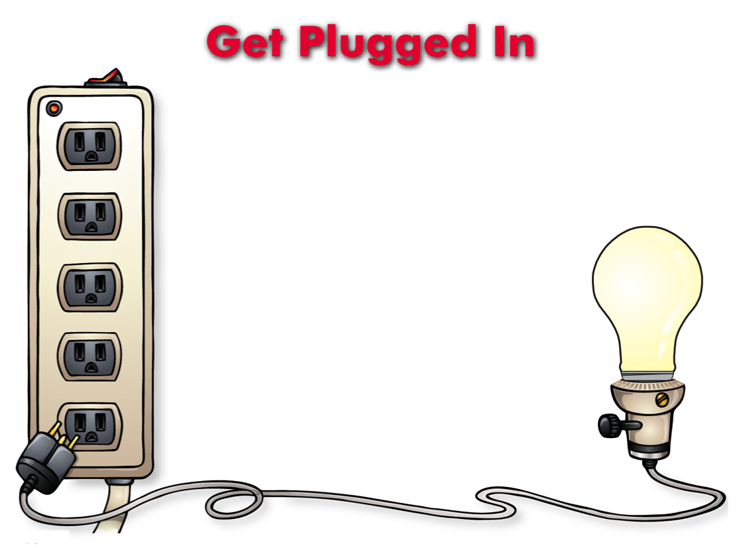
Get Plugged In
(Lesson Plan Template)

Slide 2

ATTENTION GETTER
Create your own attention-getter slide to start today’s lesson. This slide may include music, a story, an object lesson, a "Surrendering the One-up" activity, a group poll, or a brief movie clip.

Slide 3




Get Plugged In
Complete Metaphor
Animated Metaphor Walkthrough
Music
Learning
Journal
Video

Slide 4

1
Parent/Caregiver
How much time are you spending with your parent or care giver? (if you’re not spending at least 30
minutes a day then create and demand more time.)
What is one “conflict,” “argument,” or “power struggle” that you can give up today that won’t
hurt you but will help lower your parents anxiety about you?
2
Positive Friend
Remember – You know you have a “real “ friend if they do things that help (not hurt) themselves or you.
What could you do to help a friend overcome peer pressure and deal with challenges at home
and at school?
3
Teacher/Counselor/School Official
These 5
connections
will help turn on the
“light”
to see your future
more clearly
Make sure that someone at school knows the real you and what you can become
with their help. Ask how they help you reach your dreams and potential?
Let them know what you are willing to do, then work together with them to accomplish your goals
4
Positive Mentor
Who can you identify that has accomplished goals and dreams similar to those
that you want to accomplish.
What are three qualities about them that you respect and admire that
you would like to develop also?
Take a risk: If possible ask them how they can help you achieve the same thing.
5
Something that inspires or motivates you to do good
What motivates you to not hurt yourself and others?
What do you do with your time that’s fun, gives you self respect and doesn’t
get you into trouble? How can you do More of this?

Slide 5






1
Parent/Caregiver
How much time are you spending with your parent or care giver? (if you’re not spending at least 30
minutes a day then create and demand more time.)
What is one “conflict,” “argument,” or “power struggle” that you can give up today that won’t
hurt you but will help lower your parents anxiety about you?
2
Positive Friend
Remember – You know you have a “real “ friend if they do things that help (not hurt) themselves or you.
What could you do to help a friend overcome peer pressure and deal with challenges at home
and at school?
3
Teacher/Counselor/School Official
Make sure that someone at school knows the real you and what you can become
with their help. Ask how they help you reach your dreams and potential?
Let them know what you are willing to do, then work together with them to accomplish your goals
These 5
Connections
will help turn on the
“light”
to see your future
more clearly
4
Positive Mentor
Who can you identify that has accomplished goals and dreams similar to those
that you want to accomplish.
What are three qualities about them that you respect and admire that
you would like to develop also?
Take a risk: If possible ask them how they can help you achieve the same thing.
5
Something that inspires or motivates you to do good
What motivates you to not hurt yourself and others?
What do you do with your time that’s fun, gives you self respect and doesn’t
get you into trouble? How can you do More of this?

Slide 6
Music
Create your own music activity slide. This may include a WhyTry music video, a song of your own, or a song a student has shared.

Slide 7
Activity
Create your own learning activity slide. This may include either an object lesson, a group activity, or a group / movement activity. This slide may include instructions /rules for the activity or a relevant visual prompt to introduce the activity.

Slide 8
Journal
Create your own journal activity slide. This slide may include an art activity, observation activity, or game plan exercise from the WhyTry student journal. This slide may contain the actual journal page or a relevant visual prompt to introduce the journal activity.

Slide 9
Video
Create your own video activity slide. This slide may include one of WhyTry’s recommended YouTube clips that you have downloaded and embedded here, or any other relevant video clip reinforcing some aspect of today’s lesson. Videos may be funny, serious, documentary style, etc. This is a good opportunity to differentiate your approach to best meet your student’s needs.

