Slide 1
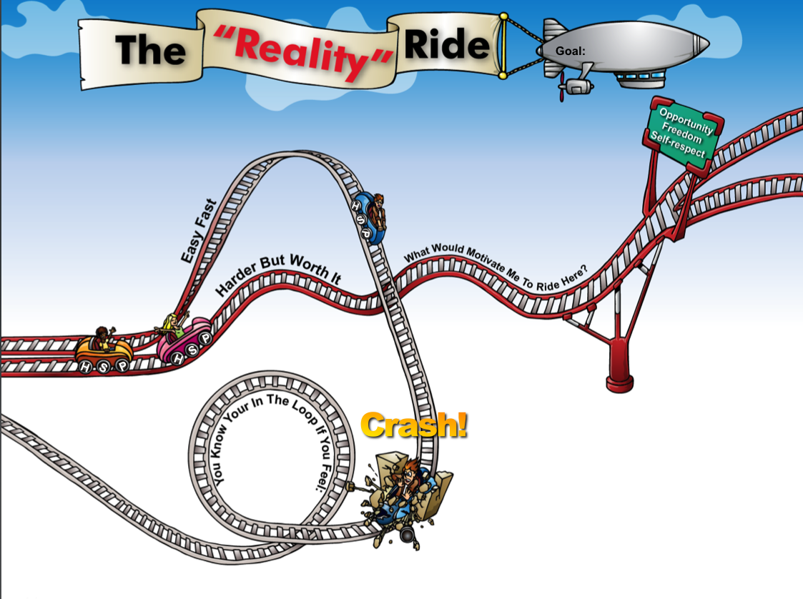
Reality Ride
(Lesson Plan Template)

Slide 2

ATTENTION GETTER
Create your own attention-getter slide to start today’s lesson. This slide may include music, a story, an object lesson, a "Surrendering the One-up" activity, a group poll, or a brief movie clip.

Slide 3




Reality Ride
Complete Metaphor
Animated Metaphor Walkthrough
Music
Learning
Journal
Video

Slide 4
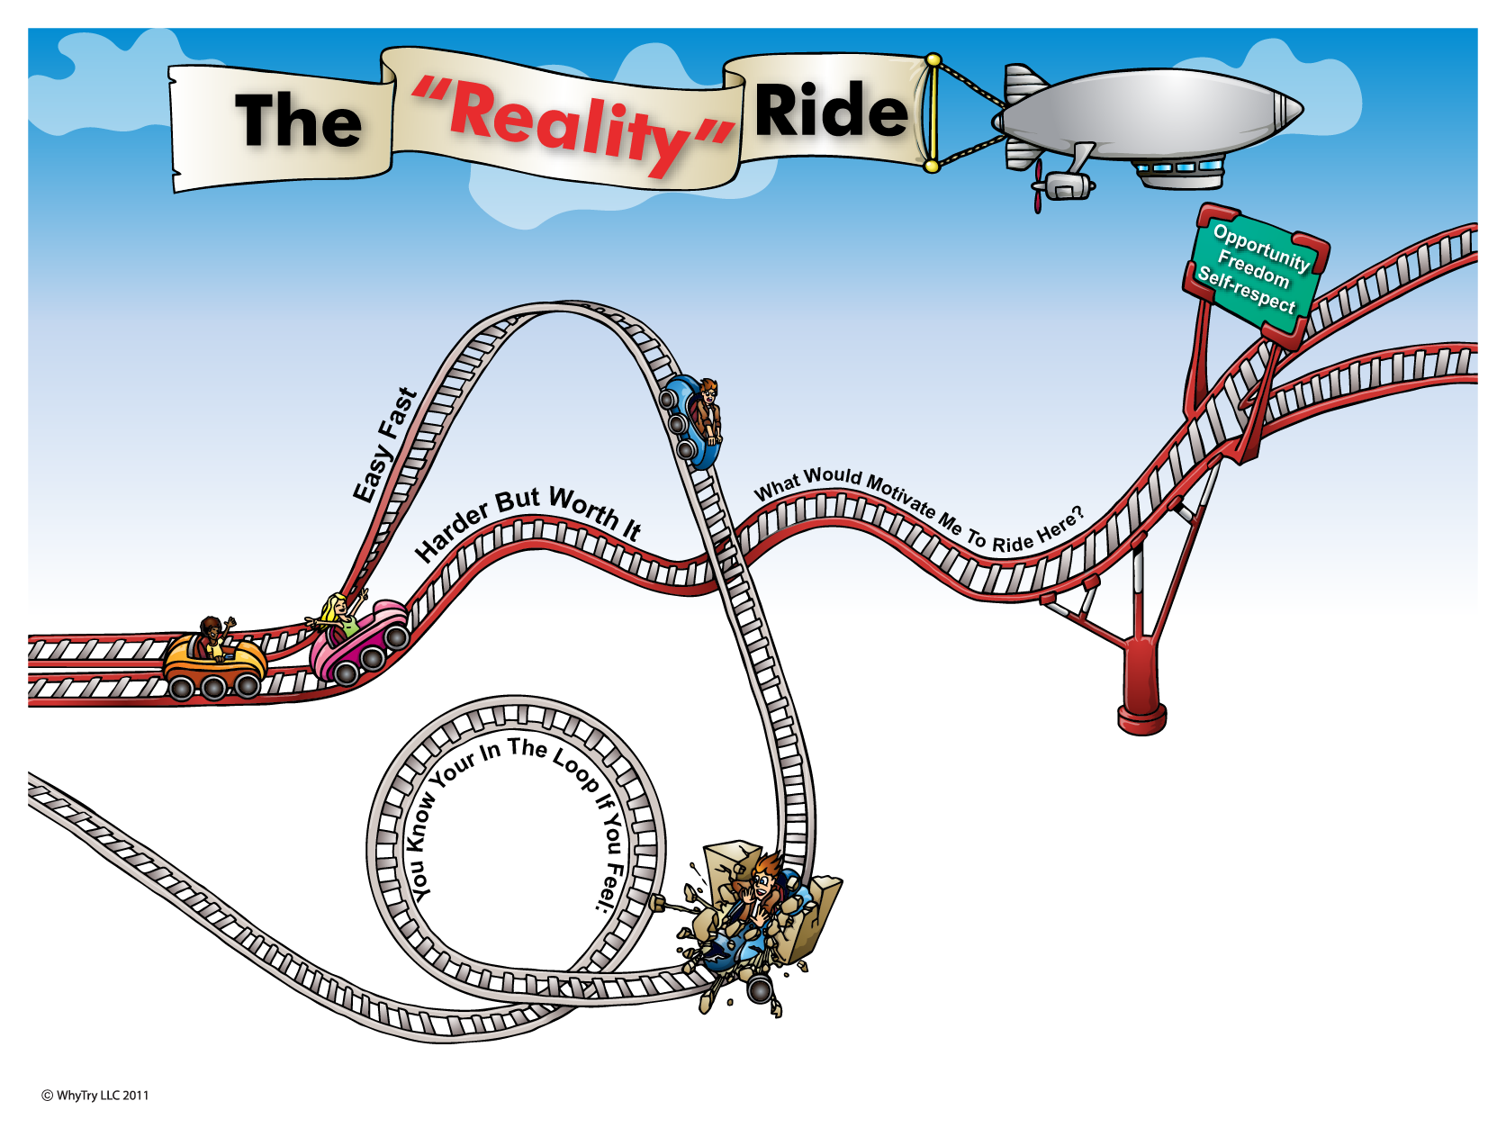
1
2
Goal:
5
Things that get you in trouble . . .
9
What will your reality be when you ride here?
At Home:
At School:
With Peers:
In Future:
What choices will
give you. . .
H
4
Your Challenges . . .
S
More Options
Home:
School:
Peers:
P
7
P
Peers
What problems do you keep having over and over?
Who Can Support You?
H
S
School
Home
8
3
Crash!
6
Frustrate
Confused
Angry
Scared
Keep getting same results
“Reality”
Consequences of the crash . . .
Start ride over
Will these things give you lasting
P
Opportunity?
Freedom?
Self Respect?
“Hit the wall”

Slide 5
1
2
Goal:
5
Things that get you in trouble . . .
9
What will your reality be when you ride here?
At Home:
At School:
With Peers:
In Future:
What choices will
give you. . .
H
4
Your Challenges . . .
S
More Options
Home:
School:
Peers:
P
7
P
Peers
What problems do you keep having over and over?
Who Can Support You?
H
S
School
Home
8
3
Crash!
6
Frustrate
Confused
Angry
Scared
Keep getting same results
“Reality”
Consequences of the crash . . .
Start ride over
Will these things give you lasting
P
Opportunity?
Freedom?
Self Respect?
“Hit the wall”

Slide 6
Music
Create your own music activity slide. This may include a WhyTry music video, a song of your own, or a song a student has shared.

Slide 7
Activity
Create your own learning activity slide. This may include either an object lesson, a group activity, or a group / movement activity. This slide may include instructions /rules for the activity or a relevant visual prompt to introduce the activity.

Slide 8
Journal
Create your own journal activity slide. This slide may include an art activity, observation activity, or game plan exercise from the WhyTry student journal. This slide may contain the actual journal page or a relevant visual prompt to introduce the journal activity.

Slide 9
Video
Create your own journal activity slide. This slide may include an art activity, observation activity, or game plan exercise from the WhyTry student journal. This slide may contain the actual journal page or a relevant visual prompt to introduce the journal activity.

